Slide 1
New Reactor Projects as Training Opportunities
Néstor P De Lorenzo
INVAP
Argentina

Slide 2
Training and more…
Human Resources Development
for Nuclear Programs
Know-how
Transfer
Licensing Management
Training
Industry Empowering
Users
Development
Academic System
Strategic Planning

Slide 3
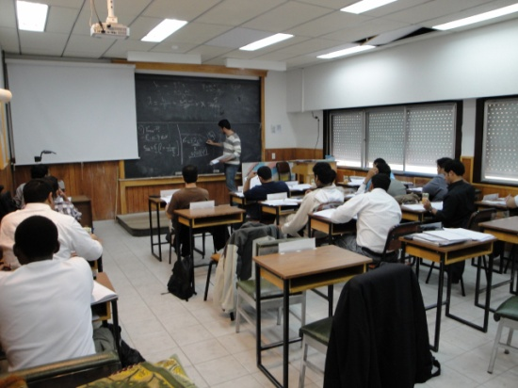
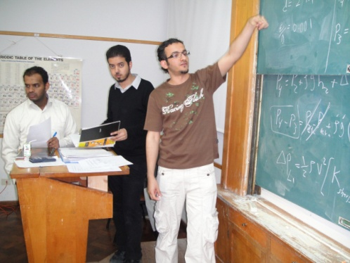
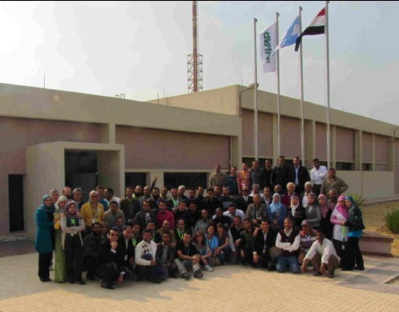
Training
Why
Trade staff
Reactor operation
Preventive and corrective maintenance
Engineering support
Safety assessments
Core follow up
Support to experiments/applications
Trainers
Training management system
How to
Why not

Slide 4
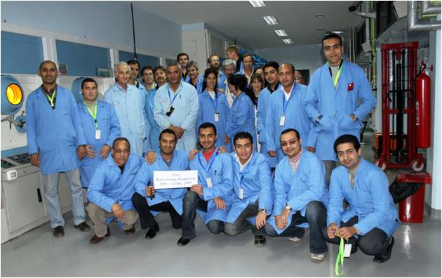
Know-how Transfer
Knowledge required to:
Plant modifications
Design techniques
Calculations
Modeling and prototyping
Facility optimization
Management systems
Performance indicators
ALARA assessments
Maintain and upgrade the Safety Analysis Report
Ageing and obsolescence management

Slide 5
Industry Empowering
Development of skills for both, nuclear and non-nuclear applications such as:
QA techniques
Testing and qualification programs
Special material procurement and handling
Special welding techniques
Special concrete types
Clean room techniques
Utilization of state of the art tools and instruments

Slide 6
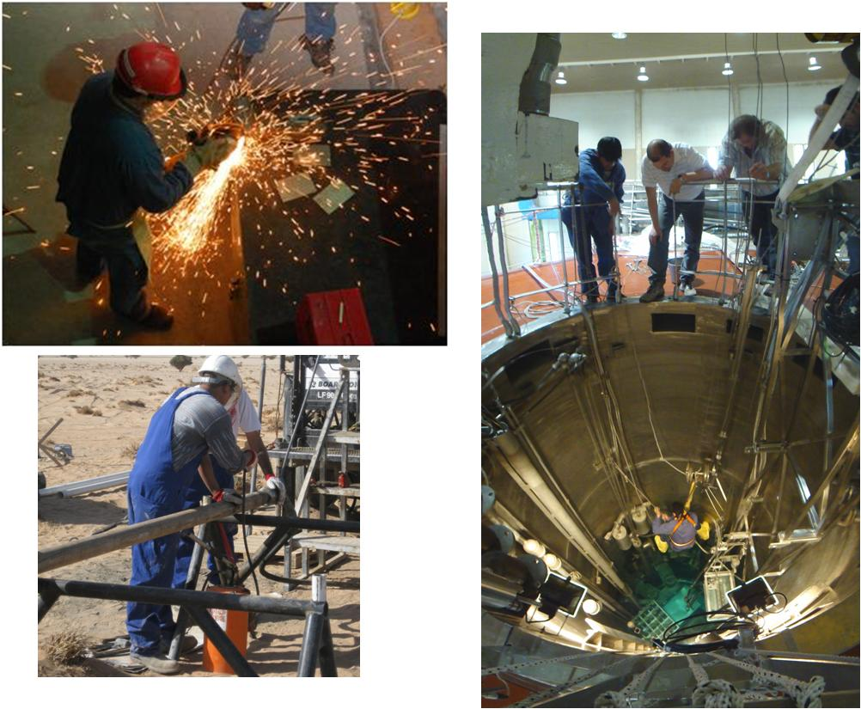

Slide 7
Strategic Planning
Extending the horizon beyond the reactor
Areas of preparation
Infrastructure requirements
Fuel cycle front and back end
Waste management
Bidding process and contract management
Scheduling, planning, cash flow and cost control

Slide 8
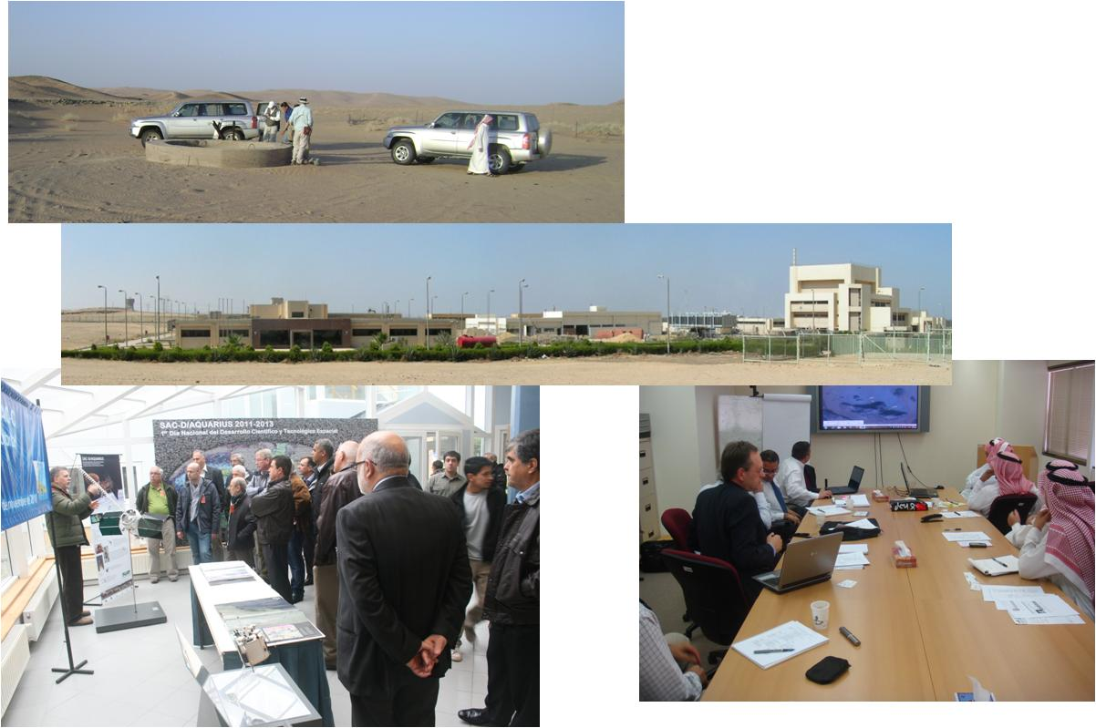

Slide 9
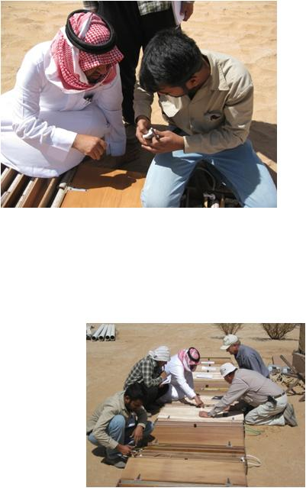
Licensing Management
Licensing strategies
Timing
Crucial issues identification
Interfaces with federal/local authorities
Preparation of Safety Analysis Report and related assessments
Organization of supporting activities
Public hearing
Environmental screening

Slide 10
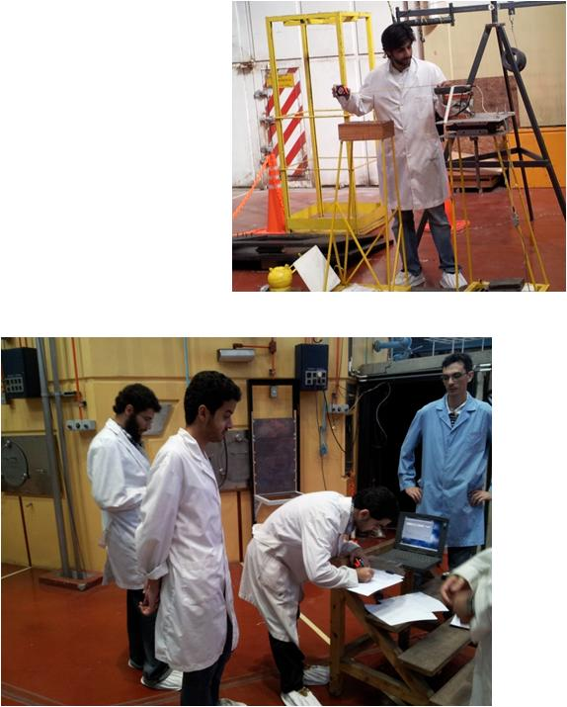
Academic System
Preparation of the infrastructure
Syllabus and curricula
Lecturers, bibliography, hands-on and other teaching activities
Laboratories
Nuclear physics
Radiochemistry
Thermohydraulic
Dosimetry

Slide 11
Users Development
Improvements on reactor utilization
Low irradiation costs
Opportunity to install new equipment
Revenues
Consolidation of research groups
Screening of new R&D areas

Slide 12
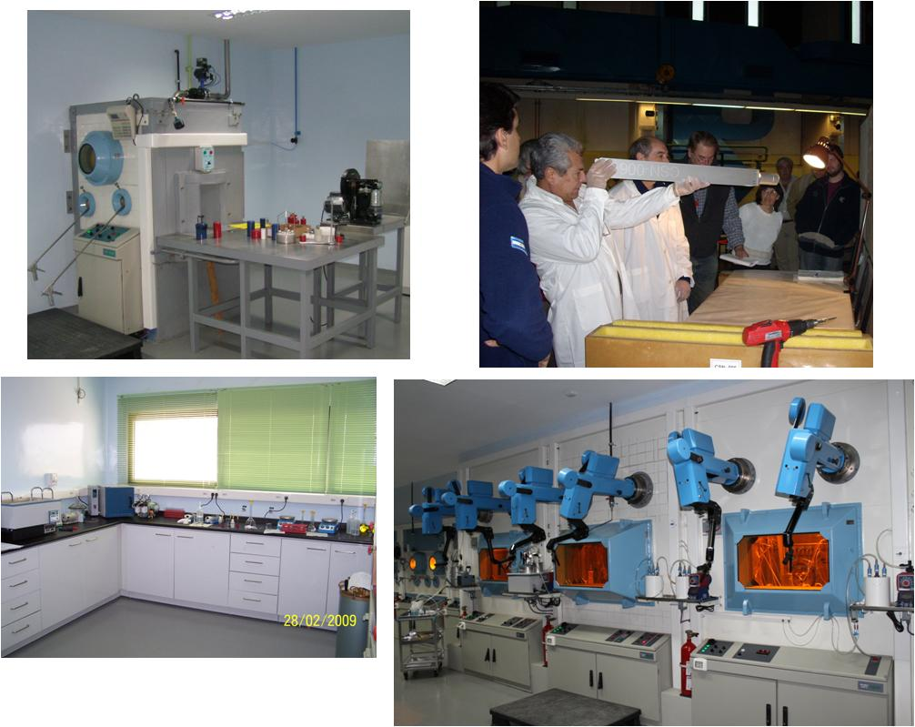

Slide 13
INVAP Assets
Experienced staff
Wide range of nuclear designs
Zero power to tens of megawatts
Open pool to pressurized circuits
Fuel rods to MTR plates
Radioisotope productions to NORM treatment plants
Construction and commission of facilities within schedule and budget both domestic and overseas
University lecturers
IAEA experts
Receptive working groups accepting customer representatives

Slide 14
INVAP Assets
Open and fair relationship with customers
Successful training courses delivered
Incorporation of modern training methods
Virtual reality
On-line training
Nuclear labs activities

Slide 15
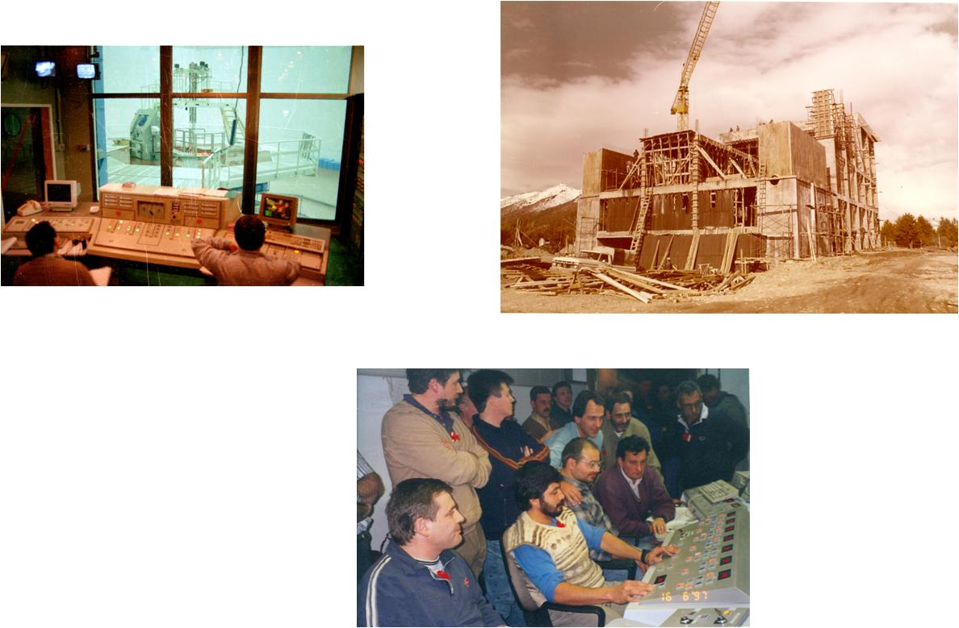

Slide 16
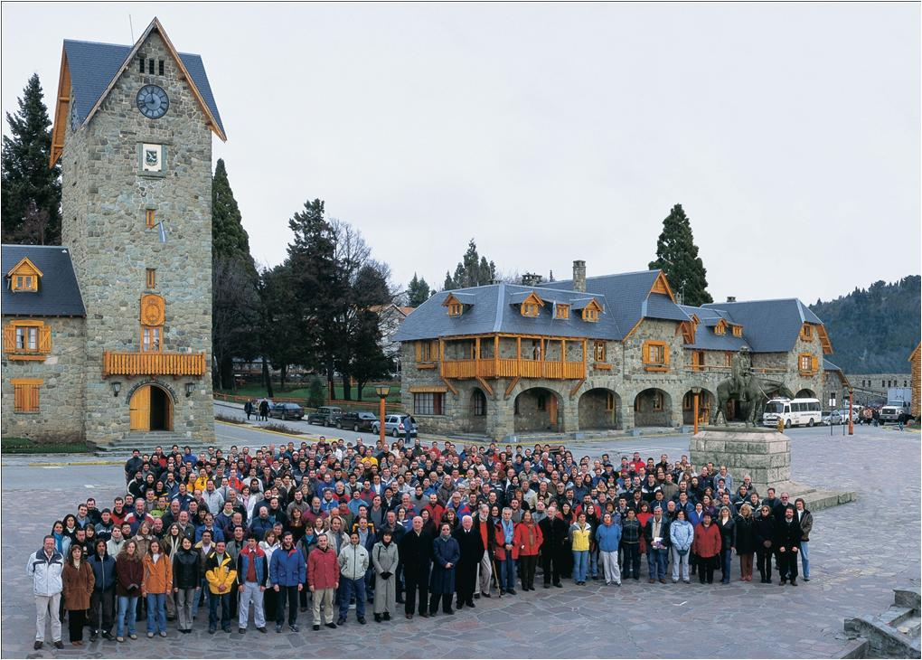
Thank you !!!!

