Slide 1
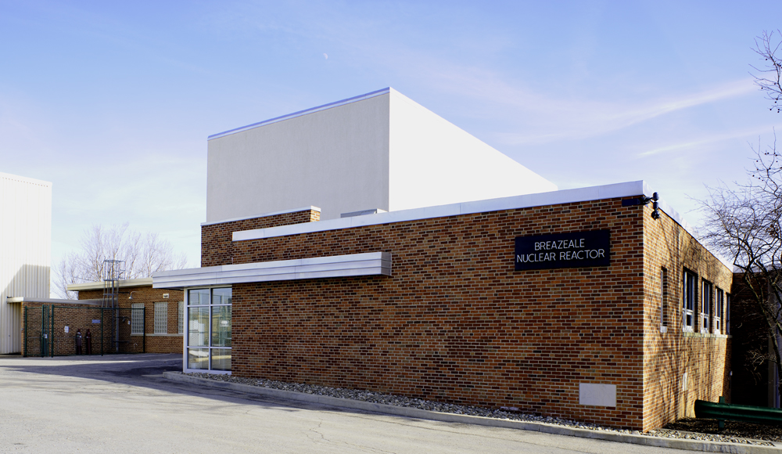
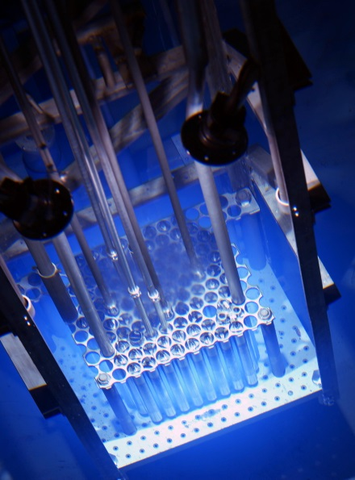
Operational Impacts of High Reactivity Targets or the perils of relearning old lessons in a new regulatory environment.
Mark Trump & Brenden Heidrich & Daniel Beck
Notes:
Mark Trump Associate Director for Operations at Penn state Breazeale reactor – Reactor manager/administrator since 2007
Those who follow Research reactor events are aware Penn State had a unexpected high power scram event when operators removed an 80 cent irradiation sample from the reactor at full power - 1 MW. All systems operated as designed, and reactor power reached a peak level of 1.3 MW. We stood down, critiqued, learned and returned to power the next day. The event was deemed reportable and we received a level 4 NOV in subsequent routine inspection review.
I profess to be a Believer in learning from errors and will invite your questions and comment on how I can learn more from this event, , but more importantly I sure we all believe it is better that we learn from the errors of others.
SO to fill up my 20 minutes, I quickly tell Some of the back story….. the title of the presentation is

Slide 2
Research Problem / Opportunity
The United States currently faces a shortage of medical isotopes for both clinical use and research and development.
Funding is available!
⁶⁴Cu and ⁶⁷Cu are two key isotopes identified as being in short supply; their emissions and their moderate half-lives make them effective for diagnosis and treatment.
Notes:
Funding was available, we got some!

Slide 3
Operations Problem / Opportunity
Experimenters are unfamiliar with experiment or techniques – its new to them
High Reactivity, Heat Generation, High Radiation, “New” Materials
Research/Experiment – hypothesize, trial …. error
Non-routine experiment becomes routine
Time pressure, holding up research at RESEARCH reactor
Oversight and conservatism - when to say NO
Notes:
The definition of research and hypothesis and trial experiment is trial and error,. But Operations cannot let experimenters errors turn into operational events

Slide 4
Research Isotopes of Interest

Slide 5
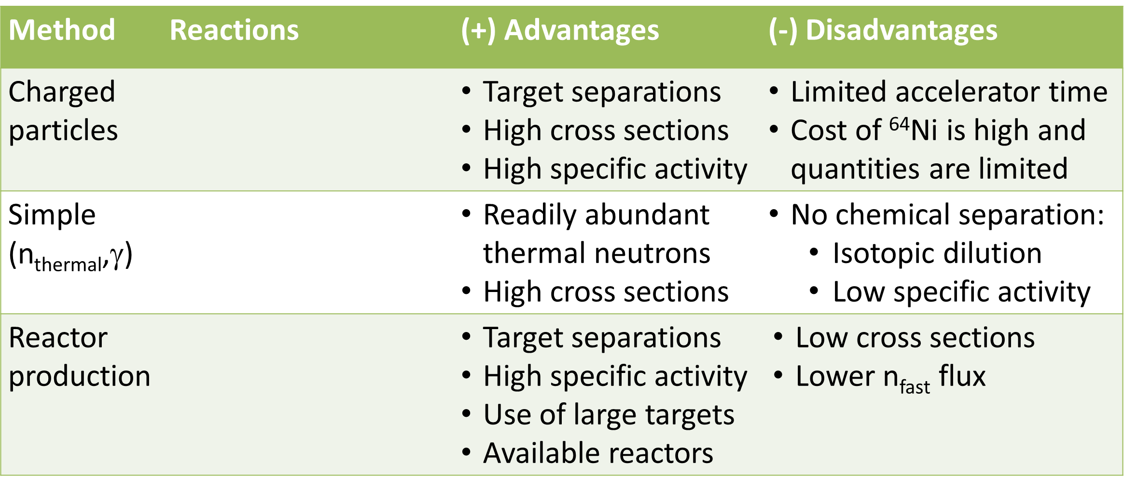
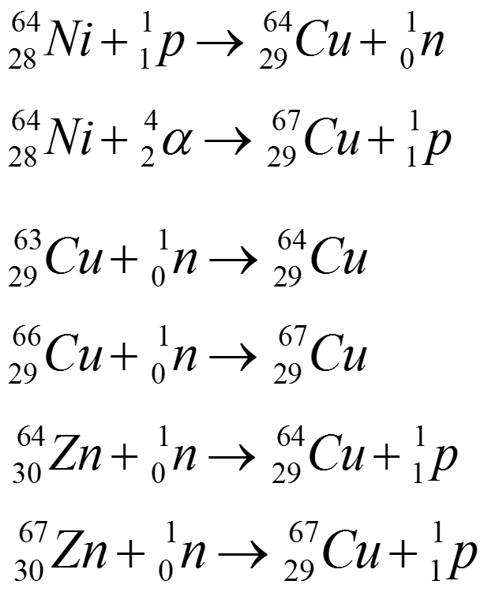
Research Methods of Production
Notes:
Ni nickel Cu Copper Zn Zinc

Slide 6
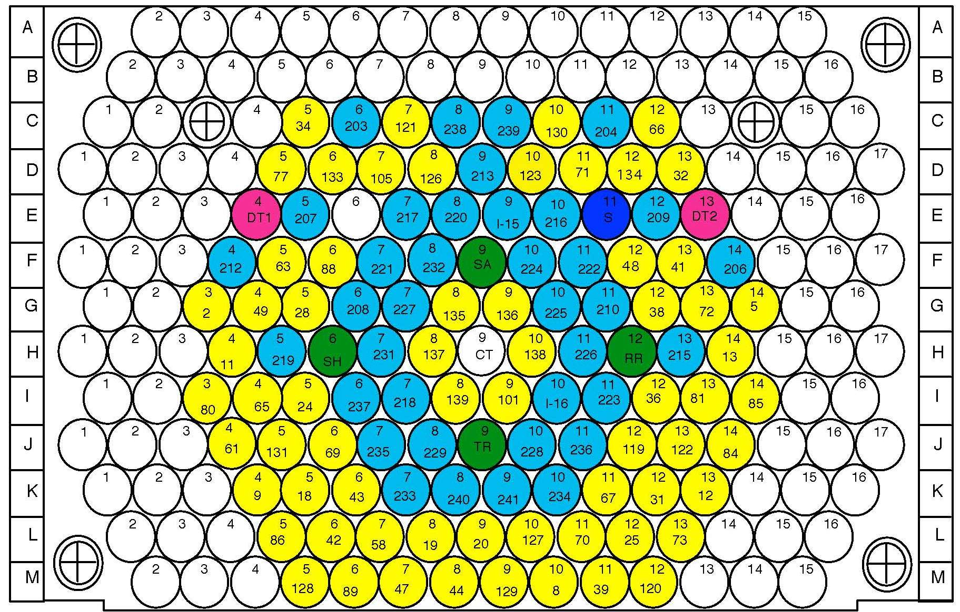
Core Loading 55

Slide 7
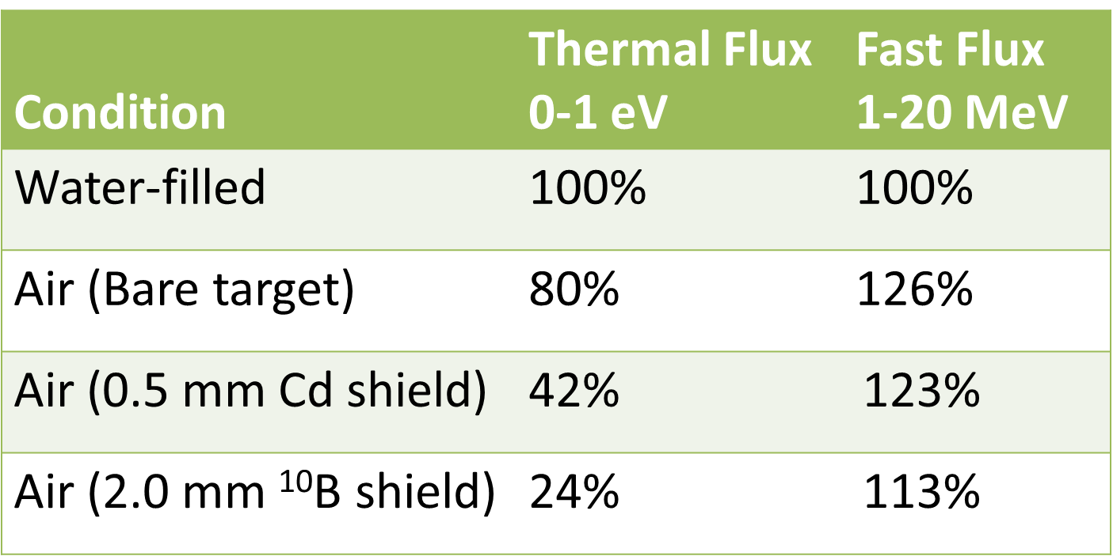
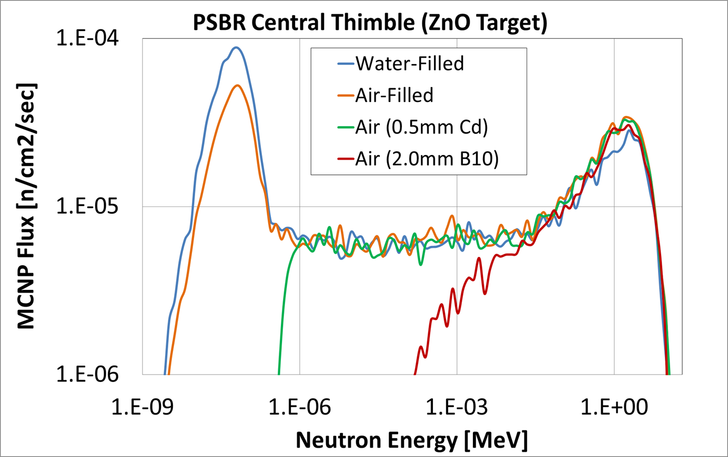
Irradiation Facility Design

Slide 8
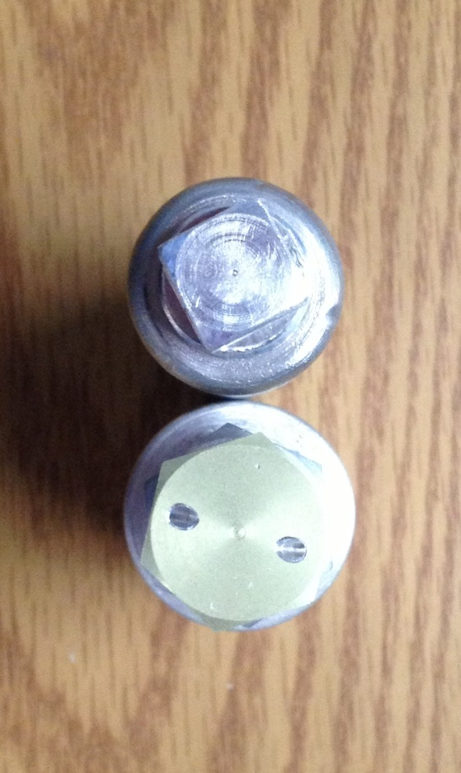
Shielded Irradiation Capsules
Rev.1
$1.20
Rev.2
$1.49
Operations had concerns over reactivity of holders

Slide 9
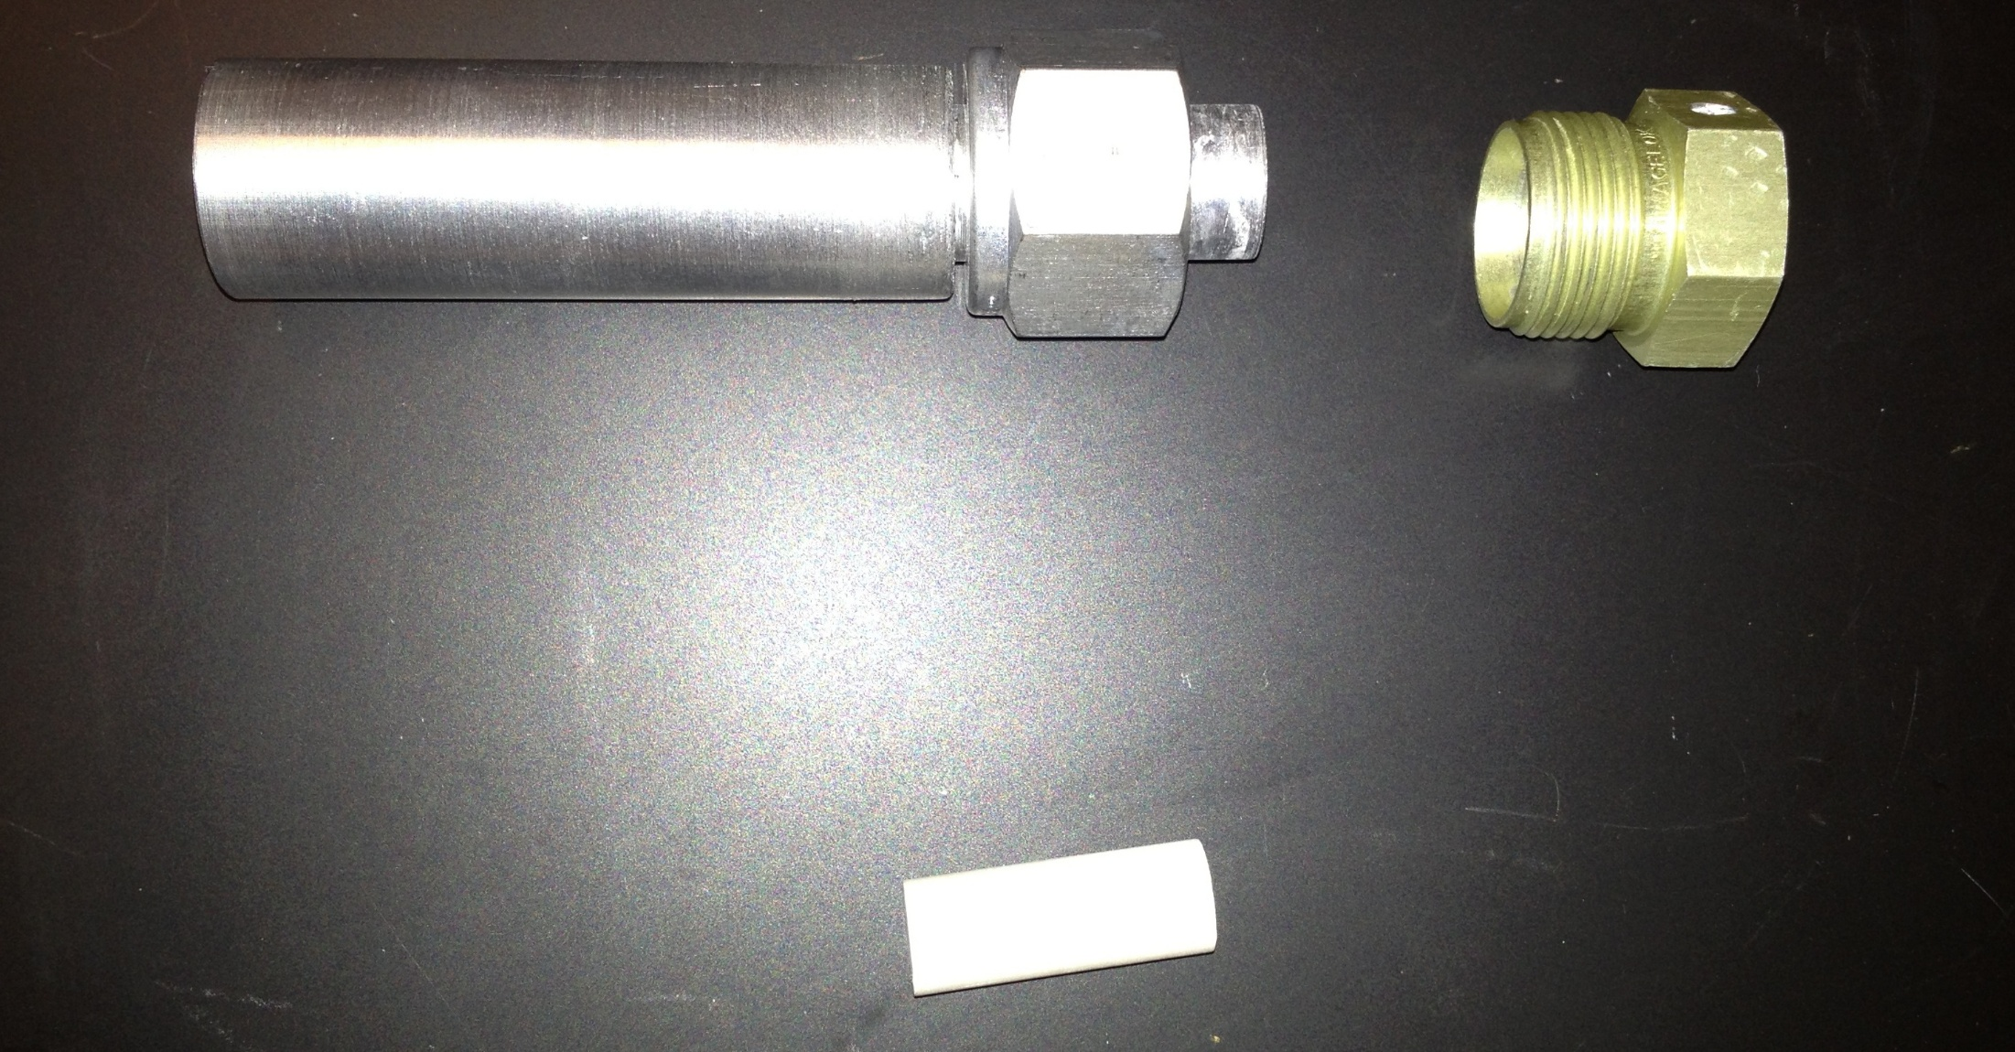
Irradiation Capsule (Rev. 3 $.80)
Capsule Body
Capsule Cap
Boron Nitride Rod
Notes:
Rev 3 further refinement of MCNP model showed shielding could be thinned out with little effect on the thermal flux. New design smaller, reactivity measured 80 cents. Trial run in dry tube at power showed temperatures less than 100C, fit easily in central thimble
Proceeded to 2 hour flux run, first 2 failed due to inability to remove boron nitride rods due to expansion or welding to other material
The runs started to get routine….. Time to get the project done was running out.
“Rushed” flux run 3 into reactor

Slide 10
Review concerns tests and predictions
Review Concern – Heat Production --- Swelling
 |  | MCNP F6 tally results
Rev. 2 | mass (g) | mev/g/source particle | MeV/s | Watts
sides | 66.9 | 1.37E-04 | 7.15E+14 | 114.5
bottom | 22.5 | 1.33E-04 | 2.34E+14 | 37.5
 |  |  | Total | 152
Rev. 3
sides | 35.9 | 1.89E-04 | 5.3E+14 | 85.1
bottom | 14.0 | 2.03E-04 | 2.2E+14 | 35.4
 |  |  | Total | 120
Rev 4
sides | 26.2 | 1.89E-04 | 3.9E+14 | 62.0
bottom | 3.31 | 3.02E-04 | 7.8E+13 | 12.5
plug | 6.29 | 1.66E-04 | 8.1E+13 | 13.1
 |  |  | Total | 88

Slide 11
Review concerns tests and predictions
Review Concern – Heat Production --- Swelling

Slide 12
Reactivity Concerns Predictions and Checks
Design | MCNP | Measurement | Deviation
rev 1 | -$1.36 | -$1.20 | 13%
rev 2 | -$1.53 | -$1.49 | 3%
rev 3 | -$0.79 | -$0.80 | -1%
rev 4 | n/a | -$0.12 | n/a
Flux maps OK with Conservative affect on Nuclear Instruments

Slide 13
Flux Runs
2 hour flux run in central thimble
Lot of oversight, reactivity checks, no problem except
Could not get the sample holder open Boron Nitrate plug sealed itself
Couple days later another run with slight design change….. Same problem
Third time is a charm …. Now routine….?

Slide 14
Operational Event High Power Scram - April 16
1415 ADO assumes RO watch to get sample going.
1501 Reactor @ 1 MW with sample in central thimble.
1520 Watch Team turnover to “new” staff SRO and student RO.
1650 RO/SRO discuss shutdown vs. pulling sample. Pulling low reactivity timed samples at low power is “routine”.
1701 Sampled pulled by SRO, High power scram (106% digital, 108% analog) Peak power 1.328MW Fuel Temp increase 1 degree C
Notes:
Tuesday PM following an oversight Meeting where we celebrated 8 years without a TS reportable event we loaded the sample and rushed to full power. Watch relief was conducted. It focused on ADO concerns for Hazardous rd levels on the sample holder and not to remove from the pool.

Slide 15
Operational Event Actions and causes
Immediate actions
Reactor secured and tagged out
Management notified
Operational stand-down, critique and event review
Causes
Mindset, group think, habit intrusion,
Experiment authorization inadequacy,
Experiment authorization procedure inadequacy
Follow-up actions
Experiment authorization suspended, all others reviewed for adequacy/suspended
Experiment authorization procedure under revision
Operator training on prompt jump and safety analysis

Slide 16
Reportability Determination
All systems performed as designed, experiment in compliance with TS - Initially determined not reportable
Student SRO brought up concern with literal compliance
For Non-Pulse Mode Operation TS 3.1.1.c. states “The maximum power level shall be no greater than 1.1 MW (thermal).”
Basis is to protect Steady State decay heat assumptions and source term.
NRC position, report now, withdraw if not reportable.
Reported prior to the end of the next business day.

Slide 17
TEST REACTOR EXCEEDED LICENSED POWER LIMIT DURING A SCRAM
The following information was excerpted from an email from the licensee: On April 16, 2013 at 1701 EDT, the research test reactor automatically shutdown from 100% power (1 MW) due to a valid high power condition. The duty Senior Reactor Operator removed a timed irradiation sample from the core that added positive reactivity. Both the digital (non-safety system) and the analog safety system acted on the high power condition and initiated the shutdown. All systems functioned as designed. The short duration power transient reached a peak power of about 1.3 MW. There was no increase in radiation levels, personnel radiation exposure, or release of radiation from the facility. No emergency event entry criteria were met. The plant was placed in a secured condition and an event review investigation was conducted. The event is (potentially) reportable in that the Maximum Power Level observed during the short duration (< 1 second) transient exceeded the steady state power limit for non-pulse mode operation as described in Technical Specification(TS) 3.1.1 Non-pulse mode operation sub-section b. The maximum power level shall be no greater than 1.1 MW (thermal). The reactor was returned to routine service at approximately 1300 EDT on April 17, 2013.

Slide 18
Thoughts, Questions,… Fallout
Operators are the last line of defense, we fail them every time we challenge them.
All our reviews, concerns, and plans did not prevent this event. They knew better, but had to learn again.
Experiments are trials and errors, there were two more minor events in this experiment series. We are trying to relearn a production method from years ago…
Questions? Feedback?
end

Slide 19
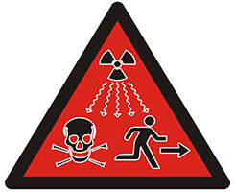
ALARA New Danger Tag
DANGER VERY HIGH
RADIATION SOURCE
DO NOT REMOVE
BEFORE:
_____5/10/2013_____
DATE | TIME | RADIATION LEVEL [R/HR]
5/8 | 12pm (t=0) | 10,000
5/8 | 6pm (t=6) | 1.250
5/9 | 12pm (t=24) | 0.420
5/10 | 12pm (t=48) | 0.150
Notes:
Extra Slide if time

Slide 20
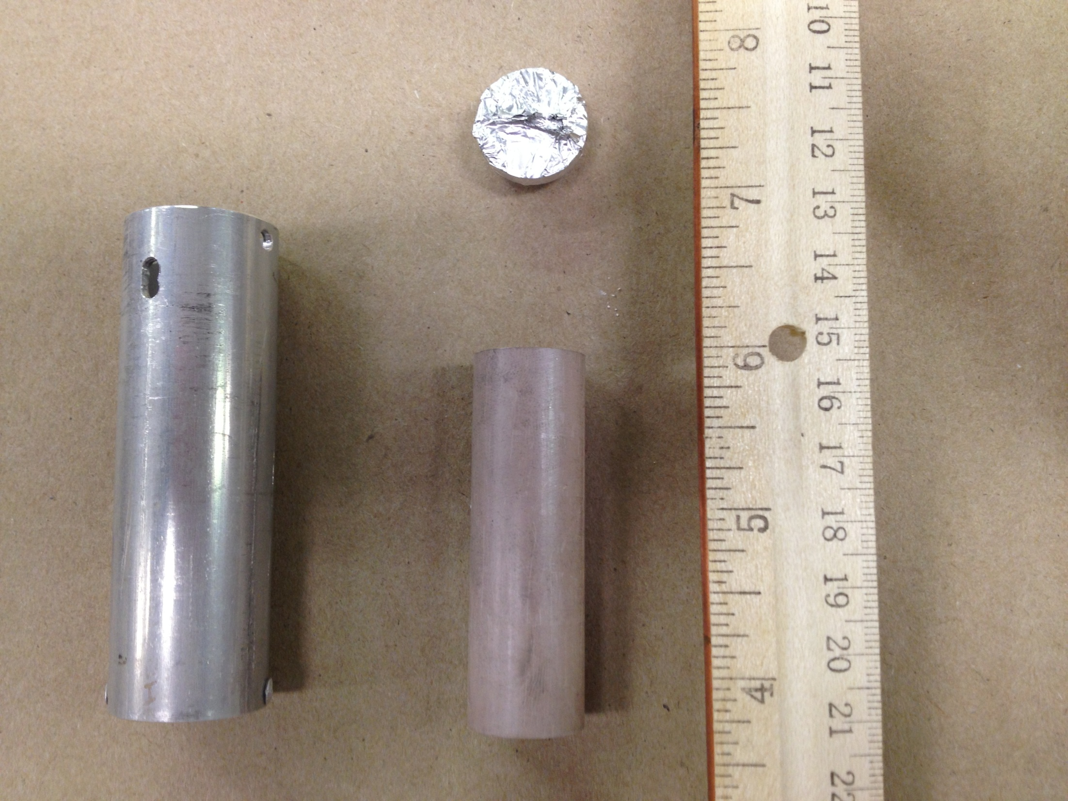
1st Flux Run
5/17/2013
Dry Tube 2
1000kW for 120min.
27grams Al-6061
33grams BN
AuAl & Ti wire
Irradiation Capsule (Rev. 4a)
[Dry Tube Location only]
Notes:
Extra Slide if time

Slide 21
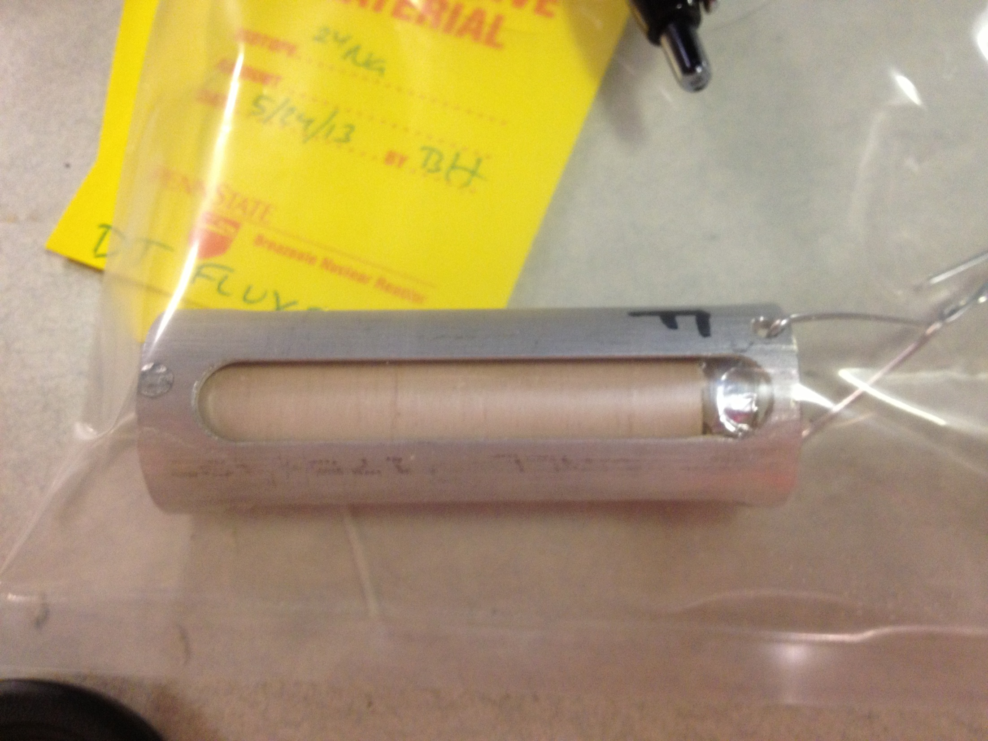
2nd Flux Run
5/24/2013
Dry Tube 1
1000kW for 6min.
14grams Al-6061
33grams BN
AuAl & Ti wire
Irradiation Capsule (Rev. 4b)
[Dry Tube Location only]
Notes:
Extra Slide if time

Slide 22
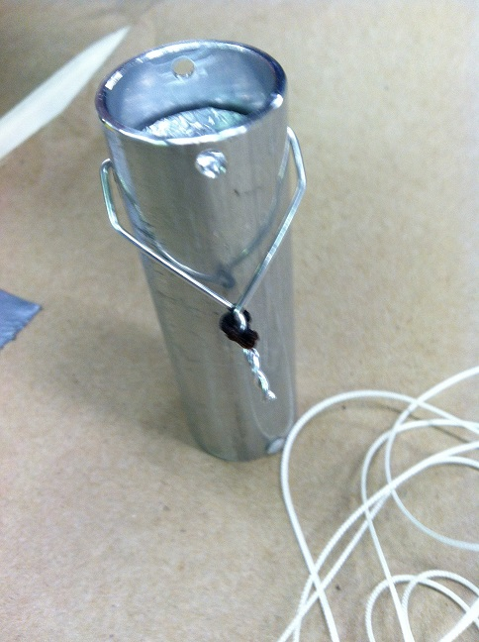
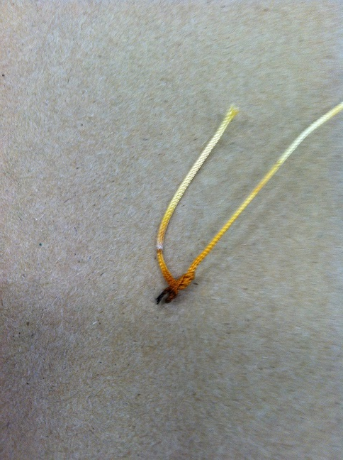
Irradiation Capsule (Rev. 4a)
[Dry Tube Location only]
Notes:
Extra Slide if time

Slide 23
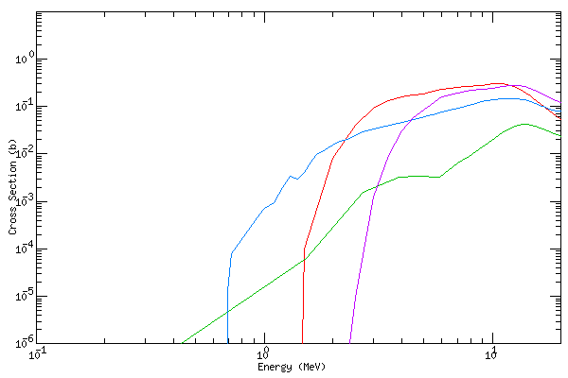
Measurements
Reactivity Worth in water-filled CT = -$0.80 (rev. 3)
Heat Build-up = 95°C at 1MW (Rev 1 & air-cooled)
Flux Measurements
Au-Al wire (thermal)
Ti wire (fast)
Zn-64 to Cu-64
Ti-47 to Sc-47
Ti-46 to Sc-46
Zn-67 to Cu-67
Notes:
Extra Slide if time

Slide 24
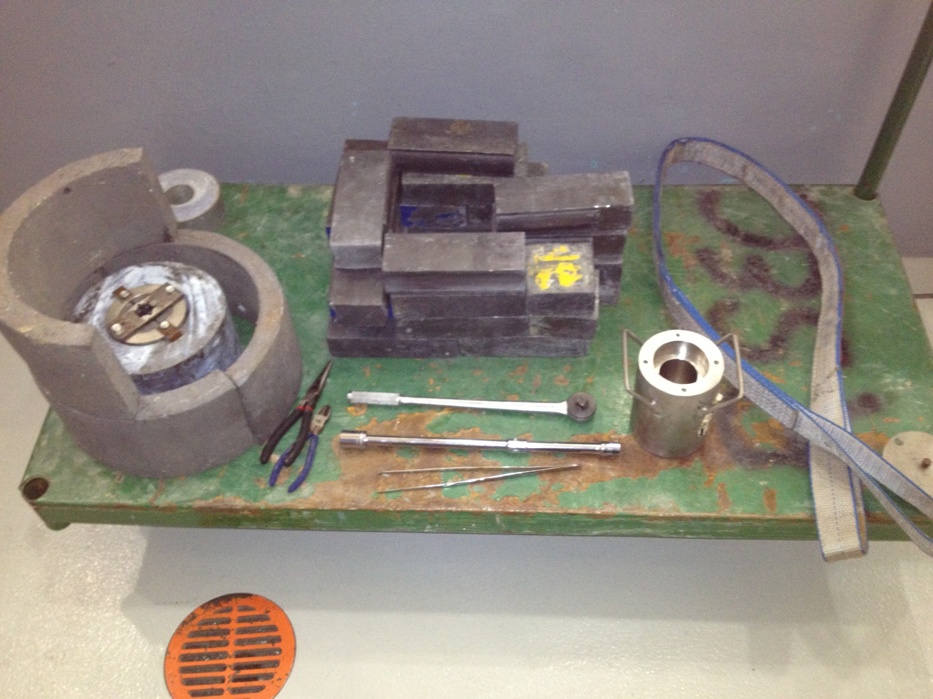
Cave for SS Cask
Lifting sling
Main Shield
Ratchet to remove cap
SSC lid
SS Cask
Tools for wire
Long tweezers
Notes:
Extra Slide if time

Slide 25
Flux Measurement Irradiation
Two shielded capsules (rev. 4) irradiated in two dry tube locations (E4 and E13)
DT1: AuAl and Ti wires
DT2: 0.7gm of natural Zinc Oxide
2 hours at 1MW
Notes:
Extra Slide if time

Slide 26
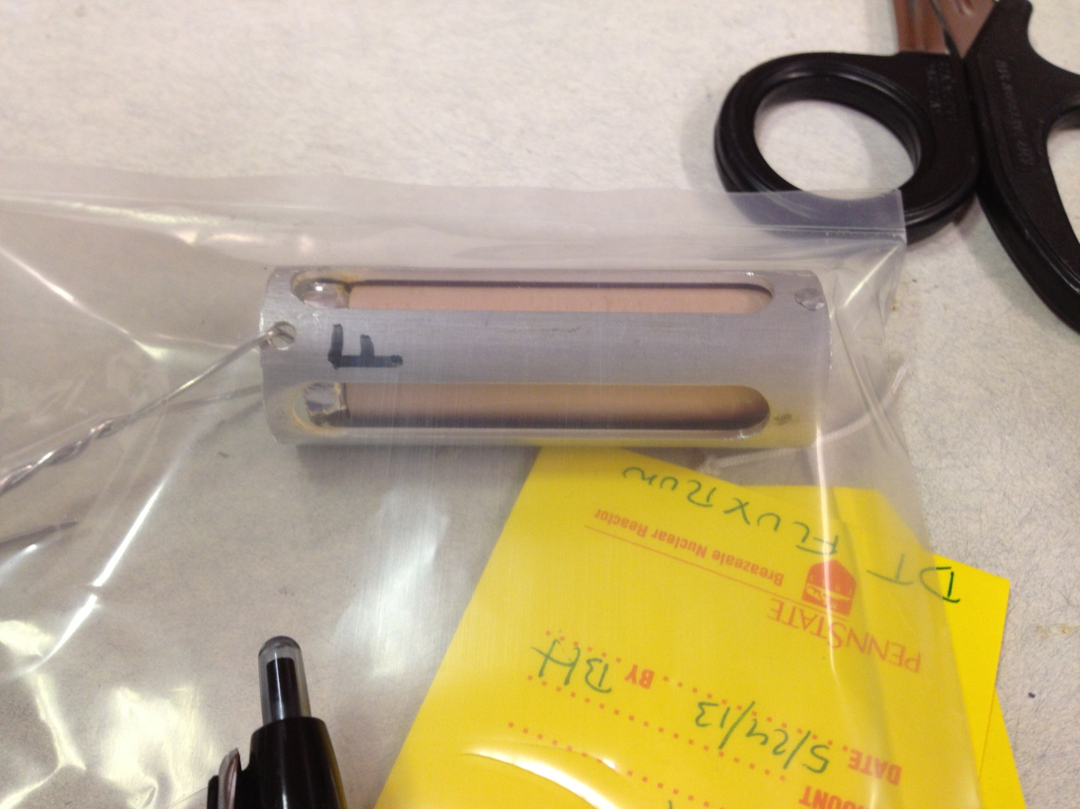
2nd Flux Run
5/24/2013
Dry Tube 1
1000kW for 6min.
14grams Al-6061
33grams BN
AuAl & Ti wire
Notes:
Extra Slide if time

Slide 27
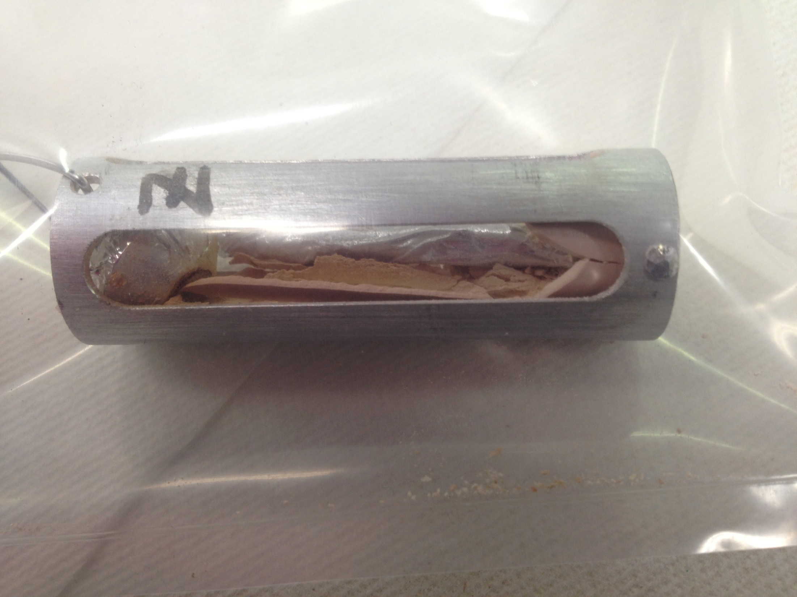
2nd Run – natural zinc
5/24/2013
Dry Tube 2
1000kW for 6min.
14grams Al-6061
33grams BN
< 1 gram Zn0
Notes:
Extra Slide if time

