Slide 1
Enhanced Digital Wide Range Neutron Flux Monitor
Ewald Liebhart Franz-Josef Terheiden
Mirion Technologies (MGPI H&B) GmbH
September 26, 2013

Slide 2
Content
1. TK 240 → Analog NFMS channels
2. proTK™/TK 250 current generation → DWK 250
3. proTK™ next generation → DWK 260
4. Summary

Slide 3
Neutron Flux Monitoring System TK 240 / proTK™ (TK 250)
TK 240
First NFMS system based on purely analog signal processing
proTK™ current generation
Incl. all NFMS channels of the TK 250 family: DAK 250, DWK 250, DGK 250, …
Qualified acc. KTA, IEC, …; extensive operational experience
proTK™ next generation
New channel DWK 260 based on the proven concept of the current generation of proTK™ channels (TK 250) with improved features,
Full qualification according to relevant international standards, regulations and guides (IEC, IEEE, USNRC, IAEA, …)

Slide 4
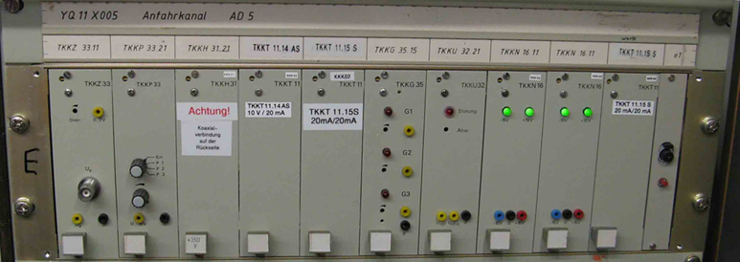
Analog Neutron Flux Monitoring System TK 240 – in 19” rack

Slide 5
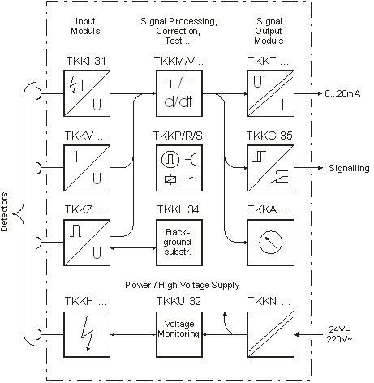
Analog Neutron Flux Monitoring System TK 240 – functional diagram

Slide 6
Digital Neutron Flux Monitoring System proTK™ / TK 250 – Overview
FEATURES
Modular construction
Versatile applications
Robust and reliable
Proven by operational experience
APPLICATIONS
Operational process monitoring
Measurement & monitoring of the neutron flux density from start-up range to the power range for research reactors
The neutron flux monitoring system
NFMS 250 combines long term experience in design and manufacturing of both detectors and signal processing electronics. These products are strictly oriented to the highest level of safety relevance and reliability and are qualified by several type tests and proven by an excellent operational experience.
The system NFMS 250 covers the requirements for measuring equipment used for the reactor protection system according to IEC 61226 cat A.

Slide 7
Digital Neutron Flux Monitoring System proTK™ – DWK 250 in 19” rack

Slide 8
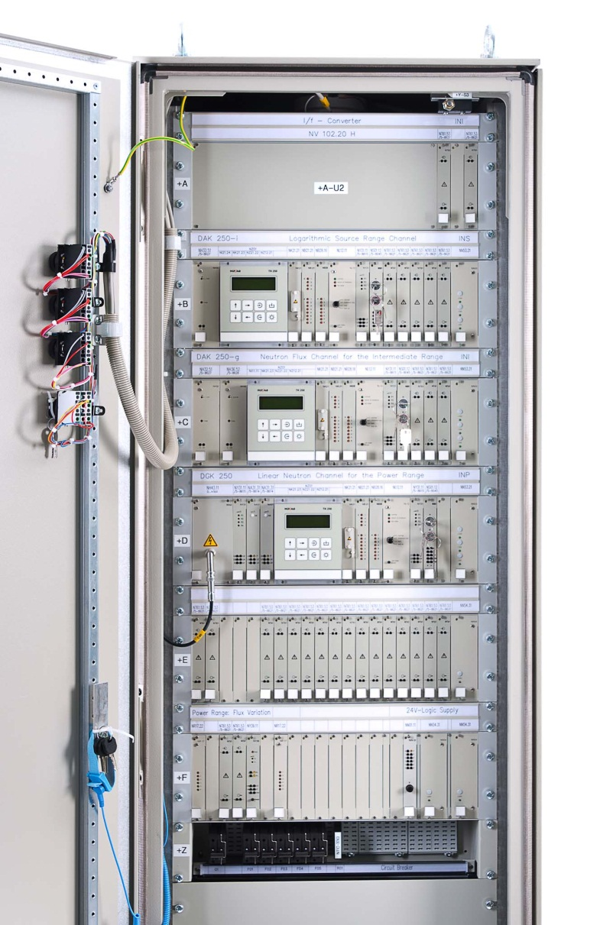
Digital Neutron Flux Monitoring System proTK™ / TK 250 – Channel Types
DAK 250 | Source range or intermediate range monitoring With pulse processing or DC signal processing; reactimeter optional also used for N-16 monitoring with e.g. gamma ionization chamber
DWK 250 | Wide range monitoring With combined pulse processing and Campbell signal processing for in-core & out-core fission chambers
DGK 250 | Power range monitoring With 1 or 2 signal paths for neutron ionization chambers or fission chambers
…

Slide 9
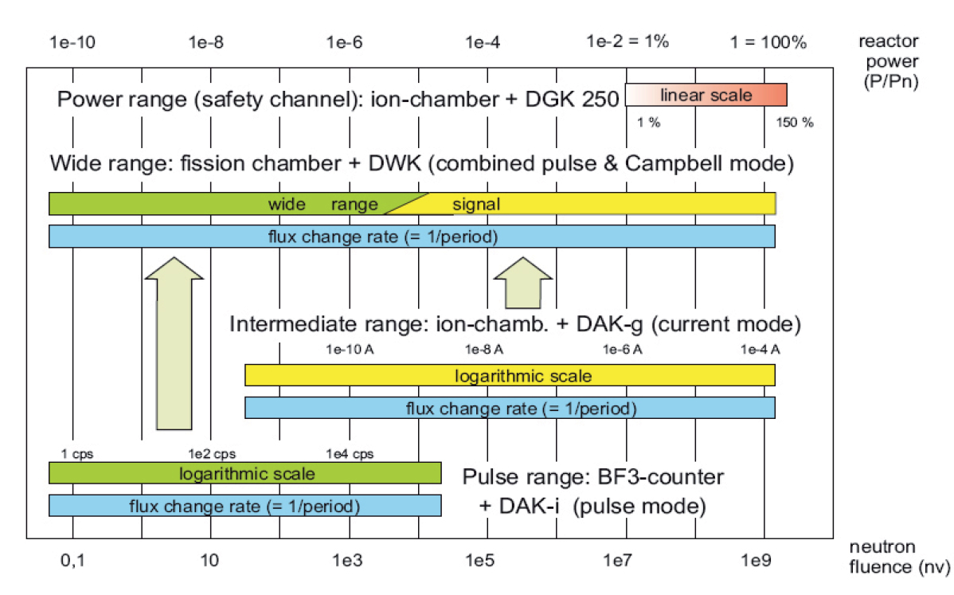
Digital Neutron Flux Monitoring System proTK™ – Channel Measurement Ranges

Slide 10
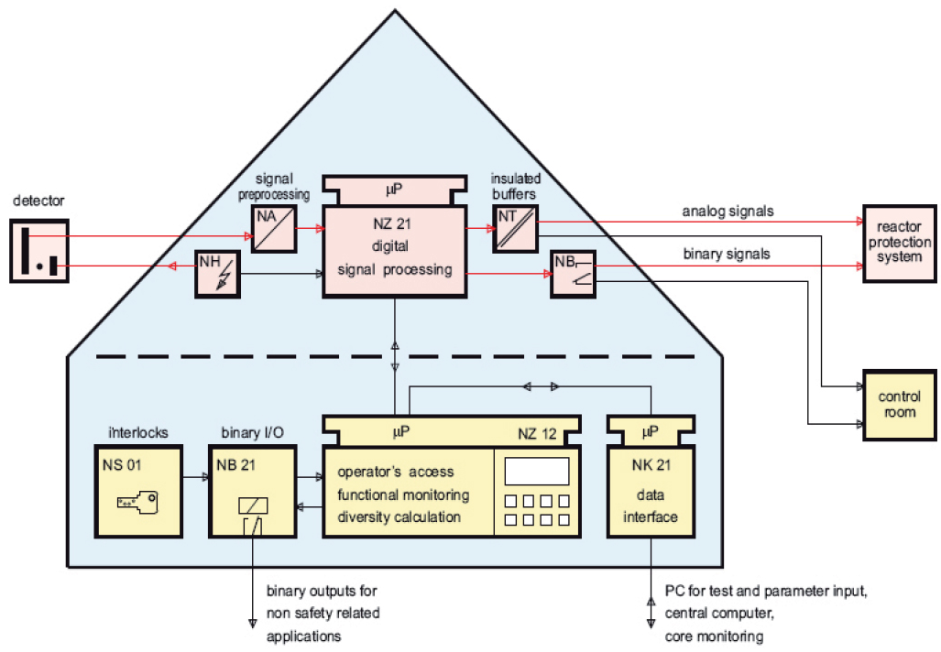
Digital Neutron Flux Monitoring System proTK™ / TK 250 – system architecture

Slide 11
Digital Neutron Flux Monitoring System proTK™ – Design is Clear, Simple, Efficient
The functions for the safety signal path are concentrated on the independent I/O-micro-processor board NZ 21:
The software is purely sequential and deterministic
The software operates cyclic in a fixed time grid, e.g. 10 ms
Therefore, the response time is predictable
There is no operating system
The volume of the software is as small as 3 to 8 kByte
All other functions e.g. operator’s access or self monitoring are allocated on the “main processor board” NZ 12
Re-use of type-tested and proven software modules
The target: zero-fault software
Designed and developed by experienced engineers
Verified in type tests - supervision/review by indep. experts (TÜV)
Reliability proven through long-term operational experience

Slide 12
Digital Neutron Flux Monitoring System proTK™ – Designed to defeat CCFs
Measures against CCF of the software
Additional to the simple and clear design there is:
No use of interrupts on NZ 21, only 1 timer interrupt on NZ 12
No use of real time clock or calendar
NZ 12 has no direct access to NZ 21 and its
Program sequence
Data or parameter memory
NZ 21 is hardware-locked by key switch against access to parameters and test-procedures
A variety of self monitoring devices, some of them complementary between NZ 12 and NZ 21

Slide 13
Digital Neutron Flux Monitoring System proTK™ – Designed to Defeat CCFs
Measures against CCF of the software
Additional to the simple and clear design there is:
No use of interrupts on NZ 21, only 1 timer interrupt on NZ 12
No use of real time clock or calendar
NZ 12 has no direct access to NZ 21 and its
Program sequence
Data or parameter memory
NZ 21 is hardware-locked by key switch against access to parameters and test-procedures
A variety of self monitoring devices, some of them complementary between NZ 12 and NZ 21

Slide 14
Digital Neutron Flux Monitoring System proTK™ – Extensive Self-Monitoring
A variety of items is used to detect faults of hardware and software, e.g. monitoring of internal voltages, arithmetics, timing, micro-processors, data transmission, data and program memory. Additional, there are two very efficient tools:
NZ 12 performs a “re-calculation” of the results
Using a snapshot of data transferred from NZ 21
Using a different software and arithmetic package (e.g. floating point package instead vs. fixed point arithmetics)
Comparing the results and generating an alarm if necessary
A cycle counter on NZ 21 is interpreted periodically by NZ 12
The differences of two readings are compared with setpoints
NZ 12 & NZ 21 are monitoring their cycle times one another
The response of NZ 12 is additionally monitored by a watch dog

Slide 15
Digital Neutron Flux Monitoring System proTK™ – Periodical Testing Easy and Efficient
Different tools make periodical testing efficient but easy:
Test generators in pre-amps or input-boards of the channel:
May be activated remotely without manipulation in the wiring
Insert a reference signal to the input of the electronic channel
The tool “simulation” enables to:
Insert arbitrary numbers at defined points of the signal path
Generate all desired output values for analog signals or alarms
Binary outputs (relays) may be activated or deactivated
All testing tools are locked by key-switch and generate a flag signal
The basic procedure for periodical testing
Is described in the user manual
Was checked by TÜV during type test

Slide 16
Digital Neutron Flux Monitoring System proTK™ – Controlled Operator Access
The access to parameters and testing is locked by 2 key switches
Without key: parameters may be displayed, but not modified
DGK 250 additionally has a separated access to re-calibration
A parameter protocol may be generated on a PC via serial interface using purely read-only instructions
The variety of functions and parameters is limited by “configuration” according to user requirements:
Delete (enable and hide) unused functions
Establish “fixed parameters”, e.g. scalings or trip thresholds
Use of modified text tables, e.g. language version
Any new configuration is done by Mirion Technologies and checked by TÜV
Configuration data are stored in EPROM

Slide 17
Digital Neutron Flux Monitoring System proTK™ – Type Tested
The type test of hardware was performed according to KTA 3505
Theoretical and practical tests observed and checked by TÜV
Test results transferable to IEEE 323 or IEC 60780
Data of operational experience for all boards available
Software type test also was performed by independent experts:
DPK 251 and DSK 250 by ISEB-TÜV-Rheinland/Köln
DAK, DGK, DLK 250 and all other channels by TÜV-Nord/Hamburg
Both institutes used different testing strategies and tools
IEC 880 was applied for DAK, DGK and DLK 250, elements of FMEA
Result: the SW is qualified for use at RPS level
Finally an integration test of hardware and software was performed:
e.g. functions, characteristics, dynamic response, EMC
Tests under worst-case conditions

Slide 18
Digital Neutron Flux Monitoring System proTK™ – Extensive Operational Experience
Electronics channels in operation | > 300
Cumulated years of operation | > 3,000 years
Average MTBF of electronic boards | > 4,000,000 hours
Total number of software faults | 0

Slide 19
Digital Neutron Flux Monitoring System proTK™ / TK 250 – Summary
Modular, multi-microprocessor system with a separate microprocessor for the safety signal path
Cycle time of signal processing starting
with 5 ms
Low heat C-MOS technology
Software fixed in EPROM, efficient self monitoring
Remote signal generators and signal simulation
Qualified according to KTA 3501/3505, IEC 60 880
Simple & clear
Fast
Safe
Reliable
Testable
Type-tested

Slide 20
Digital Neutron Flux Monitoring System proTK™ – Wide Range Channel DWK 250
Signal filtering w/variable time constant
Calculation of flux change rate (1 / reactor period)
Calibration of wide range signal to neutron flux or power units (nv, P/Pn)
Two analog outputs, defined by user (linear or logarithmic)
Up to 16 adjustable alarm setpoints
Dedicated analog & binary output signals for reactor protection system
Remote test generators, also in preamplifier (periodic testing w/o external equipment)
Digital adjustable parameters, lockable & non-volatile
Full operation (e.g. testing) & data exchange via serial data interface
Continuous functional self checks (e.g. program flow, interfaces, memory)
Qualified by TÜV according to KTA 3501/05 (similar to IEC 61226 category A)
With over 20 years of successful operation in nuclear power plants and research reactors, the DWK 250 is a direct replacement of traditional pulse and intermediate range channels; has a smaller “footprint” and isn’t “power hungry”! The combination of pulse signal and RMS-signal is performed by a digital algorithm – that is precise, stable and reliable. Using a variety of self-checks for continuous functional monitoring, the DWK 250 provides highly reliable remote test generators and signal simulation for periodic testing.

Slide 21
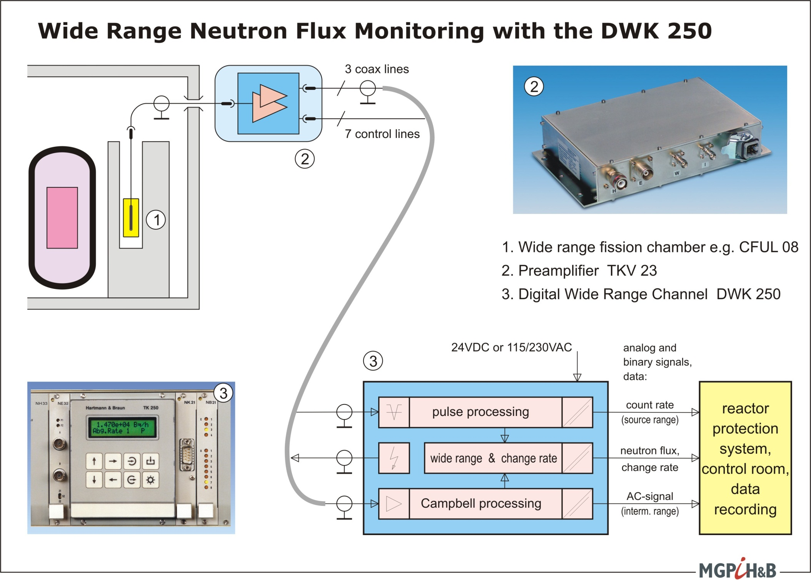

Slide 22
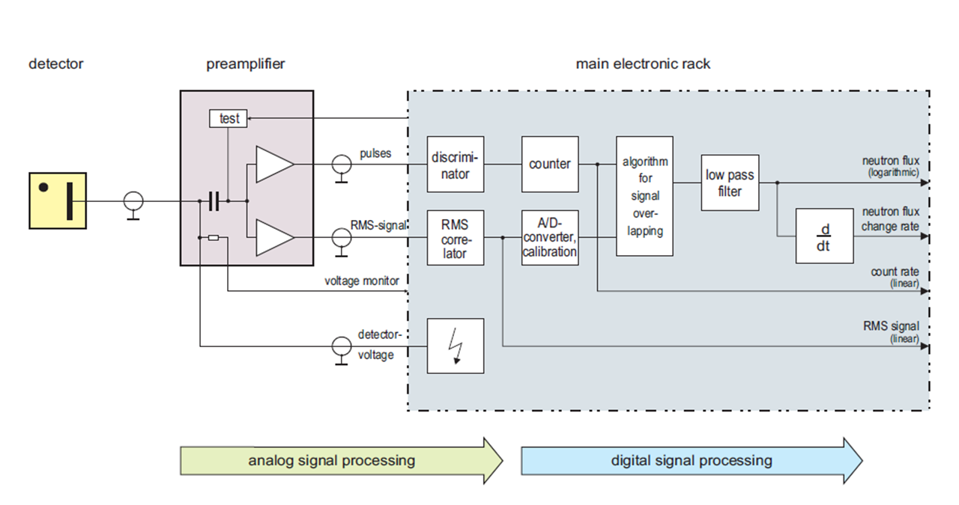
Digital Neutron Flux Monitoring System proTK™ – DWK 250 functional diagram

Slide 23
Digital Neutron Flux Monitoring System proTK™ next generation – DWK 260
Current Wide Range Monitor DWK 250
Was the first channel of the TK 250 (now proTK™) family
Generating the wide range signal by digital signal processing proved an immense benefit
More than 20 years of opperational experience
So why developing a new generation?

Slide 24
Digital Neutron Flux Monitoring System proTK™ next generation – DWK 260
Though very successful, some users (mostly NPPs) would benefit if the following limitations of the wide range monitor DWK 250 would be addressed:
Limited processing power with current I/O module NZ 21
As a consequence the wide range signal is calculated on second processor module NZ 12 and therefore reducing the response time of these signals
Limited capability of evaluating the DC current from wide range fission chamber
Number of analog inputs/outputs
Qualification acc. to KTA 350x from the 1980/90s. Transfer to current international standards possible but requires a significant effort. A complete new qualification in line with international standards is the key to faster acceptance by users and regulatory bodies.

Slide 25
Digital Neutron Flux Monitoring System proTK™ next generation – DWK 260
Next Generation
Wide Range Channel DWK 260
of the proTK ™ family
New µController on board:
With significantly improved cycle time -> improved response time
Currently 100 ms and 200 ms for NZ 21 and NZ 12, respectively.
New SW modules for evaluation of DC-signal and generation of „Super-Wide-Range Signal“
Based on proven SW algorithm for generating wide range signal (overlapping of pulse and AC/Campbell signals)
Additional analog, binary and digital I/Os on the NZ 21 (e.g. a fast RS-485 and/or Ethernet output only).

Slide 26
Digital Neutron Flux Monitoring System proTK™ next generation – DWK 260
Next Generation
Wide Range Channel DWK 260
of the proTK ™ family
New pre-amplifier NV 230
With additional output of DC-signal
Full qualification acc. to international standards
(e.g. IEC 61513/60880, IEEE 323/7-4.3.2, NRC RGs, ASME NQA-1, etc.)

Slide 27
Digital Neutron Flux Monitoring System proTK™ next generation – DWK 260
Next Generation
Wide Range Channel DWK 260
of the proTK ™ family

Slide 28
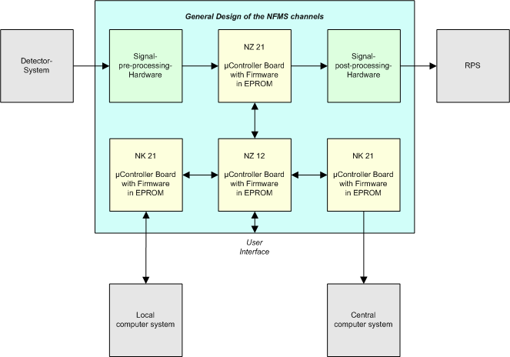
Digital Neutron Flux Monitoring System proTK™ next generation – DWK 260

Slide 29
Digital Neutron Flux Monitoring System proTK™ next generation – DWK 260

Slide 30
Digital Neutron Flux Monitoring System proTK™ - Summary
With proTK™ Mirion offers a full range of neutron flux monitoring channels for BWR, PWR and test, research and training reactors.
The modularity of SW and HW allows its implementation virtually in any NPP or other nuclear facility (existing or new).
These neutron flux monitors are designed and qualified for providing signals of highest safety standards, i.e. for the reactor protection system (RPS) and also fast signals for reactor control
proTK™ channels have accumulated > 3,000 years of operational experience
Next Generation proTK™ channels are based on the long experience of current proTK™/TK 250 monitors while integrating new customer requirements, e.g. faster response times and additional I/Os.

Slide 31
Enhanced Digital Wide Range Neutron Flux Monitor
Questions?
Comments?
Dr. Ewald Liebhart
Director R&D
Mirion Technologies (MGPI H&B) GmbH
Munich, Germany
Tel: +49-(0)89-51513-112
Mobile: +49-(0)172-8686079
Email: eliebhart@mirion.com

