Slide 1
Reed College
10 CFR 50.59
Melinda Krahenbuhl,

Slide 2
Reed at a glance
1400 Students
~60k/year to attend
10:1 student to faculty ratio
All students write a thesis
Nuclear reactor with 40 student operator (~15 SRO’s and ~25 RO)
The Reed community embraces and supports the reactor
Notes:
44 k for tuition, 11k for room and board
The President –John Kroger drops in unannounced with Board members, faculty and staff candidates and will give the “tour” himself

Slide 3
Reactor Culture
Interested students attend a training seminar typically start with 60 to 70 students
End of November they apply to be selected for continued training (receive about 20 applications)
View success as number of candidates licensed
Only the Director and Associate Director approved tours, experiments, operations and complete 50.59 screenings and evaluations
RO’s and SRO are taught to use the SOP’s. The SOPs are extremely detailed, and can be used without understanding why.
Notes:
2 hour lecture a week and a 3 hour lab. They are also assigned homework
The associate director was a Reed alum.
They know there is a procedure but since they were not responsible for the “paper trail” most do not understand it

Slide 4
Other Circumstances
In Timely renewal- RAI about core parameters/ thermal hydraulics
UA’s SS clad Fuel becomes available
Requires a License amendment
Director Position is open
Notes:
Most have never done an approach to critical experiment, This experiment is done by withdrawing a rod in increments.
The core loading experiment is approved to reload the core in the same configuration one for one exchange which is allowed.
On-going is a search for a new director

Slide 5
The timeline
1/4/2011 Amendment for UA Fuel is received
Jan11-25, 2011 Request to the Reactor Review Committee for a “core loading experiment” This configuration “is not critical” and cannot achieve 5 watts with rods full out There is some fuel shuffling with the same result
2/2/2011 The Committee is solicited to modify the approved experiment to add fuel in 5 element increments, It is approved via phone and email. Core loading continues in 5 element increments until an additional 15 elements are added
2/6/2011CE, SDM, Power calibration are completed
On 2/16/2011 the core is in use for a thesis experiment (central beam experiment)
Al fuel is shipped out and New Director arrives in June
8/3/2011 I received a phone call from the NRC requesting a letter confirming that we are using SS clad fuel only.

Slide 6
What about the 50.59?
A 10 CFR 50.59 Screening is completed (SOP 62)- screened out
Justifications
TS allow for either AL or SS clad fuel without respect to number or location
SS is a more durable
Screening form is dated 4/26/11, It contains a paragraph stating that the “analysis was performed on Jan. 11, 2011 prior to replacing the Al fuel

Slide 7
Challenges
The justifications for the screening were sparse.
There was a Core Analysis and Thermal Hydraulic analysis being completed for the relicensing RAI’s.
Does this activity screen in or out?
Request to the committee
Is the NOV a function of training? Or Culture? Or both
Notes:
Who knew what when?
No paper trail.

Slide 8
What changed after the NOV
The SOP 60 (maintenance) and 62 (changes test and experiments) were modified.
Example of answers were added to guide screening process
ALL SRO’s will now be able to document screenings and evaluations. Director and Operations Manager still have oversight and final approval
Special experiment for core loading has become a training lab.
Notes:
More Accountability/ less rote memorization,

Slide 9
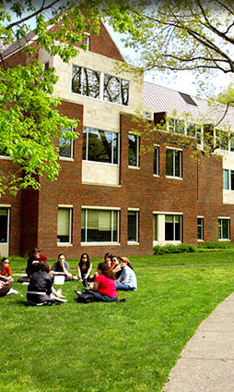
Questions

