Slide 1
Advanced Test Reactor National Scientific User Facility Rapid Turnaround Experiments
Frances Marshall, P.E.
James I. Cole, Ph.D.
Mary Catherine Thelen
TRTR Annual Meeting
September 2013

Slide 2
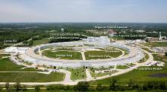
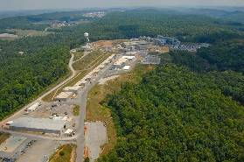
What are User Facilities?
Regional, national or international facilities with unique experimental capabilities. Access is typically cost free through a competitive proposal process.
There are currently 49 DOE user facilities in the U.S.
– Advanced scientific computing research
– High flux synchrotron and neutron sources
– Electron beam characterization
– Nano-scale science
– Biological and environmental research
– High energy and nuclear physics
– Fusion energy science
……But before 2007 there were no user facilities to address the unique challenges of nuclear energy!
Advanced Photon Source (ANL)
Spallation Neutron Source (ORNL)

Slide 3
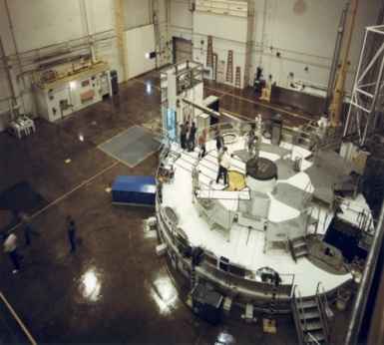
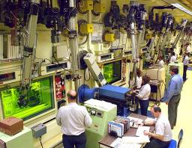
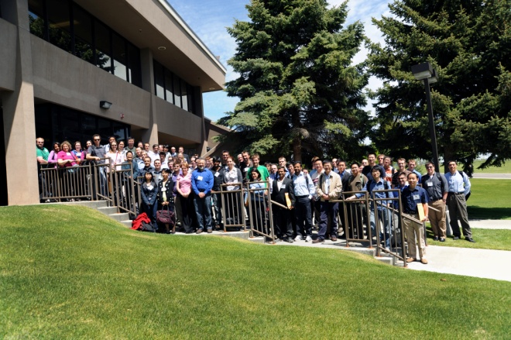
Meeting Nuclear Research Needs
To perform the research required to support nuclear energy development requires specialized (expensive) and increasingly rare capabilities
High flux reactors
Hot cells
Support infrastructure (shipping casks, test fabrication, etc.)
But also intellectual capital
Universities
Nuclear industry
Innovative small businesses
National laboratories
ATR designated as a NSUF as a means to provide the research community access to national capability to conduct cutting edge nuclear technology research and development

Slide 4
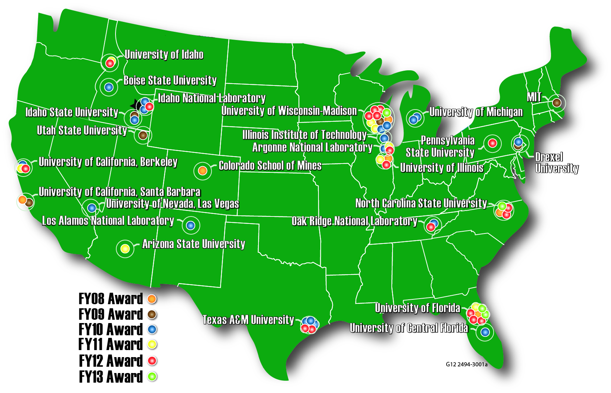
Sponsorship of Non-Proprietary Experiments
Awarded via Proposal Submittal
Can be Irradiation or PIE-only
ATR Critical Facility
Selection Review Process
Peer review for technical merit
Relevancy review for NE programs
Technical feasibility
72 Projects Awarded
63 to 20 universities
9 to 4 laboratories
Opening new opportunities to researchers

Slide 5
Sample Library— Expanding Research Opportunities
Irradiation Experiments Performed by ATR NSUF Researchers Investigate Novel Fuels and Materials
More Samples are Irradiated than are Investigated due to Budget and Time Constraints.
“Extra” Specimens are Made Available in the Sample Library to the Research Community
Additional Samples are From Other Irradiation Projects (i.e., not ATR NSUF)
Decommissioned reactors
Previous INL programs
Other laboratories
Optimize the value of the irradiation investment

Slide 6
Current Partner Facilities
Partnerships bring additional capabilities to the ATR NSUF, offer collaborative opportunities beyond the INL and form a foundation for nuclear research that reaches across the U.S.
Fiscal Year 2013 has seen continued growth with the addition of our first industry partner.
Rapid Turnaround Experiments are an ideal venue for these kinds of collaborative endeavors.

Slide 7
ATR NSUF Partnerships
Partnership Objectives
ATR NSUF aims to meet customer needs
Experiments completed sooner
Less cost to DOE (enables more experiment awards)
May not need full INL capabilities
Higher utilization of partner facilities
Support educational initiatives as the university (faculty research, student participation)
ATR NSUF will include additional capability that benefits users
University research reactors
Hot cells or hot laboratories
Accelerator facilities
Partnership Process
Potential partners self-nominate
Evaluation and selection
Capabilities added to next proposal solicitation

Slide 8
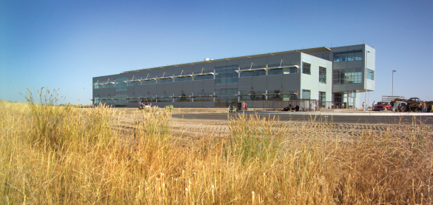
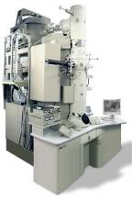
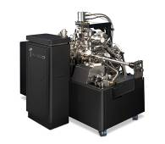
Center for Advanced Energy Studies (CAES)
Collaboration between INL and Idaho Universities
Facility owned by State of Idaho
NRC Licensed, via Idaho State University
Imaging Laboratory will house high-end equipment for use with lower activity samples
Small sample mechanical testing
Material quantity limits sufficient for atom probe and TEM on fuel
Outside the INL firewall, easier remote access for researchers

Slide 9
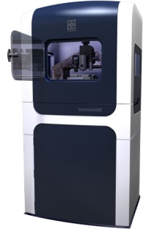
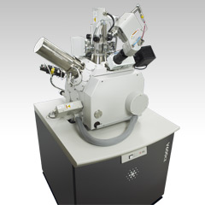
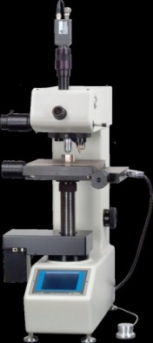
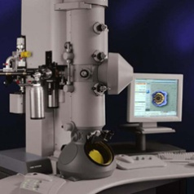
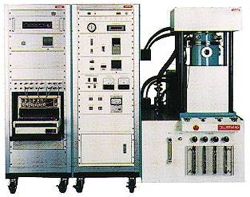
Microscopy and Characterization Suite (MaCS)
Nano-indenter, with Atomic Force Microscope
Measures mechanical properties on very small scale samples
In CAES
Non-security Access for Users
NRC License for Small Radioactive Samples
Test Material Properties by Destructive and Nondestructive Means
Characterize Materials with State-of-the art Microscopy
Local Electrode Atom Probe
Creates 3-D images of atoms in solids
Focused Ion Beam
Sections materials at micro- and nano- scales for TEM and LEAP microscopy.
Automated Hardness Tester
Measures and evaluates the micro-hardness of materials
Transmission Electron Microscope
Images nano-scale
material structures
Spark Plasma Sintering
Creates fully dense metals, ceramics and metal-ceramic composites
Scanning Electron Microscope
Images material surfaces at the nano-scale

Slide 10
ATR NSUF Rapid Turnaround Experiments
In 2011, Responding to Decreased DOE Budgets, ATR NSUF Instituted the Rapid Turnaround Experiment, or RTE
Focus is on Research that can be Performed in Partner Facilities, MaCS Laboratory, Material Previously Irradiated, Available via the ATR NSUF Sample Library, or PI-Provided Material
NOT for Full Irradiations in ATR or Extensive PIE Experiments
Expectation is that Experiment can be Completed in < 2 months for < $50K
RTE Proposal Call is Open All Year, with Proposal Reviews Quarterly
Submitted via ATR NSUF Web Site
RTE Proposal Reviews
Technical Peer Review
Facility Feasibility Review
NE Programmatic Relevance Review
Increase Research Opportunities for Experimenters

Slide 11
ATR NSUF RTE Examples
“Irradiation Damage of Ceramic Material” – Irradiation performed in NCSU PULSTAR reactor and characterization at NCSU
“Atom Probe Tomography to Study Fission Product Damage in Model Nuclear Fuel” – Irradiated surrogate fuel, CeO₂, was characterized in the MaCS lab
“Effect of Heavy Ion Bombardment on Uranium Dioxide Thin Films Under Various Conditions of Irradiation Dose, Temperature, and Actinide Surrogates” – Use of X-ray absorption spectroscopy to observe changed in UO₂ local atomic structure at the Advanced Photon Source, Materials Research Collaborative Access Team
“Atom Probe Tomography on Highly Irradiated Ferritic/Martinsitic Steels” – Previously irradiated material from the Fast Flux Test Facility, atom probe samples extracted using LANL and UCB expertise, then send to MaCS for Local Electron Atom Probe investigations

Slide 12
ATR NSUF Publications, 2009 - 2012
Publication History 2009-2012
2009-2012 Total= 114

Slide 13
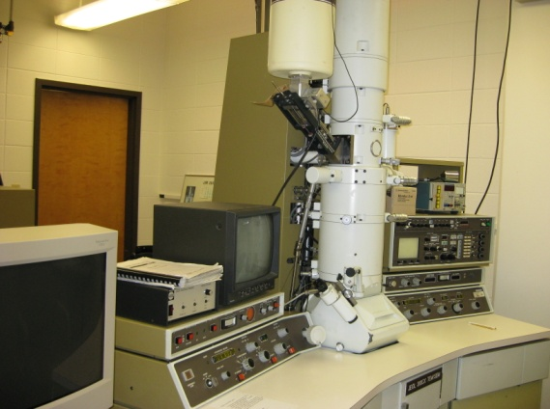
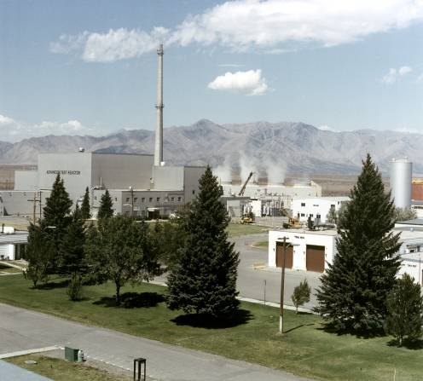
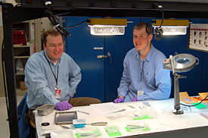
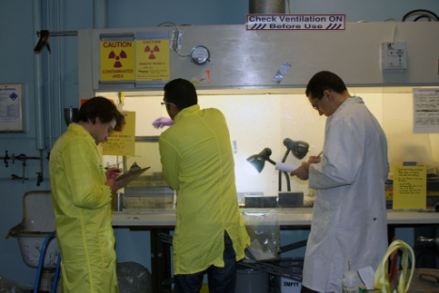
ATR NSUF Summary
Portal to national capability, pairing ideas to assets
Other National User Facilities (APS, SHaRE, NIST,
LANSCE)
Examination facilities (INL, MaCS, NCSU, ORNL,PNNL, UCBerkeley, Michigan, Purdue, UNLV, IIT, Wisconsin Westinghouse
Test reactors and critical facilities (ATR, ATRC, HFIR, MITR, PULSTAR)
An active and engaged user community

Slide 14
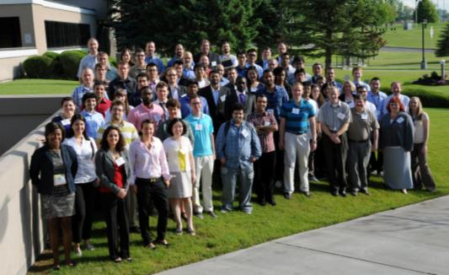
The ATR NSUF Program Team
Jeff H. Terry
Scientific Director
(219) 789-3317
terryj@iit.edu
Frances M. Marshall
Program Manager
(208) 526-8947
Frances.Marshall@inl.gov
James I. Cole
Chief Scientist
(208) 533-7165
James.Cole@inl.gov
Jeff B. Benson
Education Programs Manager
(208) 526-3841
Jeff.Benson@inl.gov
John Jackson
Industry Lead
(208) 526-0293
John.Jackson@inl.gov
Mary Catherine Thelen
Program Administrator
(208) 526-5209
Mary Thelen@inl.gov
ATR NSUF Website: http://atrnsuf.inl.gov

