Slide 1
A Liquid Deuterium Cold Neutron Source for the NIST Research Reactor –
Conceptual Design
Robert Williams, Paul Kopetka, Mike Middleton, Mike Rowe, and Paul Brand
TRTR 2013
September 24-26, 2013
St. Louis, Missouri

Slide 2
Outline:
What’s new at NIST?
Existing Liquid Hydrogen Cold Source
Performance and Heat Load Calculations for the planned LD₂ Source
Design Overview, Status
Conclusion

Slide 3
Major Expansion of Cold Neutron Facilities
New Guide Hall and Support Building - 2011
  Nearly doubled the size of the Guide Hall
  Five additional guides installed, now 12 guides
  Several new instruments available to users
Second LH₂ Cold Source installed in BT-9
  Operational since April 2012
  More intense source for MACS-II
  Cooled by existing refrigerator
Additional Facility Upgrades:
  Cold Neutron PLC Upgrade
  Thermal Shield Cooling System
  Secondary Cooling Pump Building
  Fuel Storage Pool Liner

Slide 4
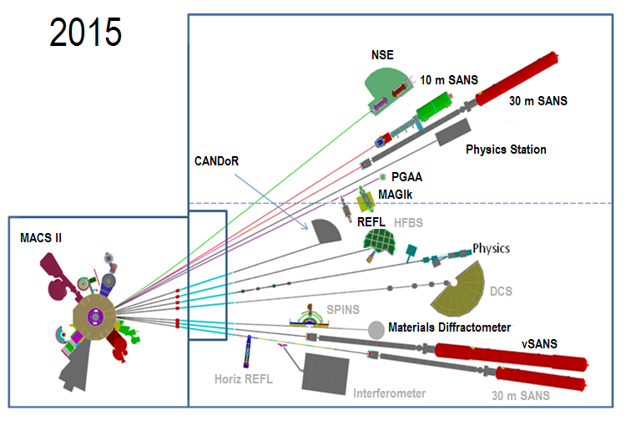
Bold indicates new or re-located, upgraded instruments.

Slide 5
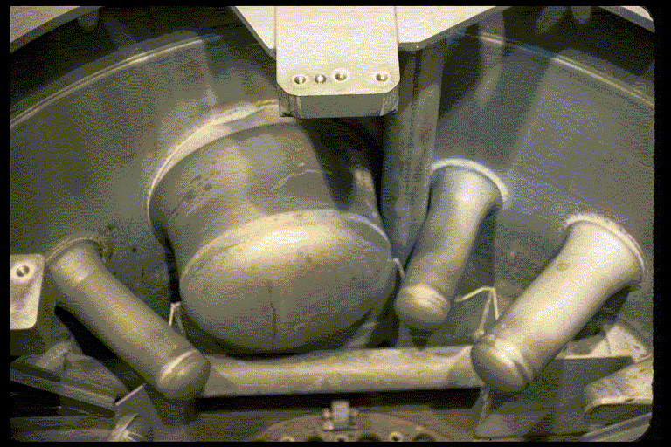
The NBSR was designed with a 55-cm diameter cryogenic beam port for a D₂O-ice CNS.
History:
D₂O Tank
D₂O Ice (1987)
Unit 1 LH₂ (1995)
Unit 2 LH₂ (2002)

Slide 6
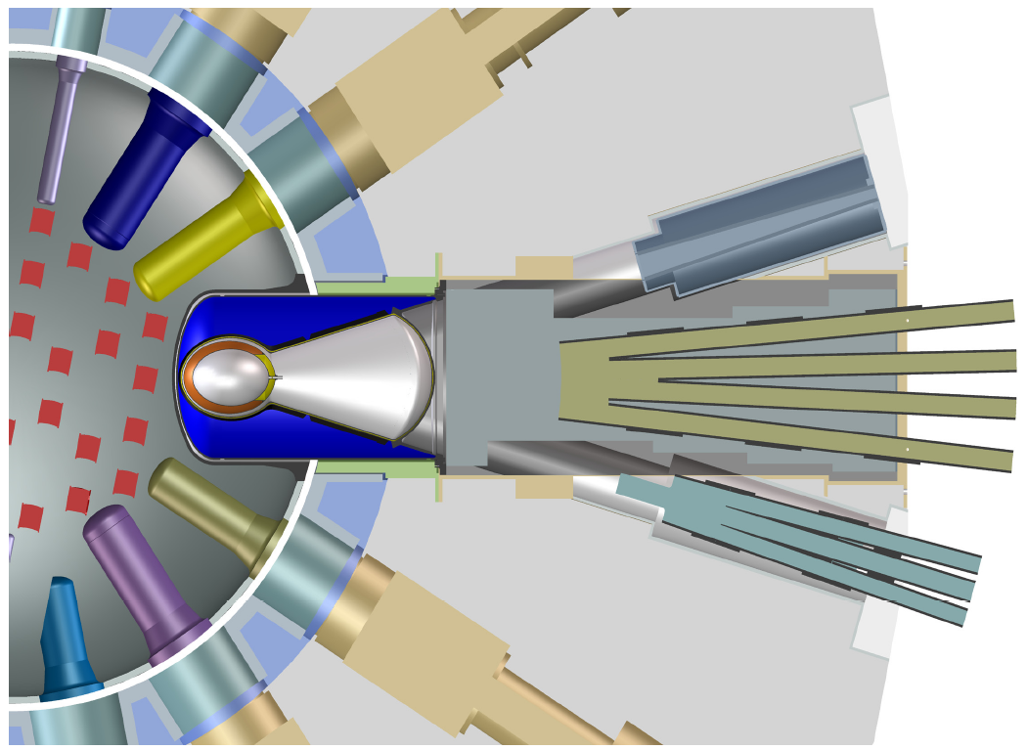
Existing LH₂ CNS, In-pile Guides as of April 2011
CTW Beam Port (now has inpile piece for new guides)
MACS
NG-1
NG-2
NG-3
NG-4
NG-5
CTE
NG-6
NG-7

Slide 7
Why Upgrade To Deuterium Cold Source
Deuterium absorption cross section is 500 times less, but
deuterium scattering cross section is 10 times less, therefore,
higher intensity cold neutron beam.
Affect Of Deuterium On System Design
Volume of liquid deuterium in cryostat is 7 times greater,
therefore, larger ballast tank, greater heat load and,
larger refrigerator capacity required.

Slide 8
What is to be gained with deuterium?
Spectrum shifts to lower energies.
Gain of 2 for the longest wavelengths.
Maxwell-Boltzmann temperature drops from 40 K to 30 K
Large volume, low absorption.
Up to 50% loss at 15 meV (2.5 Angstroms).
Φ(E) vs. E, 0 – 20 meV

Slide 9
Feasibility of a LD₂ Source
A LD₂ source requires a large volume compared to LH₂.
The CT thimble in the NBSR has ample room for a very large LD₂ moderator vessel (30-50 liters).
The nuclear heat load will be ~4 kW.
New 7-kW He refrigerator being installed
Support from DOE National Nuclear Security Administration:
  Conversion of NBSR to LEU will result in 10% reduction in thermal and cold neutron beams.
  CNS, new guides is mitigation strategy.

Slide 10
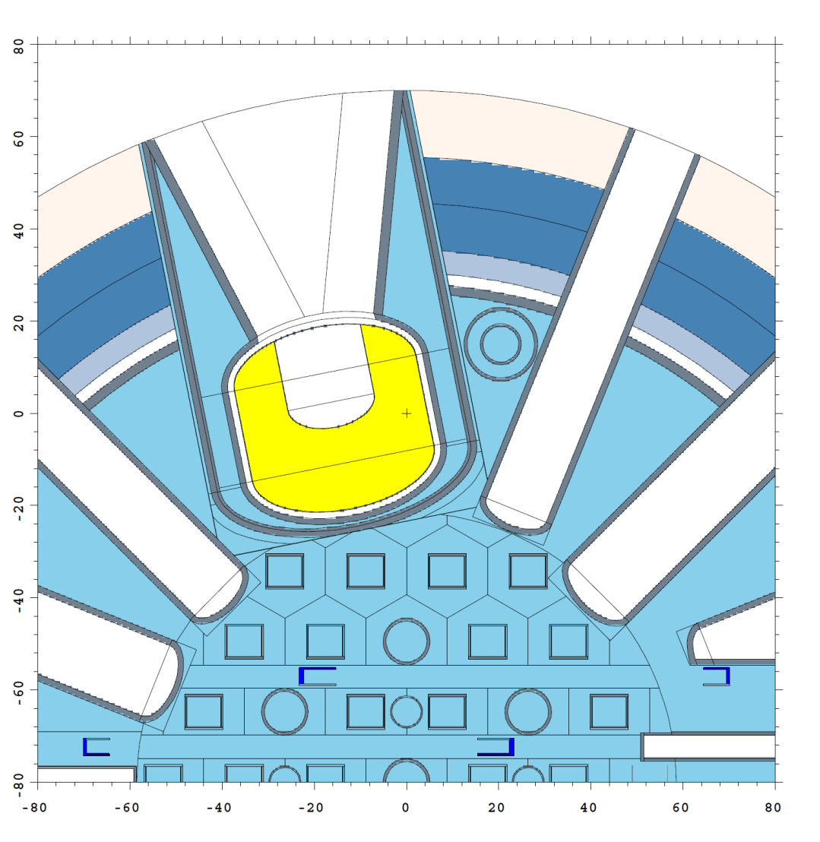
Gain Calculations: MCNP Model of the 40x40 cm LD₂ Source in the NBSR CT Port
Surface Source generated on cylinder surfaces

Slide 11
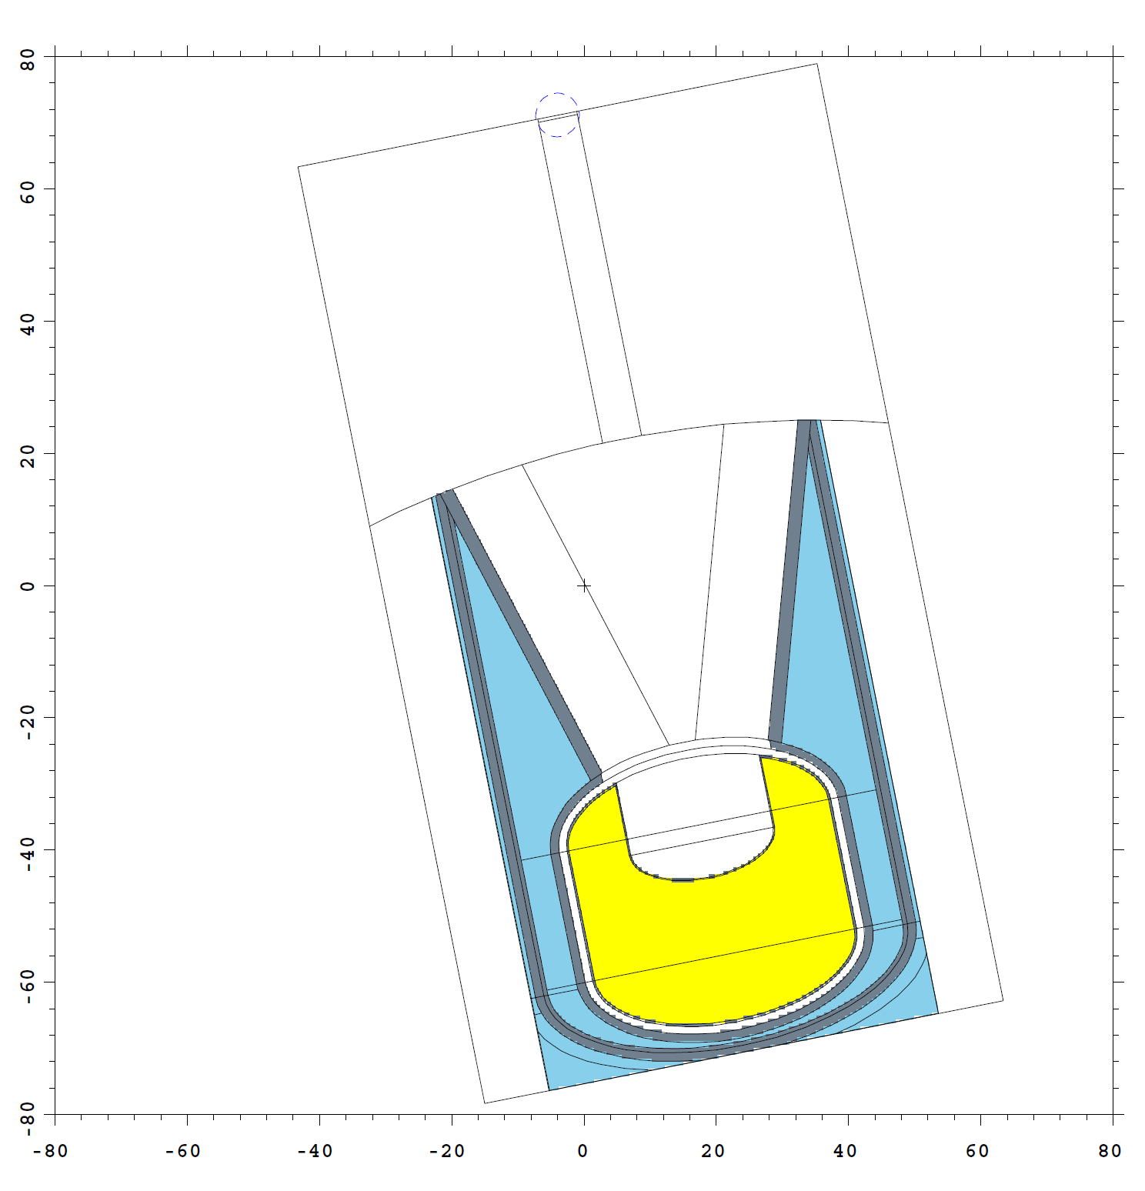
MCNP model of CNS region uses surface source for starting neutrons
DXTRAN Sphere around Current Tally Surface
D₂O Jacket and CT Thimble
D₂O Coolant
LD₂ Cold Source, 35 Liters, 22-cm ID by 18-cm deep Reentrant Hole
Vacuum Jacket and Helium Containment

Slide 12
Parameters Affecting Performance:
Volume: 400 mm x 400 mm, 35 liters LD₂
Reentrant Hole Depth: 180 mm
Reentrant Hole Diameter: 220 mm
Void Fraction (depends on heat load): Assume a void fraction of 13% (about half of Kazimi Correlation for pool boiling) based on mockup measurements, including ILL horizontal source.
Ortho/Para Content: 76% ortho-LD₂ based on measurements at PSI.
S(α,β) Scattering Kernels: The newly released MCNP6.1 includes “continuous” energy/angle thermal neutron scattering cross section data.

Slide 13
Expected Gains with Respect to Existing LH₂ Source

Slide 14
Nuclear Heat Load Calculation:
 | Deuterium 5160 g |  | Aluminum 7155 g
Radiation Source | Rate (W/g) | Heat (W) | Rate (W/g) | Heat (W)
Neutrons | 0.0851 | 440 | 0.0008 | 6
Beta Particles | - | - | 0.0793 | 567
Gamma Rays | 0.204 | 1053 | 0.215 | 1538
Subtotal |  | 1493 |  | 2111
Total Cryogenic Heat Load = 3604 W
Note that LD₂ boils at 23 K at 100 kPa, 25 K at 150 kPa.

Slide 15
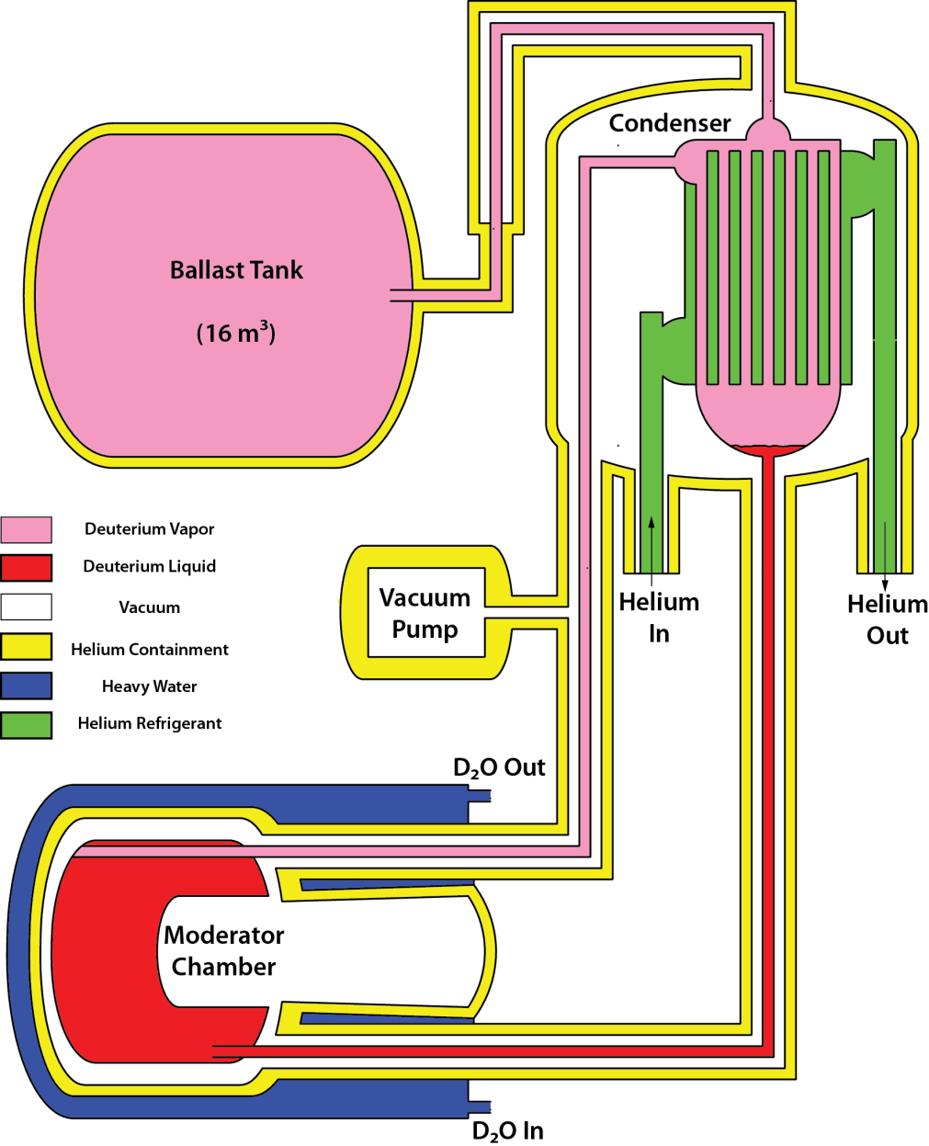
The LD₂ source must also be passively safe, simple and reliable
A thermosiphon is the simplest way to supply the source with LD₂.
  Cold helium gas cools the condenser below 23 K.
  Deuterium liquefies and flows by gravity to the moderator chamber.
  Vapor rises to the condenser and a naturally circulating system is established.
The system is closed to minimize gas handling (No vents or pressure relief).
Low pressures: 4-5 bar warm, 1 bar operating
All system components are surrounded by He containments.

Slide 16
System Components, Status:
Horizontal LD₂ source is similar to one at ILL, just larger. Thermal hydraulics modeled using data from the mockup of the ILL source. (complete)
6000 W LD₂ condenser mounted on the reactor face, ~ 2 m above the cryogenic beam port. (received)
16 m³ ballast tank for operation at 100 – 150 kPa, 400 – 500 kPa warm. (expected this fall)
Refrigerator installation in progress. (completion expected April 2014)
Procurement of the cryostat assembly and condenser containments in progress. (~ 2 years)
Installation target: 2016!

Slide 17
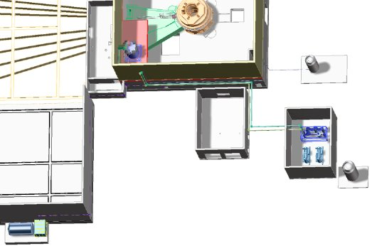
Layout of the 7 kW Refrigerator and LD₂ Cold Source Components
Condenser
LN₂ Tank
Coldbox
(C-200)
Compressors and Oil Removal Module
Low Pressure He Tank
D₂ Ballast Tank

Slide 18
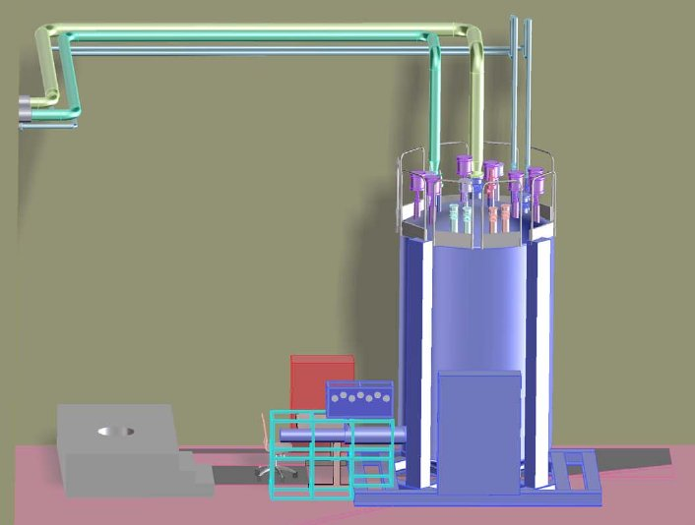
New Refrigerator Model

Slide 19
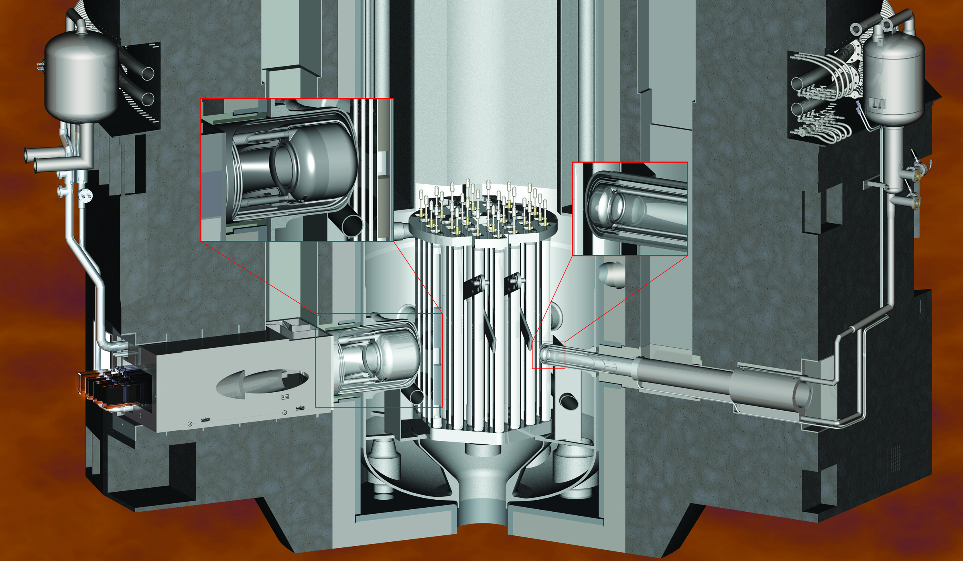
Future Cold Source Layout
BT-9 LH2 Source (installed 2012)
LD₂ Source (2016)

Slide 20
Maximum Hypothetical Accident for Liquid Hydrogen Cold Source
The Initiating Event is a guillotine break of the vacuum lines allowing air to rush in and freeze on the LH₂ vessel.
The LH₂ vessel ruptures and there is a detonation when the worst combination of oxygen and hydrogen is present.
Rupture and Ignition are assumed with no reasonable, credible scenario.
The overly conservative MHA ‘Unnecessarily Limits the Design’ of the Liquid Deuterium Cold Source.

Slide 21
Maximum Hypothetical Accident for Liquid Deuterium Cold Source
The Initiating Event is a failure of a vacuum pump which allows all the air inside the vacuum enclosure to rush in and freeze on the LD₂ vessel.
The LD₂ vessel ruptures and there is a detonation when the worst combination of oxygen and deuterium is present.
Rupture and Ignition are assumed with no reasonable, credible scenario.
The overly conservative MHA ‘Unnecessarily Limits the Design’ of the Liquid Deuterium Cold Source.

Slide 22
Implementation of New Maximum Hypothetical Accident
Change existing MHA used for the liquid hydrogen cold source for the new liquid deuterium cold source.
Install a separate BT-9 cold source vacuum system.
Modify the existing vacuum system to make a guillotine break impossible.
Changes will be completed before the Installation of the new deuterium cold source.

Slide 23
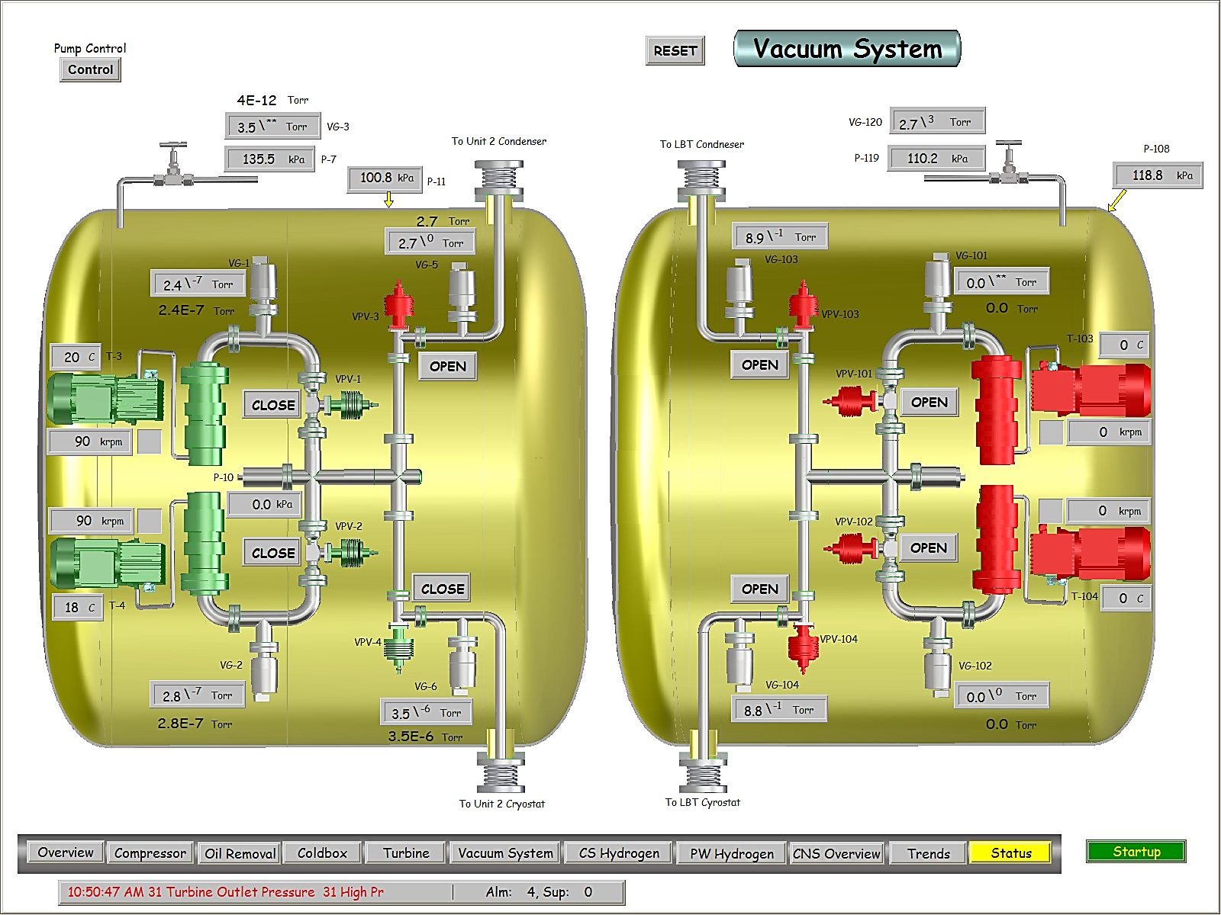
Conclusion
The cryogenic beam port of the NBSR is a perfect location for a large-volume LD₂ source.
It would allow the us to enhance our strength: providing an intense source of long-wavelength neutrons.

Slide 24
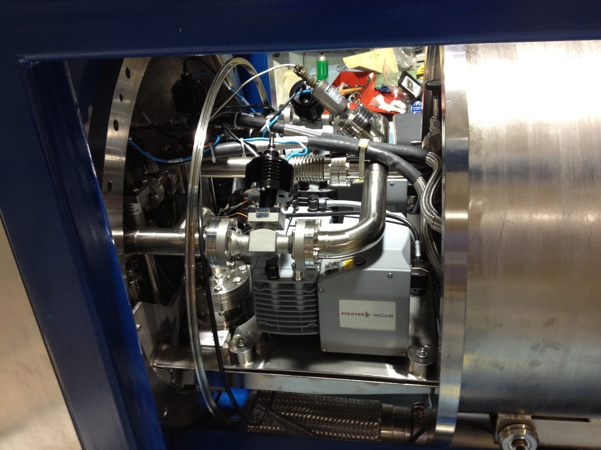
Vacuum System

Slide 25
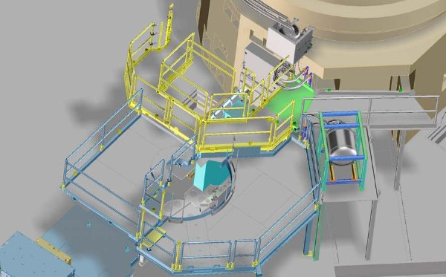
Proposed PW Vacuum Skid Location

Slide 26
QUESTIONS?

Slide 27
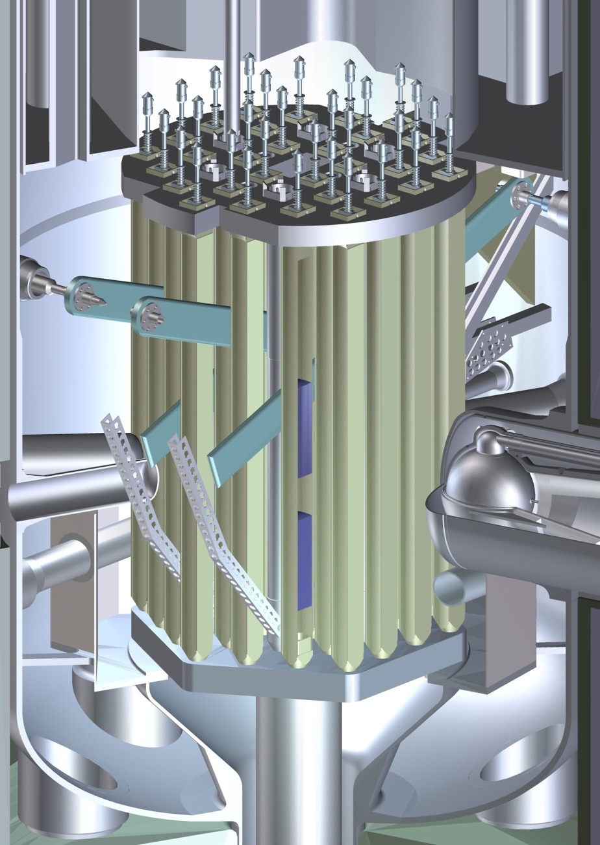
Cut-away View of the NBSR Core
Top Grid Plate
Cd Shim Safety Arms (4)
Fuel Elements (30)
Fuel Plates
Reactor Vessel
Radial Beam Tubes (9)
Liquid Hydrogen Cold Neutron Source
18-cm Unfueled Gap – Flux Trap
Bottom Grid Plate
D₂O Primary Inlet Plenums
Primary Outlet (2)
Thermal Shield

Slide 28
