Slide 1

Utilisation of the BR2 reactor

Slide 2
Utilisation of the BR2 reactor
Steven Van Dyck
Reactor manager BR2
svdyck@sckcen.be

Slide 3
Content
General characteristics of the BR2 reactor
  Historic perspective
  Core characteristics
  Supporting facilities
Utilisation
  Radio-isotope production
  Semiconductor irradiation
  Material testing
    Structural materials
    Nuclear fuel
Summary and conclusions

Slide 4
Content
General characteristics of the BR2 reactor
  Historic perspective
  Core characteristics
  Supporting facilities
Utilisation
  Radio-isotope production
  Semiconductor irradiation
  Material testing
    Structural materials
    Nuclear fuel
Summary and conclusions

Slide 5
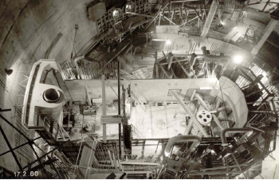
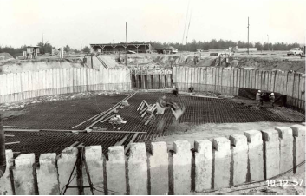
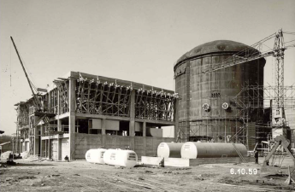
Construction and commissioning period
1956: start of BR1 (nat. U – graphite)
Construction: 1957-1960
First criticality 06/07/1961
Commissioning: 1961-1962
1962: first criticality of BR3 (first PWR Europe)
Full power operation and initial operation license for 25 years issued in 1963

Slide 6
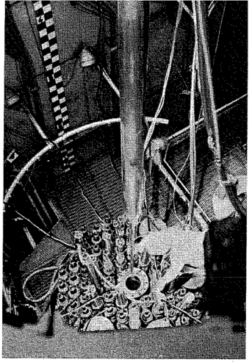
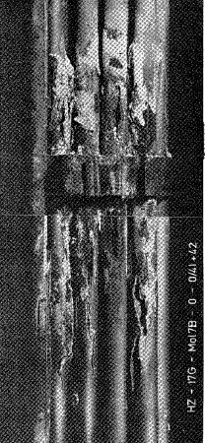
First operation period 1963-1978
Prototype experiments for
  Light water reactor
  Gas cooled reactor
  Sodium cooled reactor
First irradiations of MOX fuel
Production of isotopes for energetic applications
1978-1980: replacement of Be matrix

Slide 7
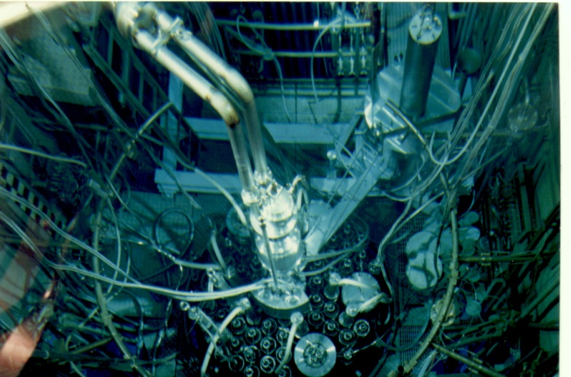
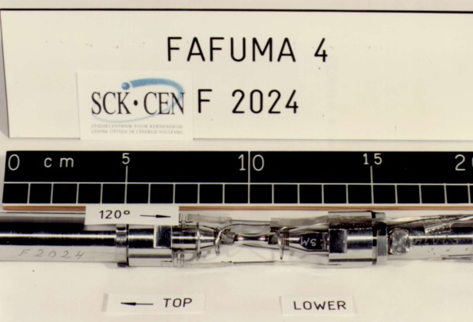
Second operational period (1980-1995)
Legislation change in 1984: no operational limit in license, periodic safety re-assessment (10 year periods)
Safety experiments Na cooled reactors
  Loss of Flow accident
  Post Accident Heat Removal
BR3 shut-down (1987)
  PWR loop in BR2
  LWR MOX studies
Material irradiations
Second Be replacement 1995-1997

Slide 8
Content
General characteristics of the BR2 reactor
  Historic perspective
  Core characteristics
  Supporting facilities
Utilisation
  Radio-isotope production
  Semiconductor irradiation
  Material testing
    Structural materials
    Nuclear fuel
Summary and conclusions

Slide 9
Essential characteristics
Geometry: tank in pool
  78 channels in hyperboloid arrangement inside vessel
  Core diameter: 1m - Top & bottom cover: 2m
  Vessel height: 14m
  Cilindric fuel elements, fueled zone 800mm
Materials
  Be prisms in core, stainless steel extension tubes
  Aluminum 5052 vessel
  High enriched uranium (Ualx fuel disperion)
Cooling
  Light water cooling: nominal power 100 MW + 25 MW
  35-50°C, 120MPa pressure, 10m/s
  Maximum heat flux 470W/cm² (600W/cm² in experiments)

Slide 10
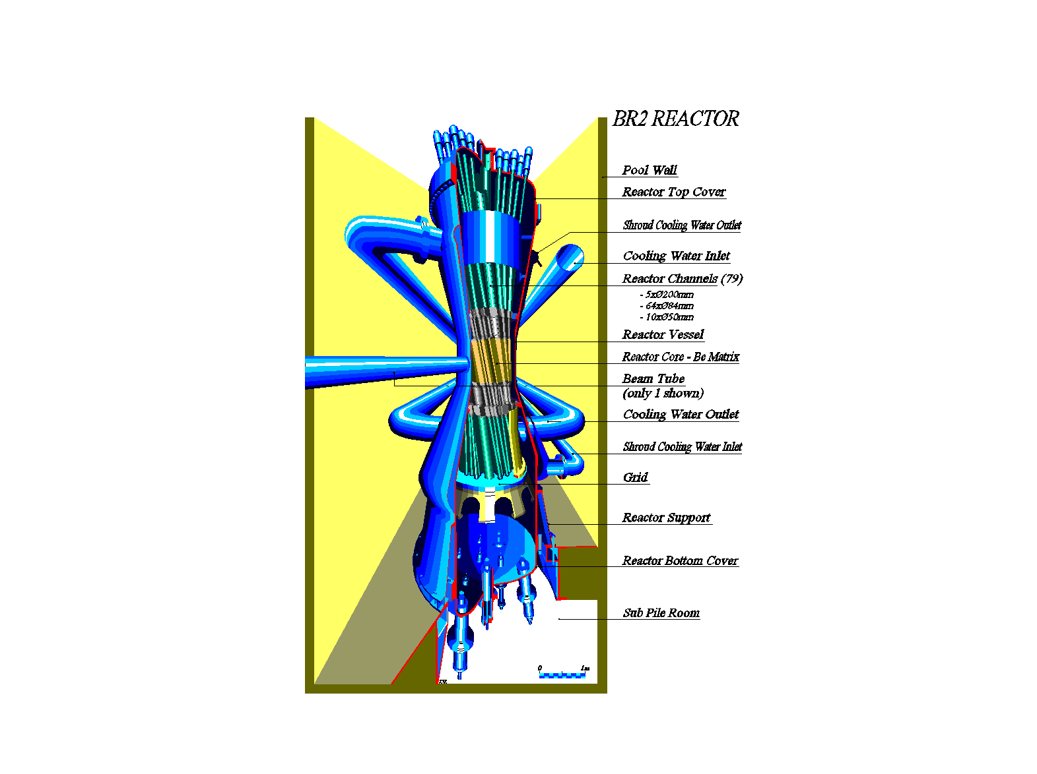
The essential chracteristics
Light water cooled, water+ Be moderated MTR
Maximum thermal power level 100MW
Typical flux levels
1E15 n/cm²s thermal
6E14 n/cm²s fast (E>0.1MeV)
Irradiation inside rigs in reactor channel or in axis of fuel element

Slide 11
Flexibility in applications: variable core configuration
  Fuel elements
  Control rods
  Regulating rod
  beryllium matrix
  beryllium plugs
  PRF (isotope production)
  DG (isotope production)
  CALLISTO (PWR simulation)
  SIDONIE (irradiation of Si 5”)
  POSEIDON (irradiation of Si 6”-8”)

Slide 12
Content
General characteristics of the BR2 reactor
  Historic perspective
  Core characteristics
  Supporting facilities
Utilisation
  Radio-isotope production
  Semiconductor irradiation
  Material testing
    Structural materials
    Nuclear fuel
Summary and conclusions

Slide 13
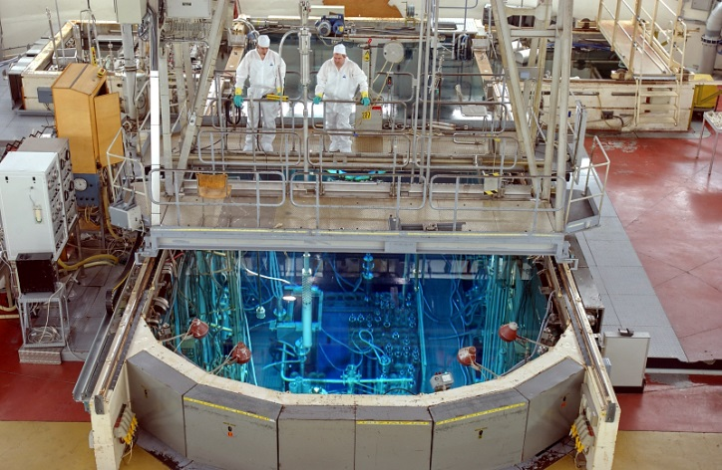
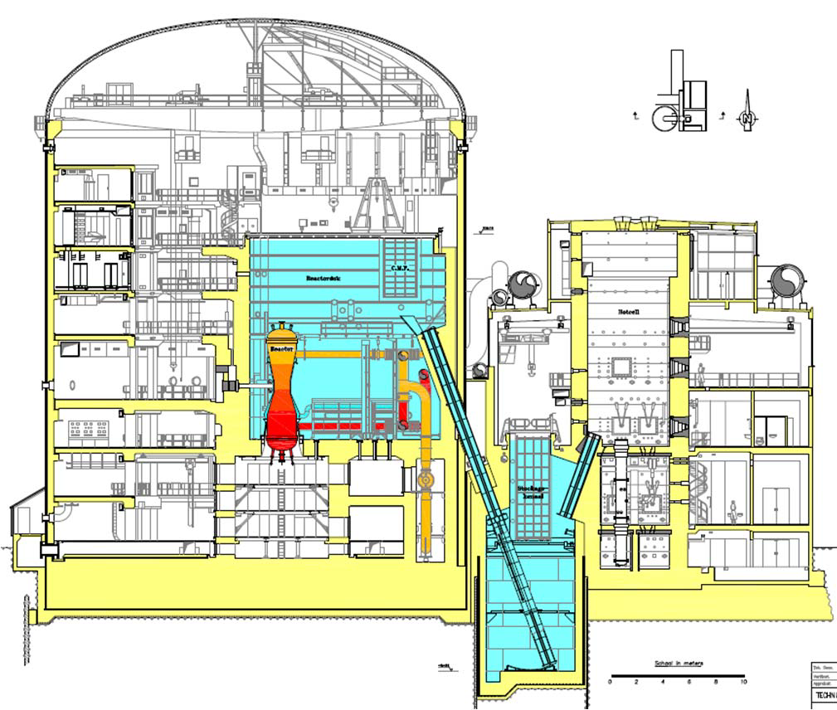
Supporting facilities inside BR2
Secondary cooling
  Reactor
  Pool
  Experiments
Containment building
  Reactor pool
  Irradiated fuel and experiment storage pools
  Transfer tube to storage channel / hot cell
Hot cell
  Dismantling of experiments
Gamma irradiation facilities
  ⁶⁰Co and ¹³⁷Cs sources

Slide 14
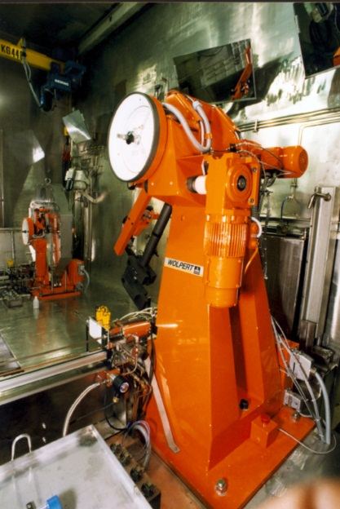
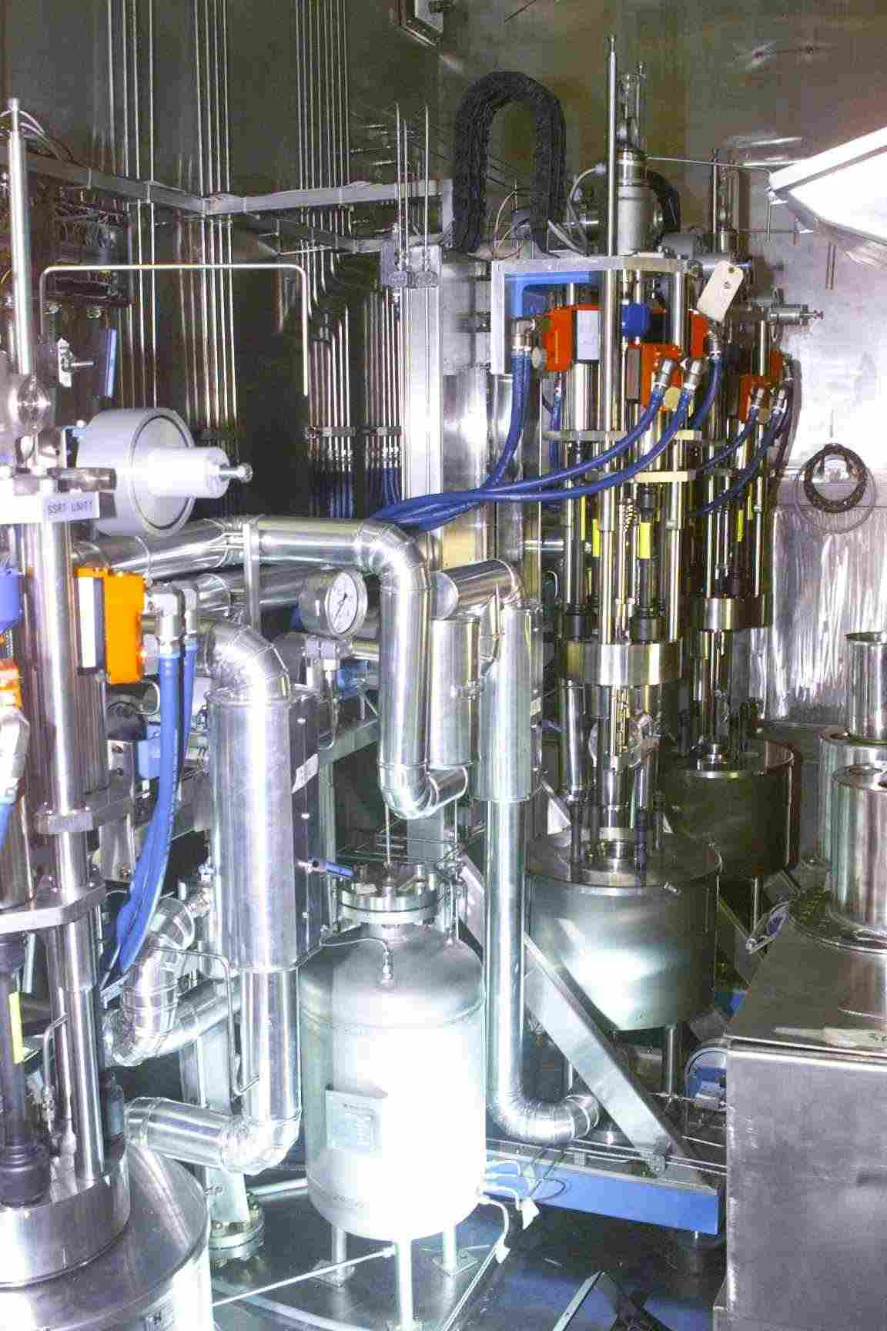
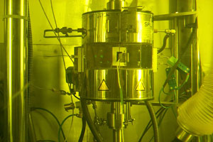
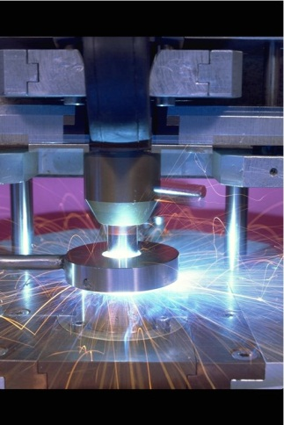
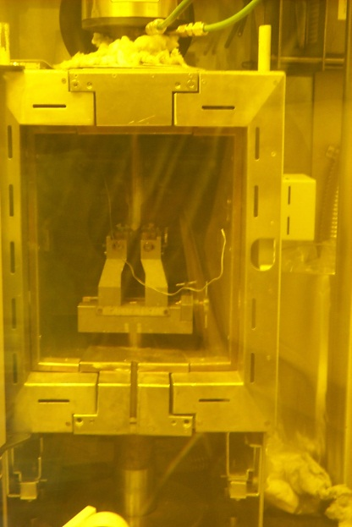
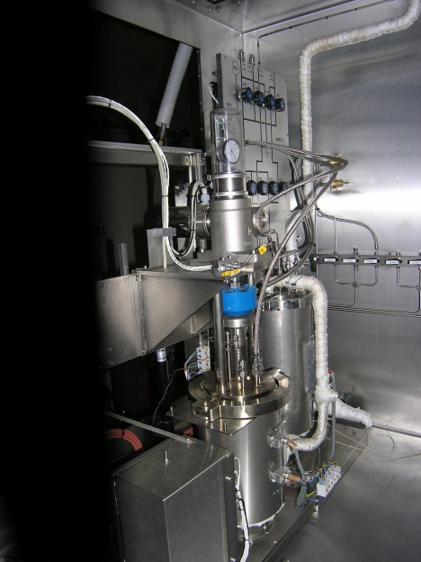
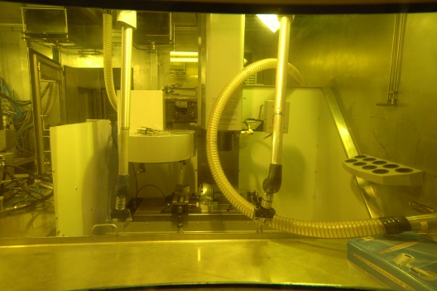
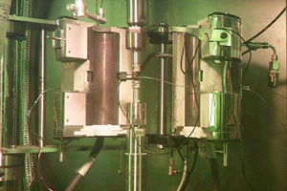
Supporting facilities outside BR2
Mechanical testing
Autoclave
Slow Strain Rate Tensile
Constant Load
Cyclic Load Testing
Tensile
Testing
Impact
Testing
Charpy
Reconstitution
Liquid Pb Alloy
Tensile
Constant Load
Cyclic Load Testing
Milling
Machine
Fracture
Toughness
Testing
Fatigue
Testing

Slide 15
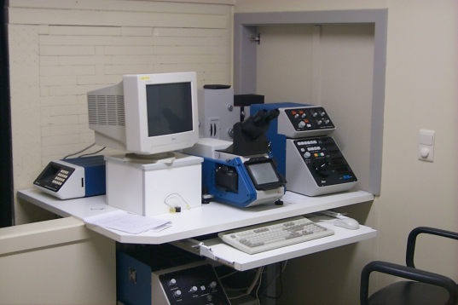
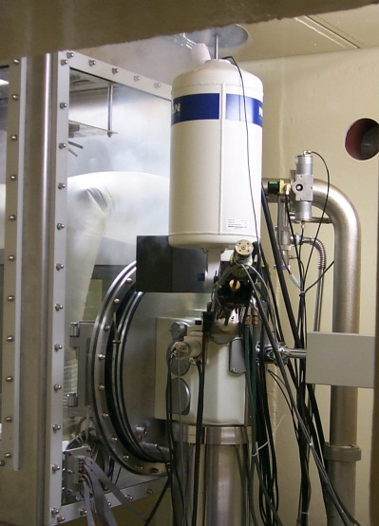
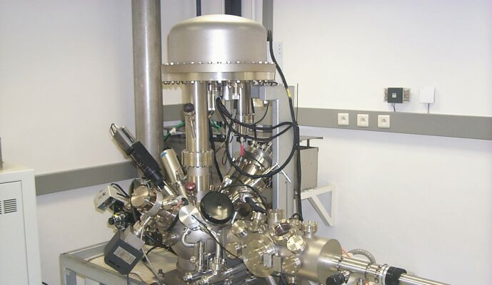
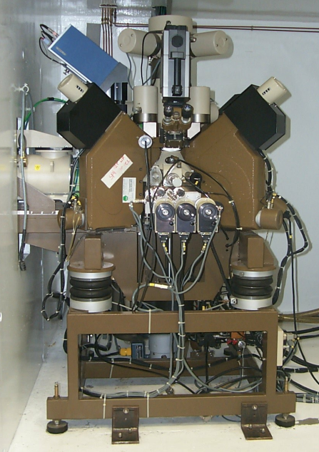
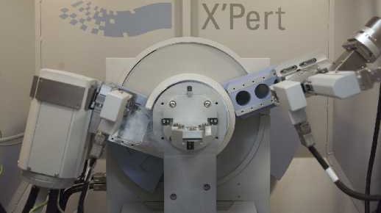
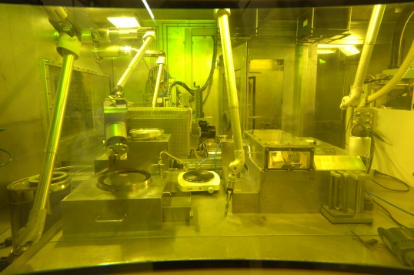
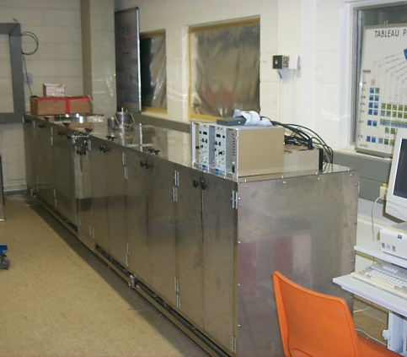
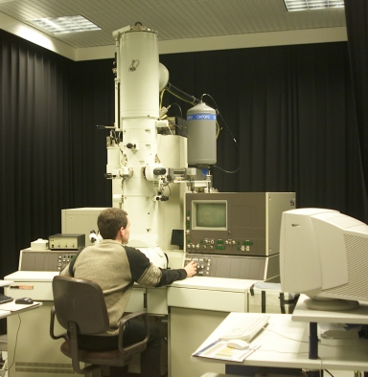
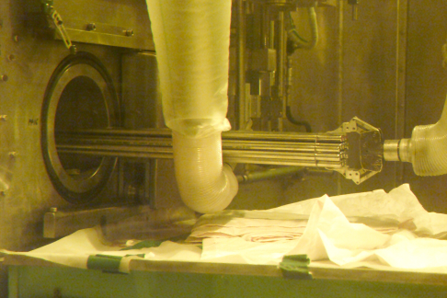
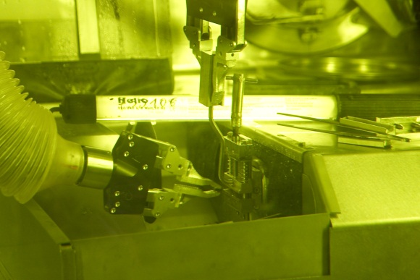
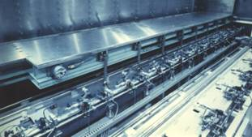
µStructure & Non-destructive Analyses hot laboratory (LHMA)
masters and runs the microscopes with associated preparative equipments
and physical infrastructures (NDT, fuel refab./instr.)
OM
XPS
SEM
EPMA
XRD
Preparation for
metallography
EPMA
Fuel Rod NDT
TEM
PA
TEM disc slicing

Slide 16
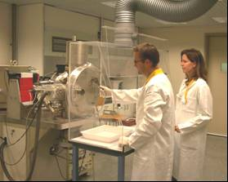
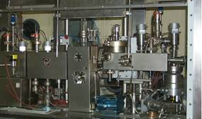
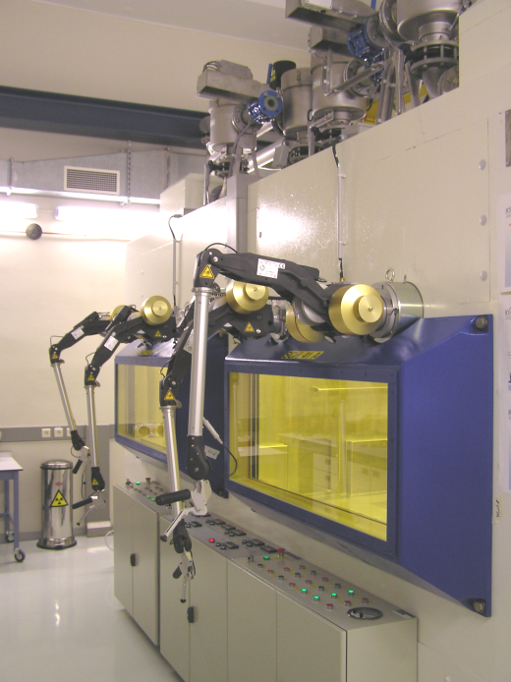
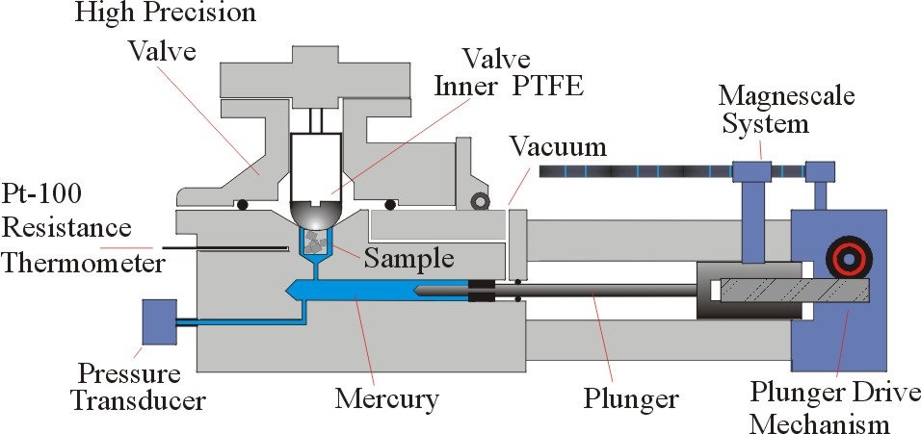
Radio-Chemical Analyses Laboratory α,β,γ-Spectrometry / TI-MS, ICP-MS, AES, ICP-AES, IC, TOC, ISE, G-MS / RGA / Pycnometry
TIMS
Residual Gas analysis
Sample Dissolution
& Chemical Treatment
Mercury Pycnometry

Slide 17
Content
General characteristics of the BR2 reactor
  Historic perspective
  Core characteristics
  Supporting facilities
Utilisation
  Radio-isotope production
  Semiconductor irradiation
  Material testing
    Structural materials
    Nuclear fuel
Summary and conclusions

Slide 18
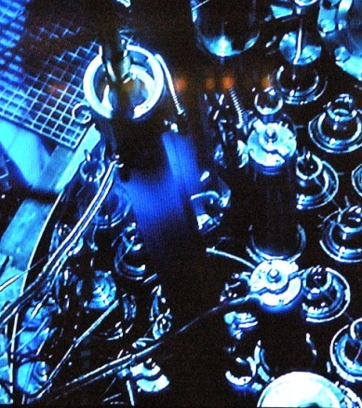
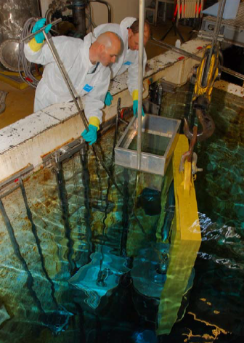
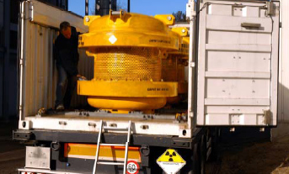
Radio-isotopes from fission
Irradiation of (HE) Uranium metallic (dispersed) targets
  Irradiation capacity: 75 targets, 6 irradiation facilities
  Maximum production rate ⁹⁹Mo: 7800Cie/week (6 day calibrated)
  Annual production: 20% of global demand
Major assets of irradiation devices
  Heat flux limit 350W/cm²
  Loadable during operation
  In-pile cooling and underwater loading for shipment

Slide 19
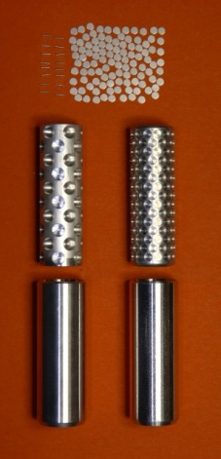
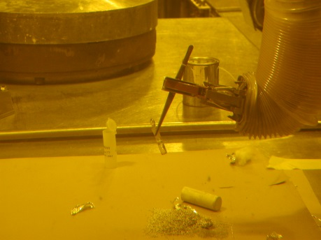
Radio-isotopes from activation
Irradiation in thimble tubes:
  ¹⁷⁷Lu, ¹⁸⁶Re, ¹⁵³Sm, ¹⁶⁹Er, ⁹⁰Y, ³²P, ¹²⁵I,…
  “Small” quantities and low heat generation
  Flexible loading/unloading
  Low to medium flux (4 10¹⁴n/cm²s)
Irradiation in baskets (primary water flow)
  ¹⁹²Ir, ⁸⁴Sr, ¹⁸⁸W, ^{117m}Sn, ⁶⁷Cu, ¹⁴C,…
  “Large” quantities, high heat generation
  Full cycle irradiation
  Up to maximum neutron flux available in BR2
Decanning and packaging in BR2 hot-cell

Slide 20
Content
General characteristics of the BR2 reactor
  Historic perspective
  Core characteristics
  Supporting facilities
Utilisation
  Radio-isotope production
  Semiconductor irradiation
  Material testing
    Structural materials
    Nuclear fuel
Summary and conclusions

Slide 21
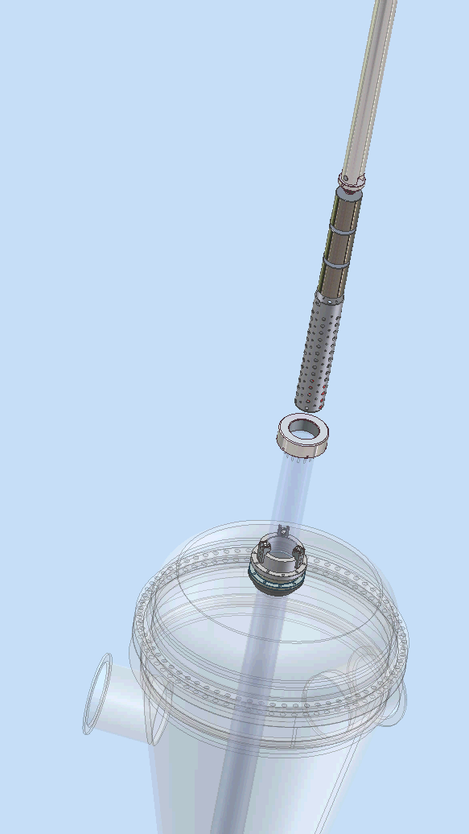
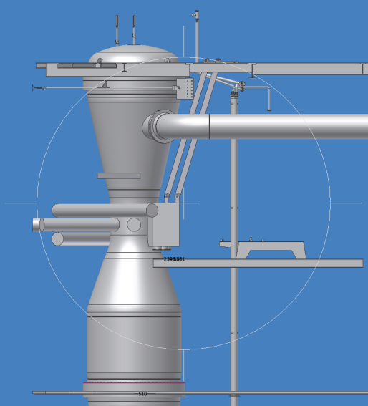
Production of high grade semiconductors by neutron transmutation
³⁰Si(n,γ)³¹Siβ-³¹P creates semiconduction silicon crystals with high quality.
2 installation in BR2:
  SIDONIE: inside vessel for 4-5” diameter crystals
  POSEIDON pool side facility for 6-8” crystals
Total capacity of 15 and 18 tonnes/year respectively
Application of NTD Si: transport (electric-hybrid vehicles), energy (solar & wind)

Slide 22
Content
General characteristics of the BR2 reactor
  Historic perspective
  Core characteristics
  Supporting facilities
Utilisation
  Radio-isotope production
  Semiconductor irradiation
  Material testing
    Structural materials
    Nuclear fuel
Summary and conclusions

Slide 23
Irradiation rigs for structural materials
Standard capsules in primary water
  High flexibility in nuclear conditions (reflector or fuel element)
  Irradiation temperature determined by design
  Full cycle(s) irtradiation
  Environment: gas or (primary) water
Capsules in thimble tube (“ROBIN”)
  Limited flux levels (0.5 to 5 10¹³ n/cm²s E>1MeV)
  Temperature control by design and cooling flow adjustment (+/-30°C)
  Irradiation time flexible
Dedicated rigs: boiling water capsule (“MISTRAL”) / pressurised water loop (“CALLISTO”)
  Stable temperature, accurate control
  Full cycle irradiation
  Variable flux levels

Slide 24
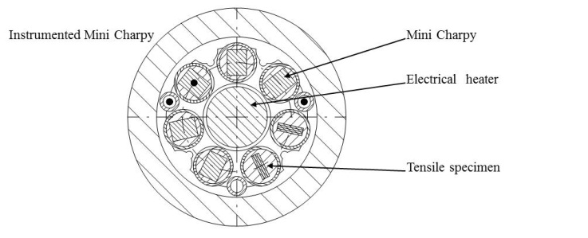
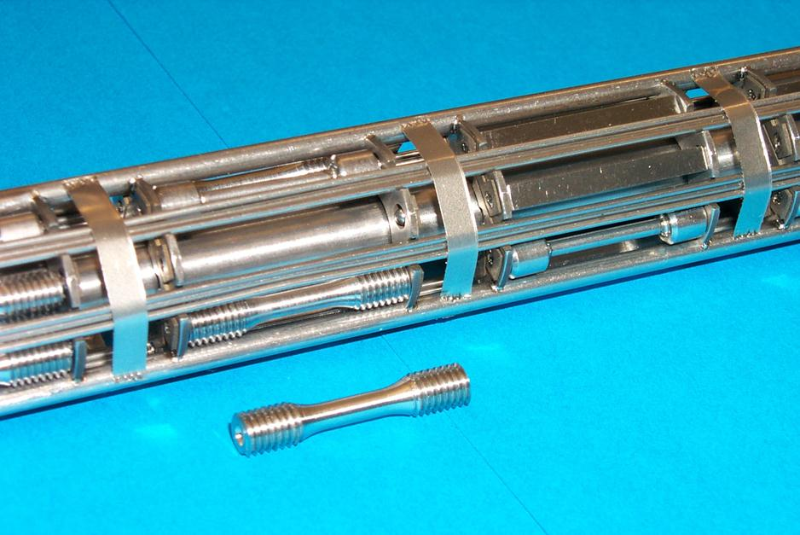
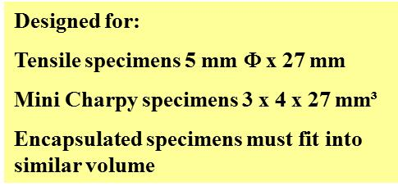
Boiling water capsule irradiation “MISTRAL”
200-300°C irradiation temperature
Boiling water environment
High Fast Flux level
Irradiation temperature monitoring and control by water pressure and heating element
Reloadable with standard specimens

Slide 25
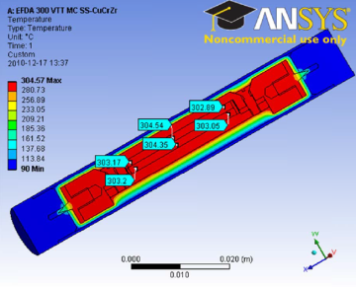
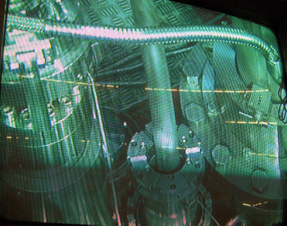
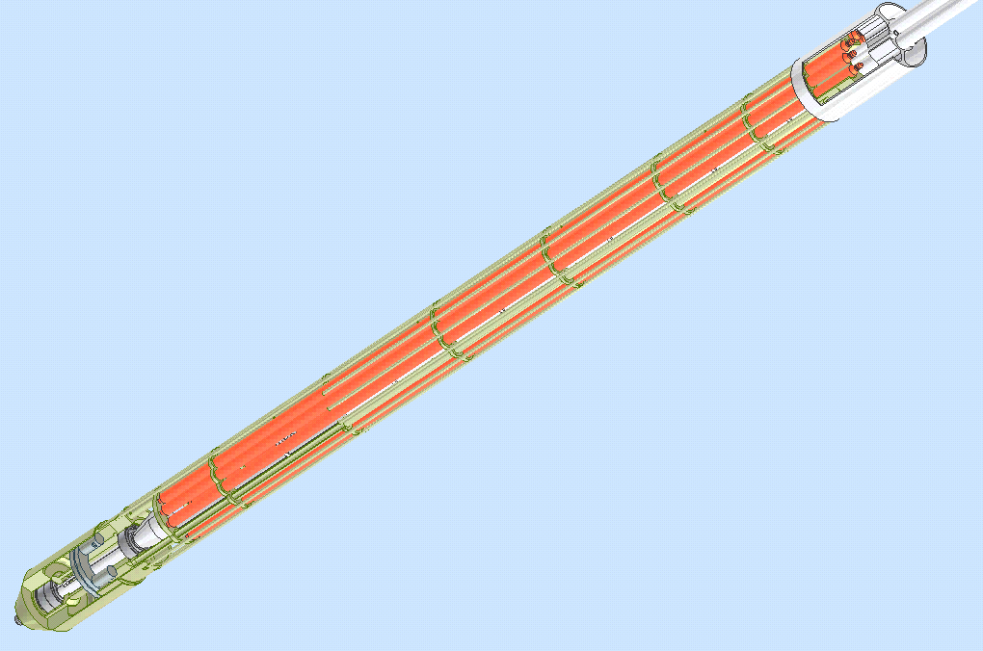
Thimble tube capsule holder “ROBIN”
Specimen holder geometry with gas gap and metal matrix sample holder
Incoporation in closed needle
Monitoring by measurement of temperature in dummy specimen
Temperature control by water flow adjustment

Slide 26
Content
General characteristics of the BR2 reactor
  Historic perspective
  Core characteristics
  Supporting facilities
Utilisation
  Radio-isotope production
  Semiconductor irradiation
  Material testing
    Structural materials
    Nuclear fuel
Summary and conclusions

Slide 27
Nuclear fuel irradiation experiments
Objectives
  Determine safe operational conditions for fuel in representative conditions (power, environment, dimensions)
  Steady state irradiation: power and burn-up limits
  Transient irradiation: safety margin
  Accident studies: DBA and beyond DBA
Tools
  Irradiation loops: CALLISTO, EVITA
  Irradiation baskets: PWC, FUTURE
  Dedicated rigs (MOL7C, PAHR-PYRAMID…)

Slide 28
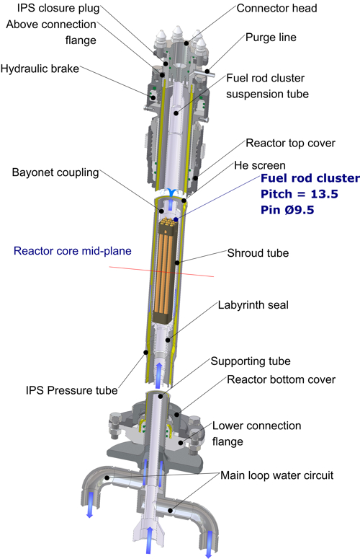
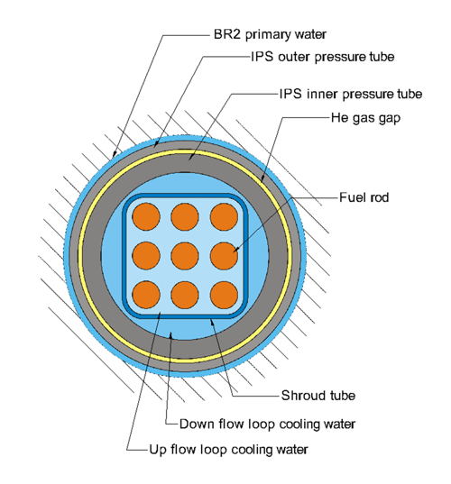
Simulation of PWR in BR2: the CALLISTO loop
Full thermal-hydraulic simulation of PWR conditions
Independent cooling system
Fuel: 3x3 assembly 1m rods
Structure materials

Slide 29
Irradiation conditions
  Parameter
  Typical value
  Linear power at hot plane
  350
  W/cm
  Axial shape factor (max/avg)
  1.6
  Coolant pressure
  155
  bar
  Coolant mass flow rate (in IPS)
  2.1
  kg/s
  Av. coolant velocity along rods
  3
  m/s
  Coolant temperature
  at fuel bundle inlet
  at fuel bundle outlet
  294
  313
  °C
  °C

Slide 30
Example of PIE on LWR Fuel:
Geometrical and FP response to power transients
Gross-γ
  Power profile
  Interpellet
    Pits (dishes, chamfers)
    Peaks (FP migration)
Profilometry
  Creep
    Reflecting power profile
  PCMI
    Reflecting power profile
    + interpellet pits/peaks
30

Slide 31
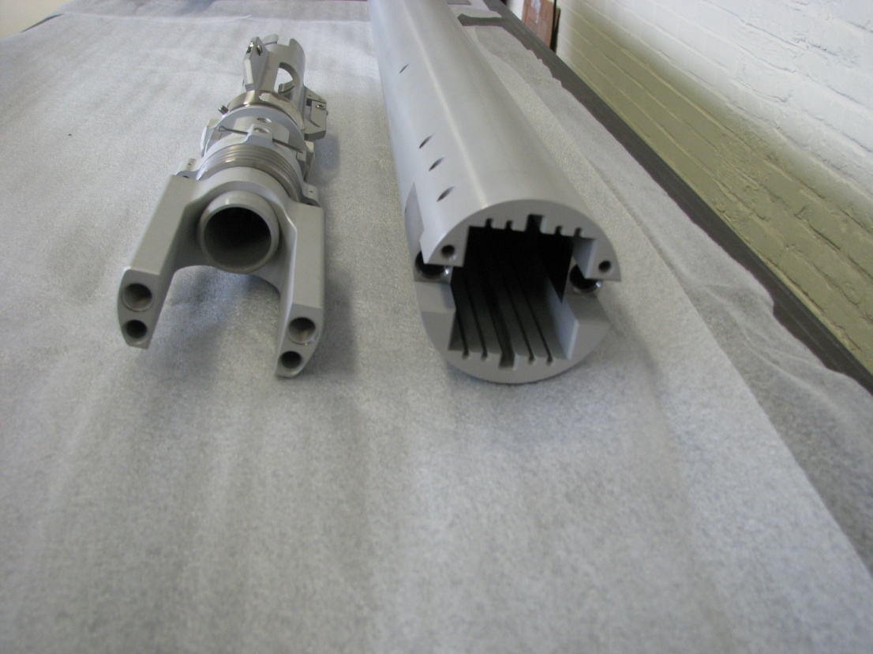
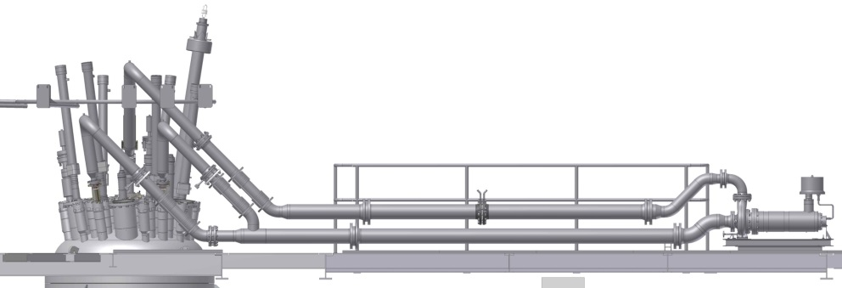


MTR fuel irradiation
Applications:
  Qualification of high density Low Enriched Uranium fuel for high performance MTRs
  Qualification of new fuel elemnt designs
Tools:
  Test baskets for plate irradiation
  Test loops for full element irradiations
Support:
  Advanced modelling of irradiation conditions
  Inter cycle inspections
  Non-destructive + destructive PIE

Slide 32


Modelling and experimental characterisation
Irradiation condition modelling
  Neutronics: fluxes and fission density
  Thermal hydraulics: temperature and power distribution
Characterisation
  Oxide thickness
  Swelling
  Microstructure en FP distribution

Slide 33




Dispersed Umo characterisation
Failure modes:
Buckling
Blistering

Slide 34


Simulation of Jules Horowitz Reactor: the EVITA loop
Full scale RJH element qualification
Representative thermal hydraulic simulation
Open cooling system

Slide 35



On-line power and flux monitoring
Silicide fuel was qualified up to nominal power and burn-up of the Jules Horowitz Reactor!

Slide 36
Content
General characteristics of the BR2 reactor
  Historic perspective
  Core characteristics
  Supporting facilities
Utilisation
  Radio-isotope production
  Semiconductor irradiation
  Material testing
    Structural materials
    Nuclear fuel
Summary and conclusions

Slide 37
BR2 provides SCK●CEN with
A powerfull and flexible tool for
  Production of radio-isotopes and semi-condutors
  Studies of irradiation induced ageing of reactor construction materials
  Performance studies and qualification of nuclear fuel in normal and abnormal conditions
In order to do so it needs
  High performance and efficient irradiation rigs, supported by an in-house design and construction capability
  Top level pre- and post irradiation testing facilities
  Efficient logistics
  An effective maintenance and renewal programme

Slide 38
The future of BR2
Although the facility celebrated its 50th aniversary in 2013
  It is permanently kept in good shape
  It is being prepared for the future periodic safety reassessment period (2016-2026)
The BR2 reactor will undergo an extensive overhaul in 2015
  To replace its Be core
  To perform major maintence operations and inspections
  To be upgraded to conform to the future’s challenges

Slide 39
Copyright © 2013 - SCK•CEN
PLEASE NOTE!
This presentation contains data, information and formats for dedicated use ONLY and may not be copied, distributed or cited without the explicit permission of the SCK•CEN. If this has been obtained, please reference it as a “personal communication. By courtesy of SCK•CEN”.
SCK•CEN
Studiecentrum voor Kernenergie
Centre d'Etude de l'Energie Nucléaire
Belgian Nuclear Research Centre
Stichting van Openbaar Nut
Fondation d'Utilité Publique
Foundation of Public Utility
Registered Office: Avenue Herrmann-Debrouxlaan 40 – BE-1160 BRUSSELS
Operational Office: Boeretang 200 – BE-2400 MOL

