Slide 1
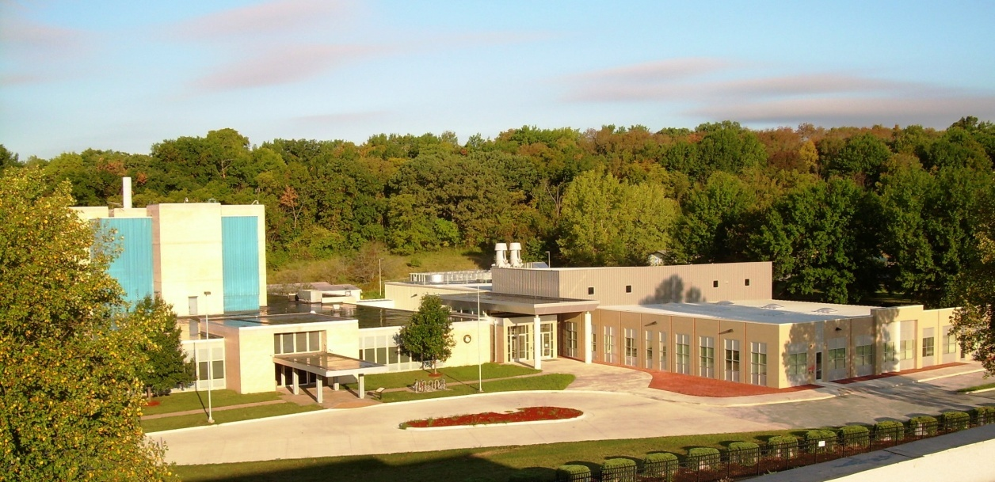
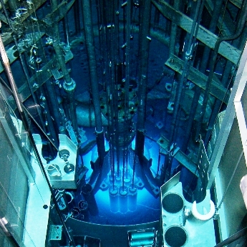
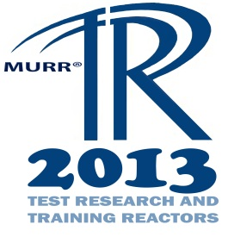
Control Blade Design and Fabrication Improvements using Laser Welding
Les Foyto, Associate Director
John Fruits, Reactor Manager
Carl Herbold, Assistant Reactor Manager

Slide 2
Overview
MURR Facility
Control Blade History
Project Background
The Part
The Idea
Making It Happen
Lessons Learned
Q & A

Slide 3
History of MURR
Located in Columbia, Missouri
October 13, 1966 – Facility established initial criticality and licensed to operate at 5 MWs
July 18, 1974 – Facility uprated to 10 MWs
September 1, 1977 – Facility starts a 10 MW, 150-hour-per-week operating schedule
September 1, 2006 – Facility submits 20-year license renewal application to the NRC

Slide 4
Key Reactor Parameters
MURR® is a pressurized, reflected, heterogeneous, open pool-type, which is light-water moderated and cooled
Maximum thermal power – 10 MW
Peak flux in center test hole – 6.0E14 n/cm²-s
Core – 8 fuel assemblies (775 grams of U-235/assembly)
Control blades – 5 total: 4 boral shim-safety, 1 SS regulating
Reflectors – beryllium and graphite
Forced primary coolant flow rate – 3,750 gpm (237 lps)
Forced pool coolant flow rate – 1,200 gpm (76 lps)
Primary coolant temps – 120 °F (49 °C) inlet, 136 °F (58 °C) outlet
Primary coolant system pressure – 85 psia (586 kPa)
Pool coolant temps – 100 °F (38 °C) inlet, 106 °F (41 °C) outlet
Beamports – three 4-inch (10 cm), three 6-inch (15 cm)

Slide 5
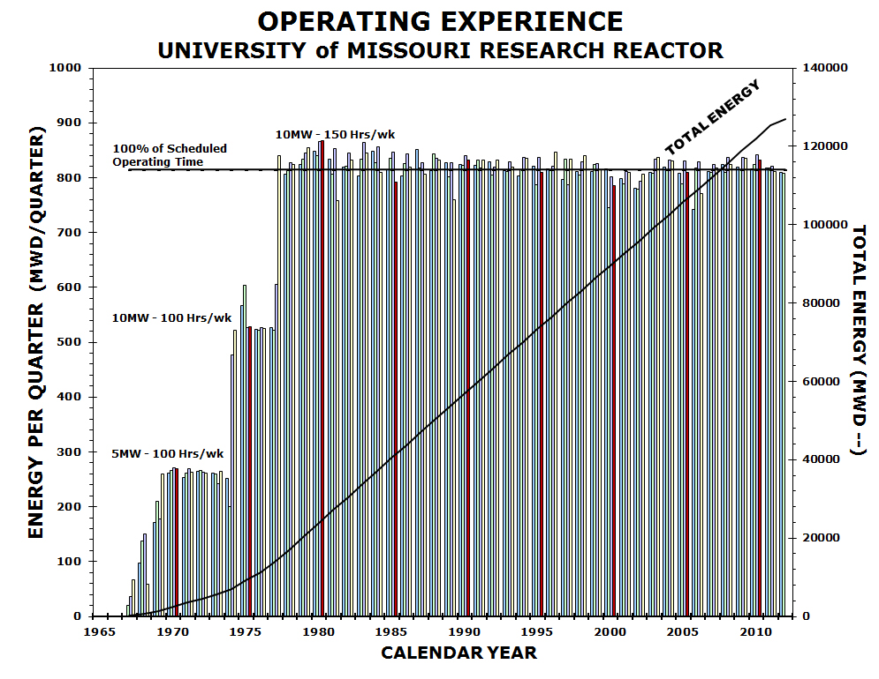

Slide 6
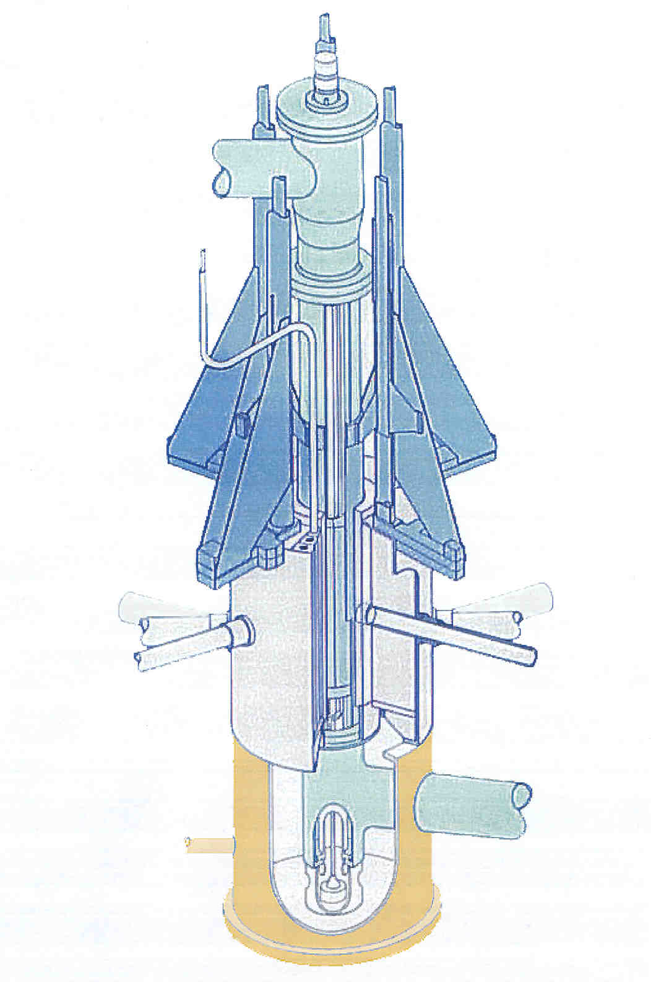
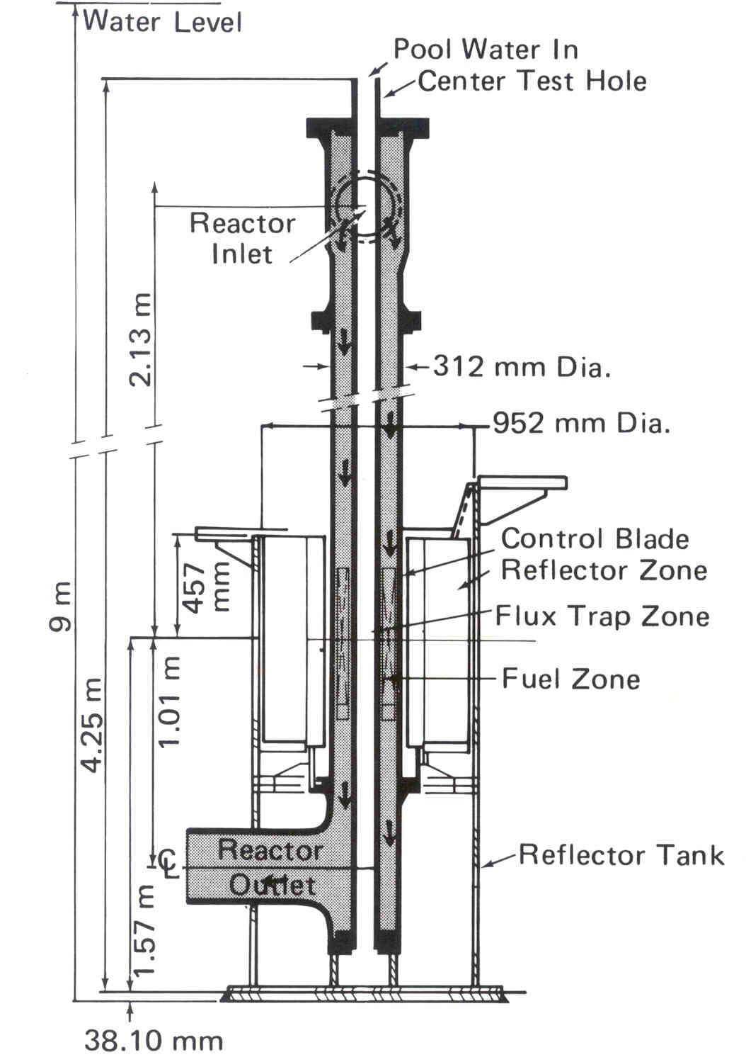
Reactor Core Assembly
Control
Blade
3-D View
2-D View
Notes:
Show fueled region.
Show flux trap area.
Show primary coolant flow path.
Show pool coolant flow path.

Slide 7
Previous Control Blade History
2006 Contracted vendor ceases production, sells remaining material and equipment to MURR.
2008-2010 MURR produces several control blades using Tungsten Inert Gas (TIG) welding with moderate success.
2010 Laser welding is explored.
2012 Laser welding is used to produce MURR control blades.
2012 First laser welded blade is placed on service in MURR reactor.

Slide 8
Project Overview
Our overall task was to produce enough qualified Control Blades to serve the needs of MURR into the foreseeable future.
Our specific task was to improve the sealing of welds in the manufacturing of Control Blades.
In considering laser welding, we sought the help of a well-respected Laser Services job shop.
Their development work and resulting feedback on coupon welding was invaluable.

Slide 9
The Part
The MURR control blade is a composite of sintered BORAL® clad in Aluminum.
Four blades are used as shim safety rods – can be dropped from electromagnets to ensure safe reactor shutdown.
Each blade occupies a circular arc of 72 degrees between the outer reactor pressure vessel and the Beryllium reflector, in a water gap roughly one-half inch across.
Each blade is mounted to an offset mechanism and controlled via the electromagnets by a drive mechanism.

Slide 10
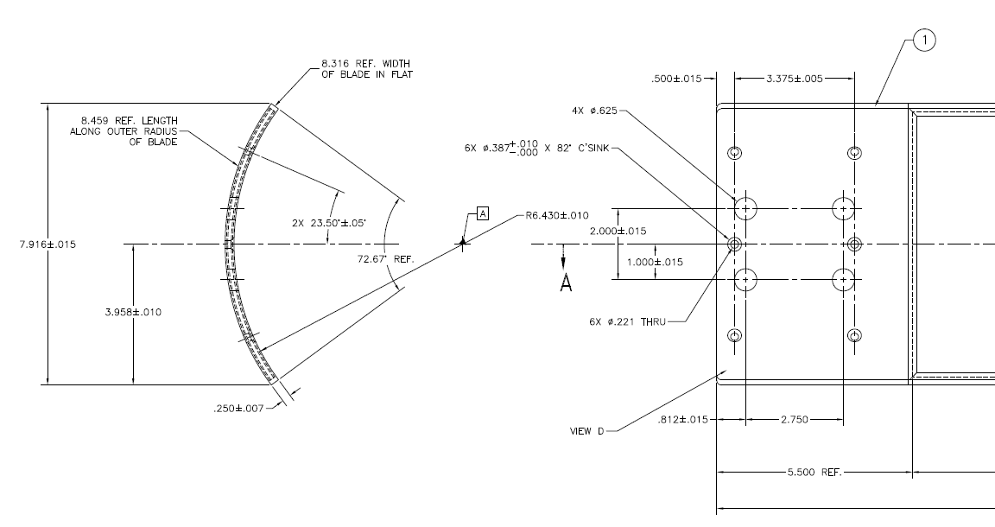
The Part

Slide 11
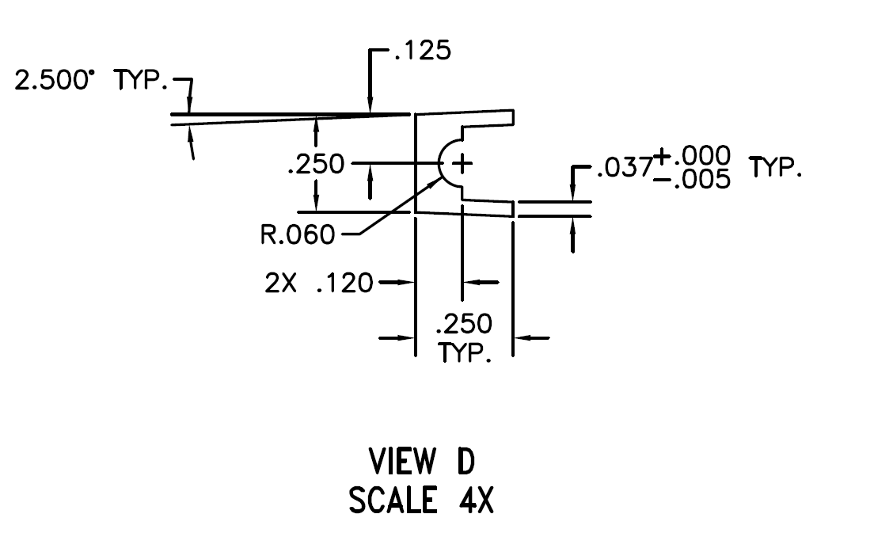
The Part
An edge channel is welded to the entire perimeter of the BORAL® plate.

Slide 12
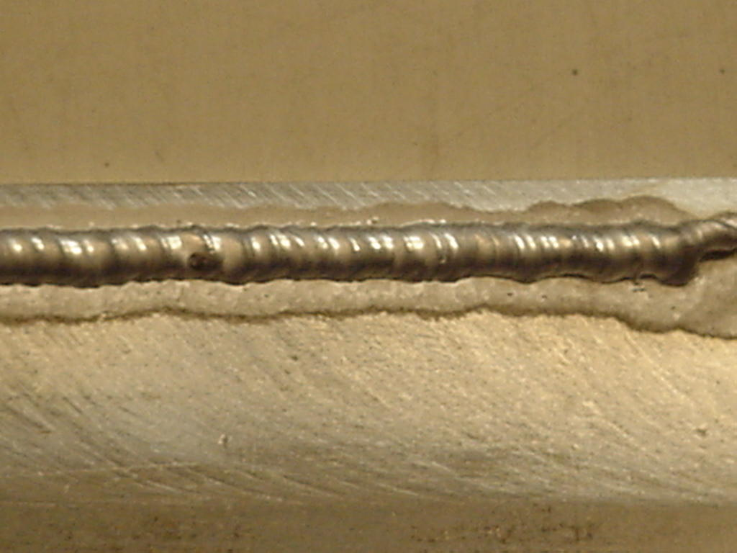
The Part
TIG welding produced a large heat-affected zone, required grinding and often resulted in boron contamination of the weld.

Slide 13
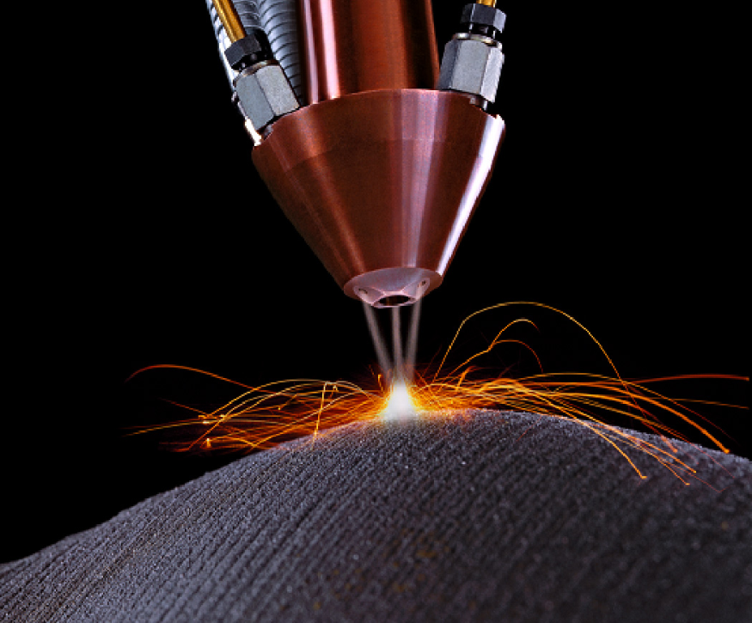
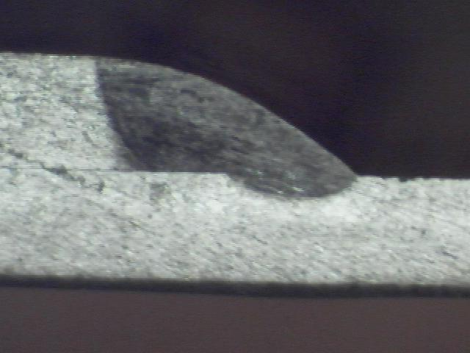
The Idea
Laser welding offered a much smaller heat-affected zone, no grinding and the promise of preventing weld contamination.

Slide 14
Making It Happen
Laser welding came with the tradeoff that a better fit between parts was needed.
Alloy 1100 needed alloy 4047 to work.
Fixturing was developed to ensure better fitments.
The outside channel was replaced with alloy 4047, including the top channel, which was incorporated into the top mounting plate.

Slide 15
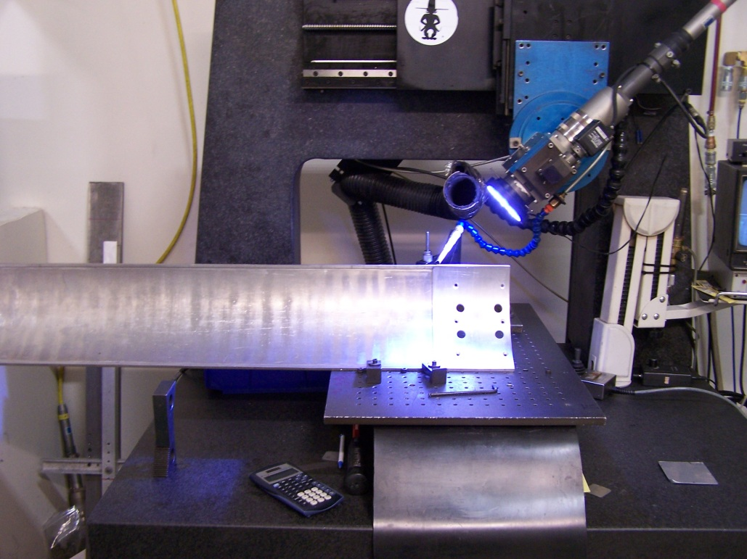
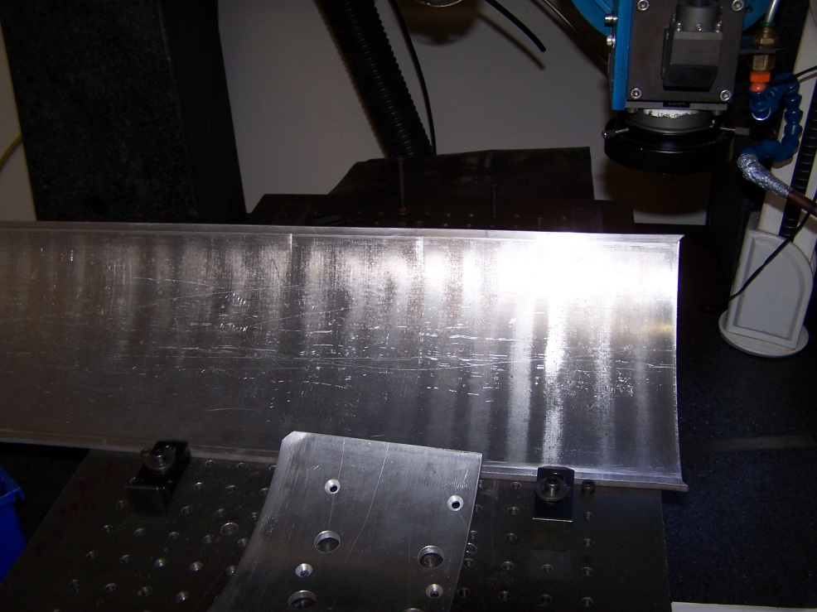
Making It Happen
Head Piece
Laser Head
- Lens
- Camera
- Argon Supply

Slide 16
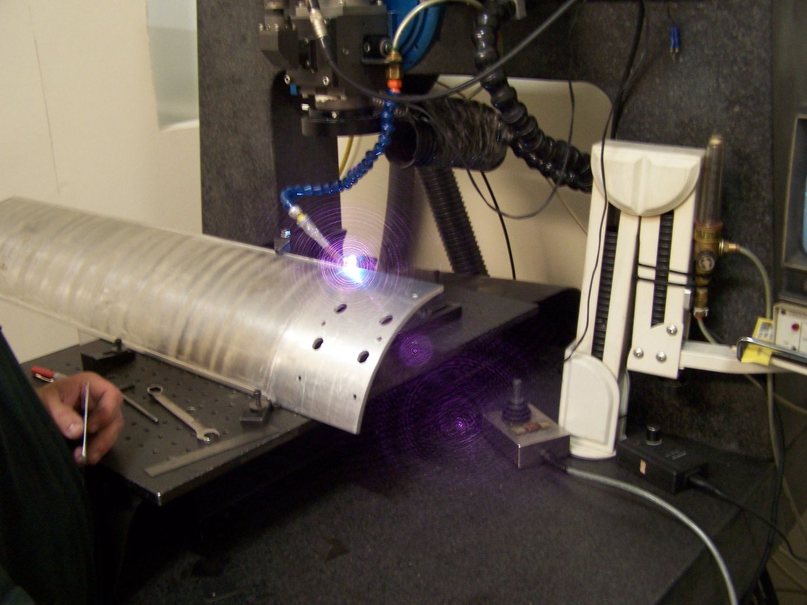
Making It Happen
Really High Tech

Slide 17
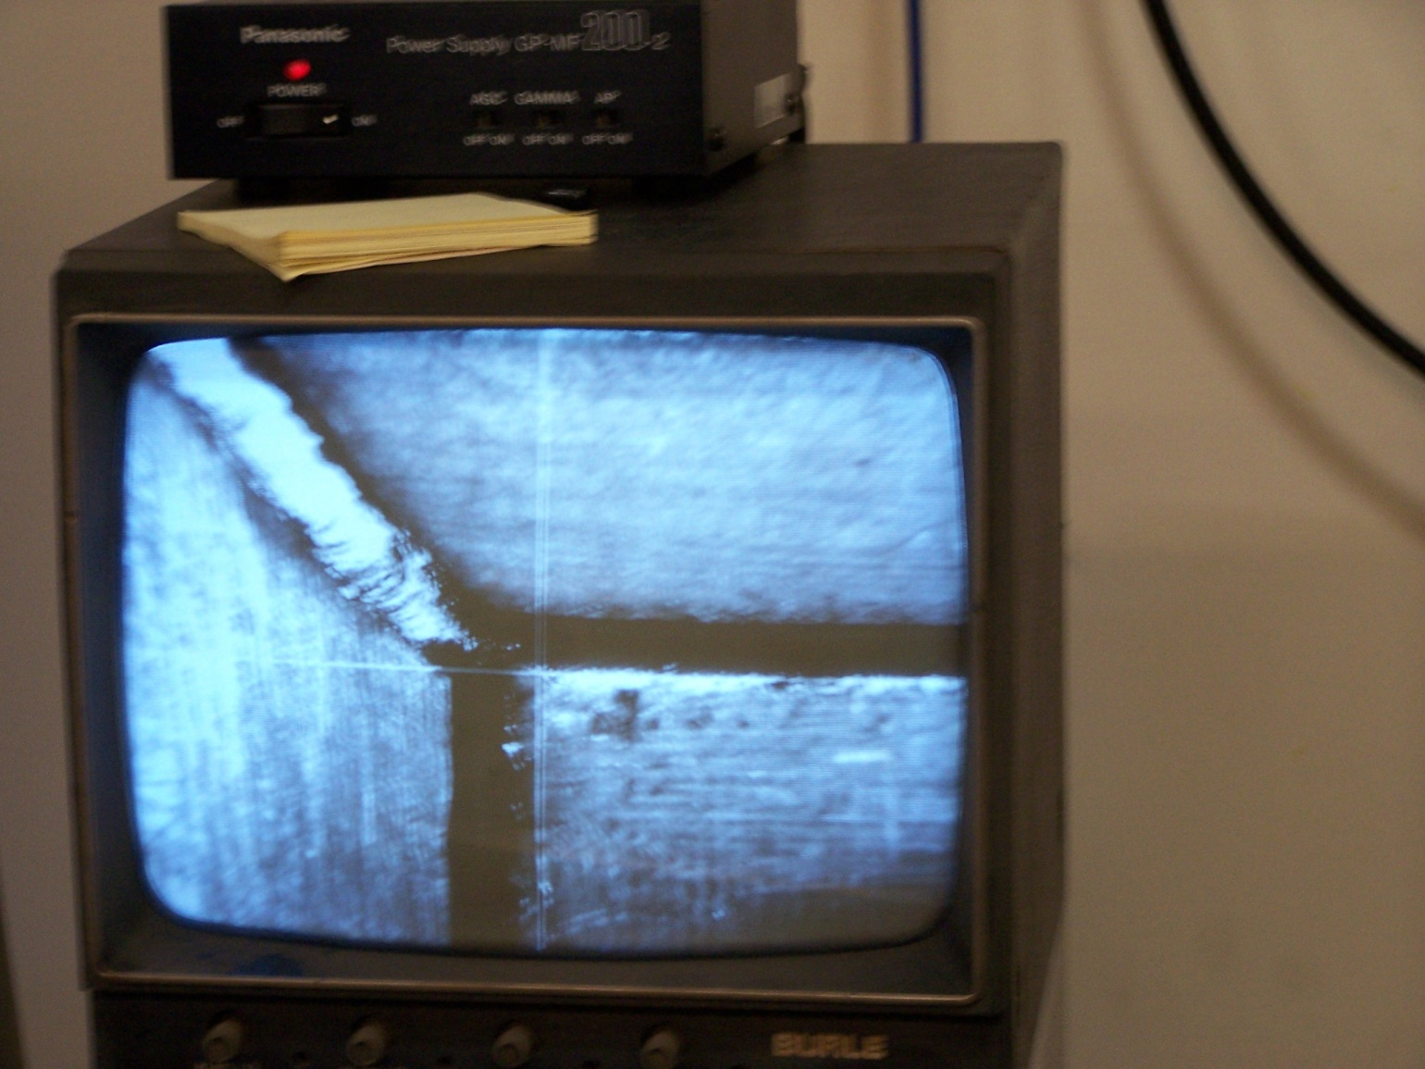
Making It Happen

Slide 18
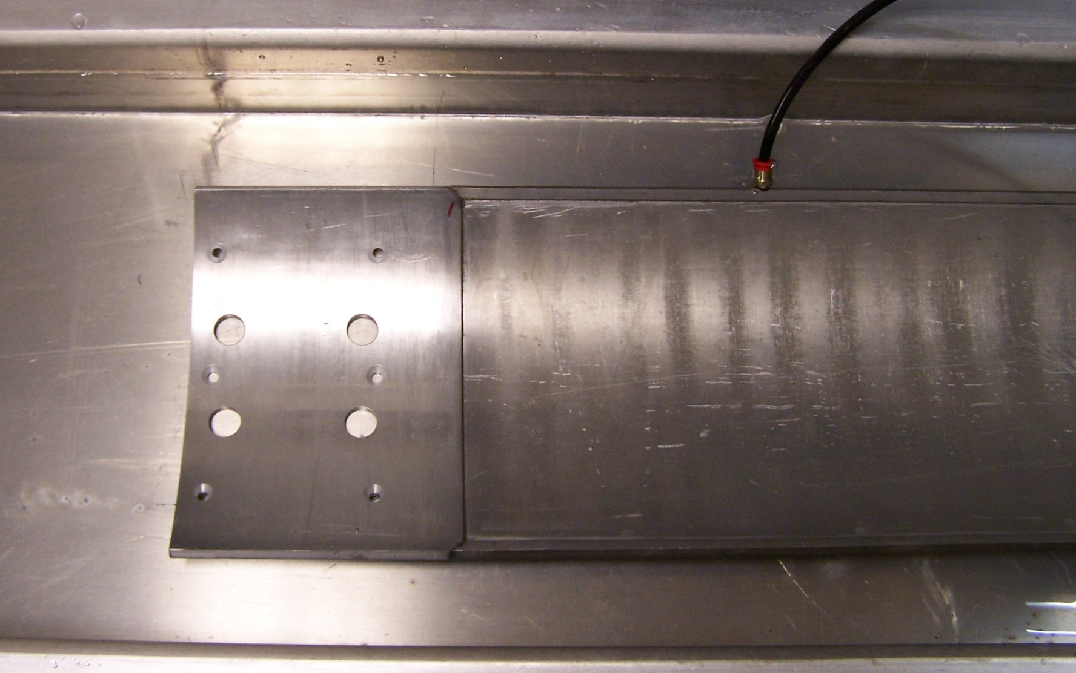
Making It Happen
Nitrogen applied inside channel

Slide 19
Making It Happen
Modification Record documentation was performed to capture design changes and to authorize laser welding as a fabrication alternative.
10 CFR 50.59 documentation was performed to ensure reactor safety and regulatory compliance.
The first laser welded blade was placed into service in December, 2012.

Slide 20
Lessons Learned
Laser welding meets the objectives of producing leak-free control blades, but comes with its own challenges.
Proper fit of the parts becomes a major focus of the effort.
Weld repairs can be done more easily.
Quality still depends greatly on the skill of the welder.

Slide 21
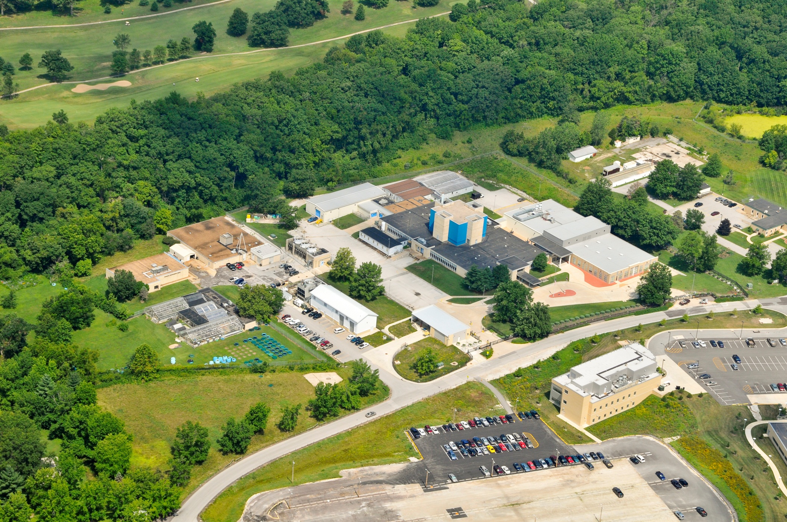
Thank You For Your Attention,
Any Questions???

