Slide 1
TRTR Members – What About the Health Effects of Radiation?
Presented at the TRTR Annual Meeting
September 2013 at St. Louis MO
by
Jay F. Kunze
Reactor Administrator (and Emeritus Prof.)
Idaho State University
(and Emeritus Prof. from Univ. of Missouri)

Slide 2
The Dilemma
The USA had 104 operating nuclear plants. In the last year four were shut down (now only 100 operable, 99 by June 2014). Three of the four shutdowns were because of anti-nuclear pressure, resulting in delays and approval uncertainties, essentially the result of public fears of radiation.
The Fukushima tsunami killed 20,000, destroyed 4 (maybe 8) nuclear power plants, and resulted in most of Japan’s 50 reactors still not allowed to operate, all because of fear of radiation.

Slide 3
There is more paranoia
Fear of a CT-scan, whole body giving a dose of ~ 2 Rads (20 milligray)
Fear of a dental x-ray (~10 mRad (0.1 milligray)
ALARA levels for workers as low as 100 mREM per year (1 milliSv per year)
A recent worker at the INL who received a Pu inhalation dose less than the average received by 26 soldier machinists on the Manhattan project. The INL worker is mentally suffering with fear. The soldier machinists lived well beyond the average age of their comrades who were unexposed.

Slide 4
What do TRTR folks believe?
Does any gamma ray have a probability of giving us cancer?
Are we prone to a significant increase in cancer if we go over our organization’s ALARA limits?
Is there a threshold of radiation dose below which there is no negative health effect? (The LNT hypothesis says “no.”)
Is there any proof that the LNT and the Collective Dose Hypothesis are not valid?

Slide 5
A Tribute to Dr. T.D. Luckey
Prof. Emeritus and 14 years Dept. Chair of Biochemistry at University of Missouri
Nat. Academy of Science Subcommittee on Interaction of Nutrition and Infections
Author of two volumes on Radiation Hormesis, 1980 and 1991 publications
Co-author of “Metal Toxicity in Mammals” and “Heavy Metal Toxicity, Safety, and Hormology
Nutrition consultant for Apollo space flights
Lectured internationally on radiation hormesis since 1979

Slide 6
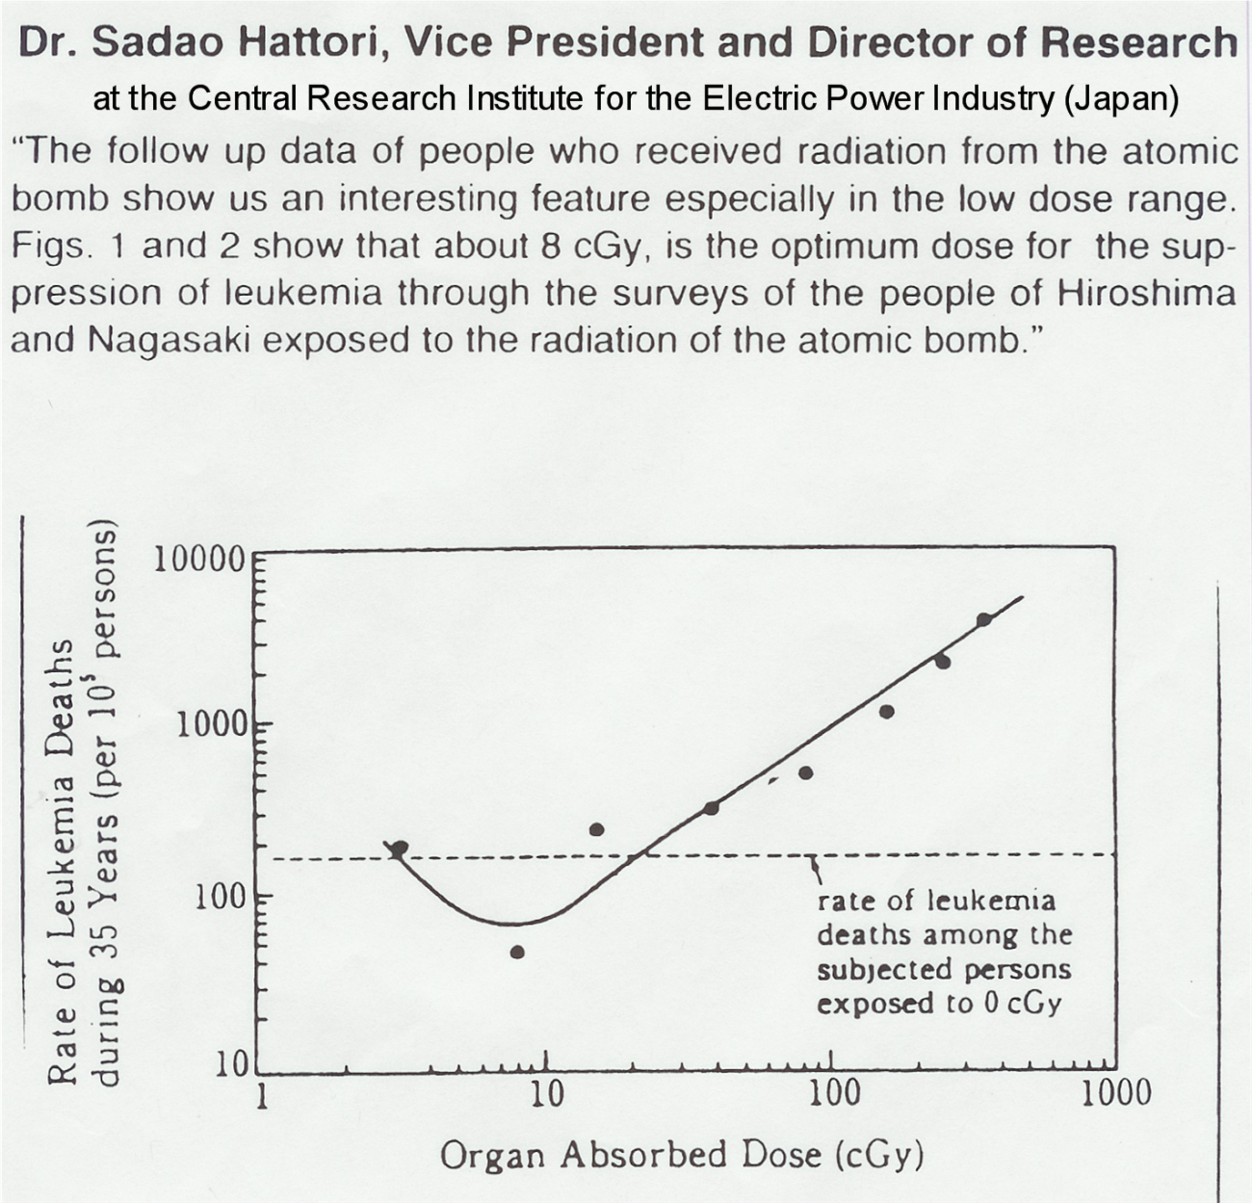
Japanese Bomb Survivors

Slide 7
History of Discovering Hormesis of Ionizing Radiation
~1978 – The UNSCEAR data from atomic bomb survivors showed an anomaly at 10 cGy.
1981 – Dr. T.D. Luckey published “The Hormesis of Ionizing Radiation” – contained 1600 references of low to moderate doses of radiation being beneficial to health of plants and animals.
1982 - Society of Nuclear Medicine published study of military personnel exposed in USA atomic bomb tests
1990 - 2nd Edition of Luckey’s book
1993 – Radiation Science and Health formed at Worcester Polytechnic Institute in Massachusetts, and continues to bring forth the data that refutes the LNT hypothesis, and also the Collective Dose Hypothesis

Slide 8
Most Recently
Three ANS Presidents - Alan Walther (1999-2000), Larry Foulke (2004-1005) and Eric Loewen (2011-2012) have championed the Hormesis of Radiation concept during their terms as president.
Otto Raabe, former Health Physics Society President, has strongly promoted the concept as well as the studies of the cancer development, requiring continued “promotion.” The stochastic model for cancer is FALSE.

Slide 9
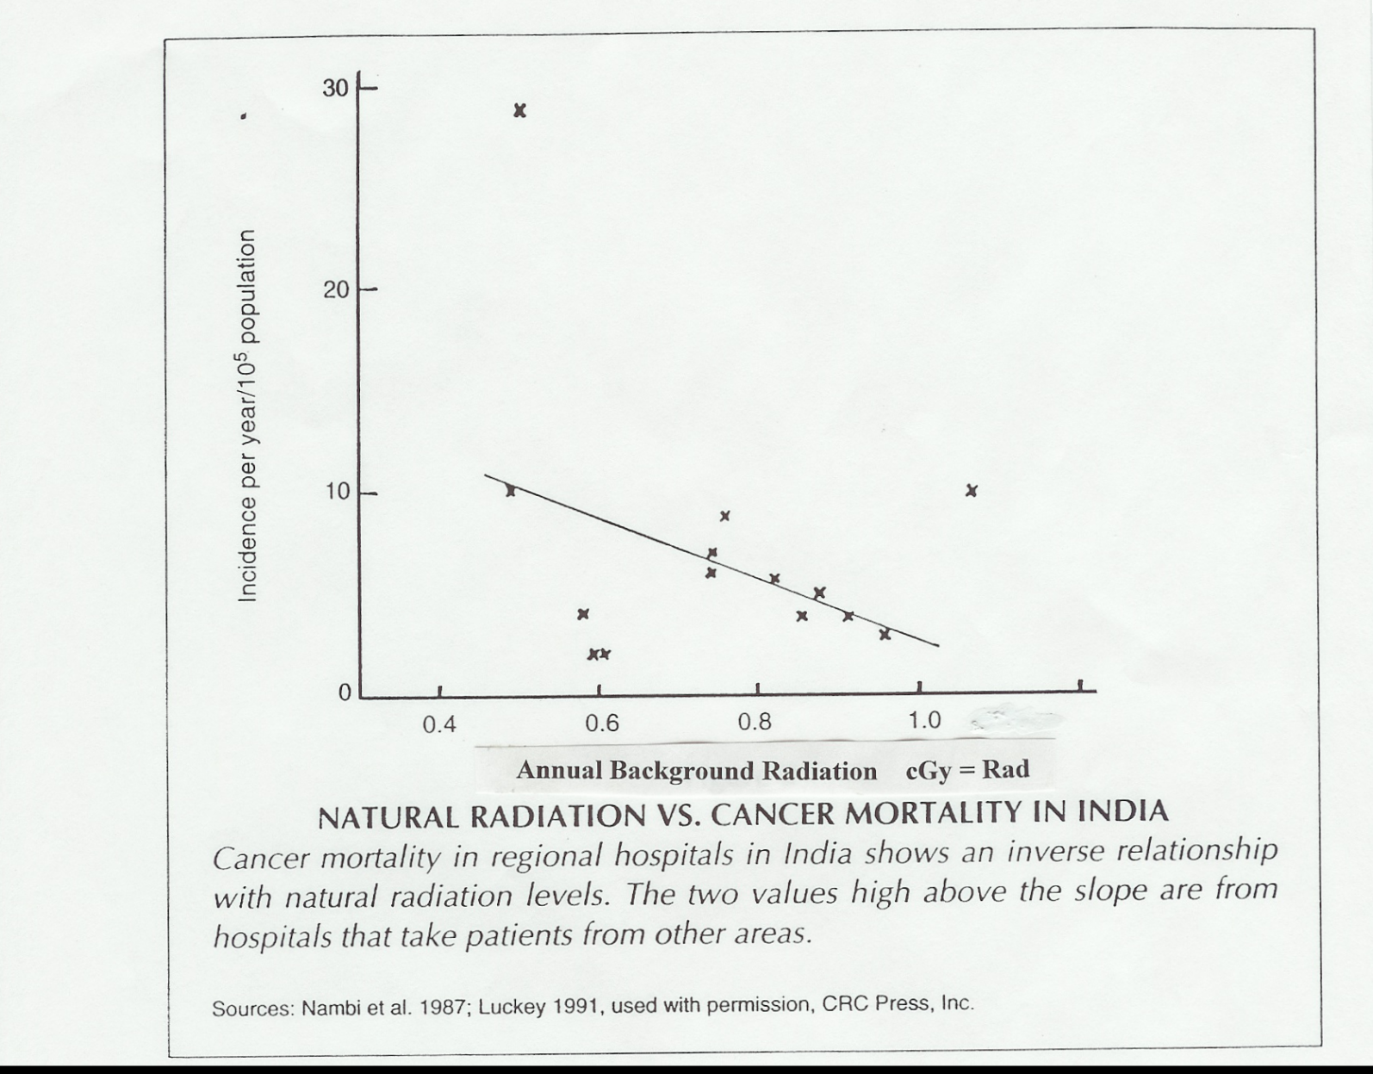
Natural Background in India

Slide 10
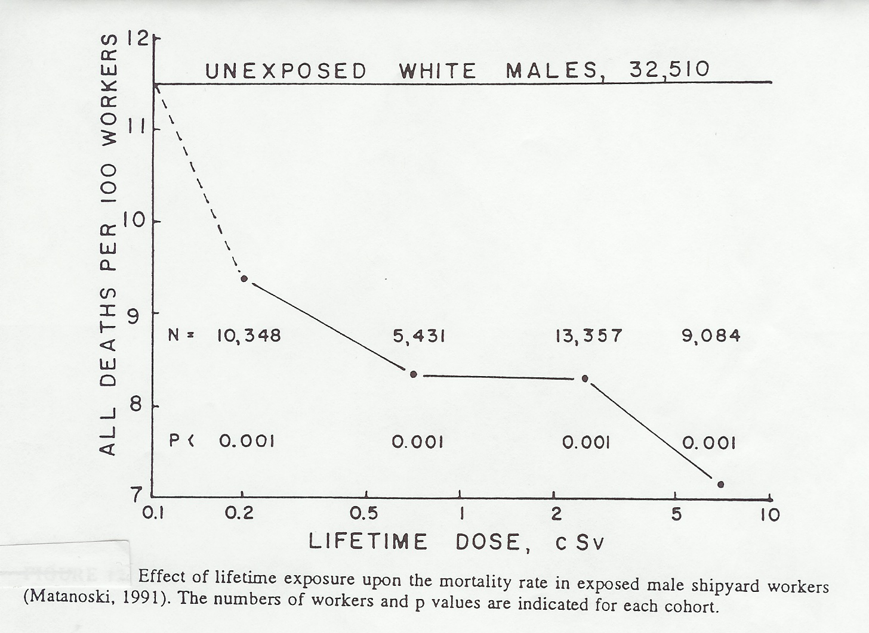
USA Nuclear Shipyard Workers

Slide 11
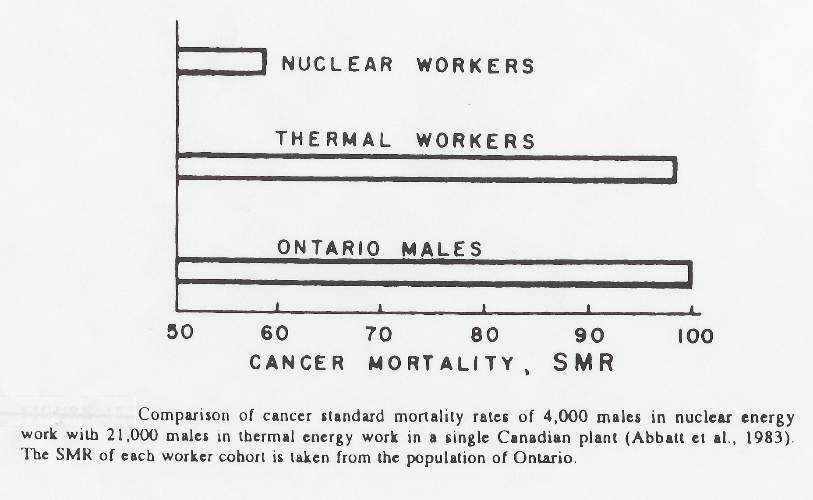
Canadian Ontario Hydro Workers

Slide 12
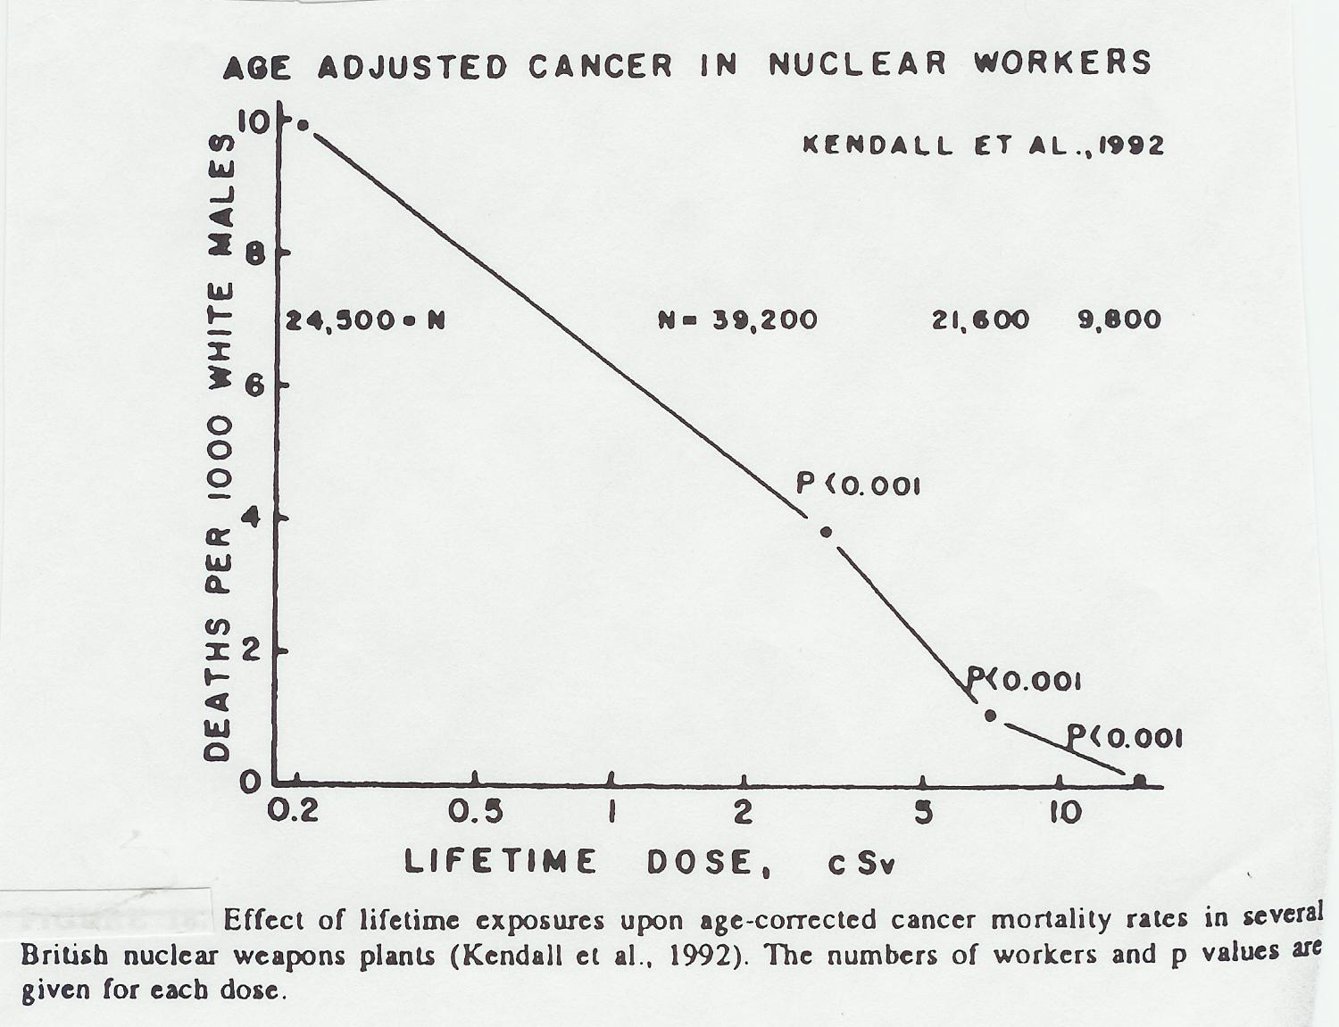
British Nuclear Weapons Workers

Slide 13
Radon - Inert Gas, 3.7 days half life
Radon (an inert gas) is a decay product of uranium-radium decay chain – naturally occurring in the ground. The radon decay products are solids, alpha particle emitters. These lodge in the lungs, promoting cancer.
During energy crisis of early 1980s, in USA homes were sealed from outside air infiltration. Radon seeped into basements. Using the LNT and Collective Dose Hypothesis from uranium miner mortality data, Dr. Bernard Cohen estimated ~20,000 die per year from radon exposure. (Still used today by EPA.)

Slide 14
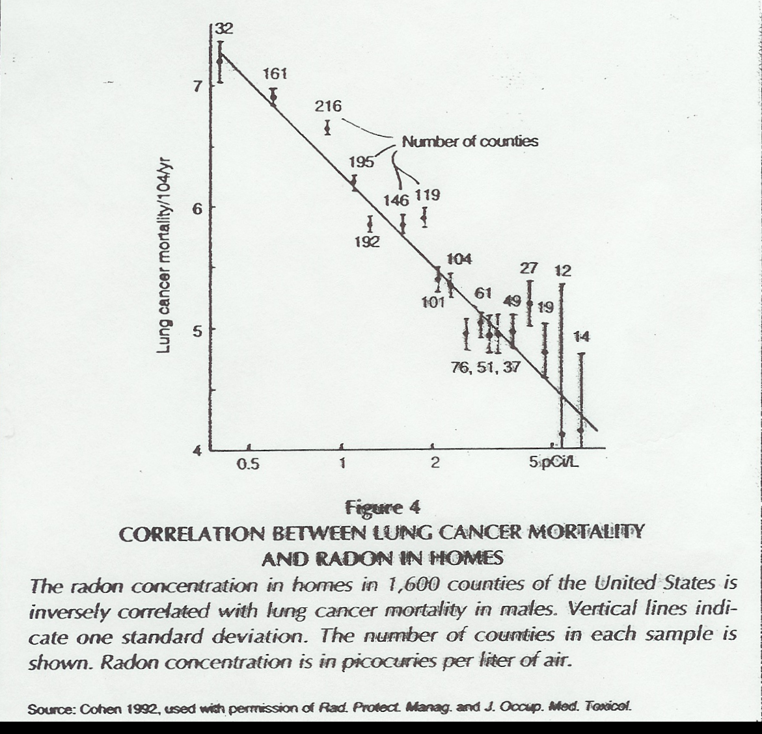
10 years later, the USA radon data

Slide 15
There is data on radiation required to promote cancer and death
Radium dial painters in the 1920s - about 1000 REM (10 Sv) was the threshold
Dog experiments: cancer threshold at least 100 Rads (1 Gy) acute dose, 10 Rads/day chronic
The seven human deaths in USA over the 70 year history of nuclear energy development has resulted estimating the LD(50, 30) as about 350 REM (3.5 Sv)
Cancer treatment is typically ~5000 Rad (50 Gy) administered in 20 daily doses of 250 Rad

Slide 16
The Aspirin Analogy
Example of Collective Dose Hypothesis
Aspirin is quite beneficial as a pharmaceutical, for various applications
But, taking 100 aspirin (an entire bottle) in a single dose will likely result in death.
Therefore, the risk factor is 1 death per 100 Person-Aspirins.
Hence, of 100 persons, each taking 1 aspirin, one will die!
In USA, ~ 100E6 aspirins taken per day, therefore aspirin is killing about one million each day in the USA!

Slide 17
Plutonium - and the case of the 26 young machinists who ingested plutonium dust into their lungs
The public media has labeled plutonium as “The most dangerous substance on earth.”
During construction of the atomic bombs used in World War II, 26 young machinists worked on shaping the plutonium bomb, and they breathed plutonium dust from the machining operation.
After the end of the war, it was realized that Pu has valence 2 characteristics, similar to calcium. Hence, Pu tends to go to the bones. It is also a potent alpha particle emitter, the most damaging of the basic decay products of radioactive isotopes.

Slide 18
Plutonium and 26 Young Men (continued)
Pu-239 has a 24,000 year half life. These young men were later scanned for radioactivity, and their lifetime (50 year) commitment from the Pu in their system was analyzed.
The average lifetime dose was 125 cSv, with the largest being 750 cSv.
They all were expected to have an early death from bone cancer.

Slide 19
26 Young Men and Their Pu Demise
(continued)
In 1995 a follow up study (50 yrs later) was done to determine how they had all died.
But only 7 had died, 3 from cancer, one had died from an accident.
19 were still alive and healthy (ages 69 to 76)
One wonders then how Plutonium can be “the most dangerous substance on earth”

Slide 20
Two False Hypotheses
LNT (linear no-threshold) - probability of the effect (cancer development or cancer mortality) extrapolating linearly from high doses to zero dose.
Collective Dose Hypothesis - usually using the BEIR V recommended factor of 800 deaths per million person-REM.* Then apply to a large population receiving low doses - i.e. EPA’s 20,000 deaths per year from Radon in homes, and projections of deaths from accident-releases of radiation from nuclear power plants.
*less than the 1400 deaths/million-person REM one obtains from inverting the 350 LD(50,30) figure

Slide 21
The Taipei “Experiment”
In 1982 several large apartment buildings were construction using radioactive re-bar (unknowingly)
The discovery of high levels of radioactivity in the apartments was made in 1992.
Over the 10 + year period, about 7,000 people were exposed to average radiation levels of 7.4 cSv, with the highest being 91 cSv.
About 270 of those should have died of cancer by 2005, per average Taiwan death rate.
But only 7 had been confirmed to have died of cancer – Reference papers by YC Luan (2002, 2003), W.L.Chen 2004
Note: a cancer incidence study by S.L.Hwang, 2006, found an increase in childhood leukemia. But other cancers were nominally the same or less than the normal population.

Slide 22
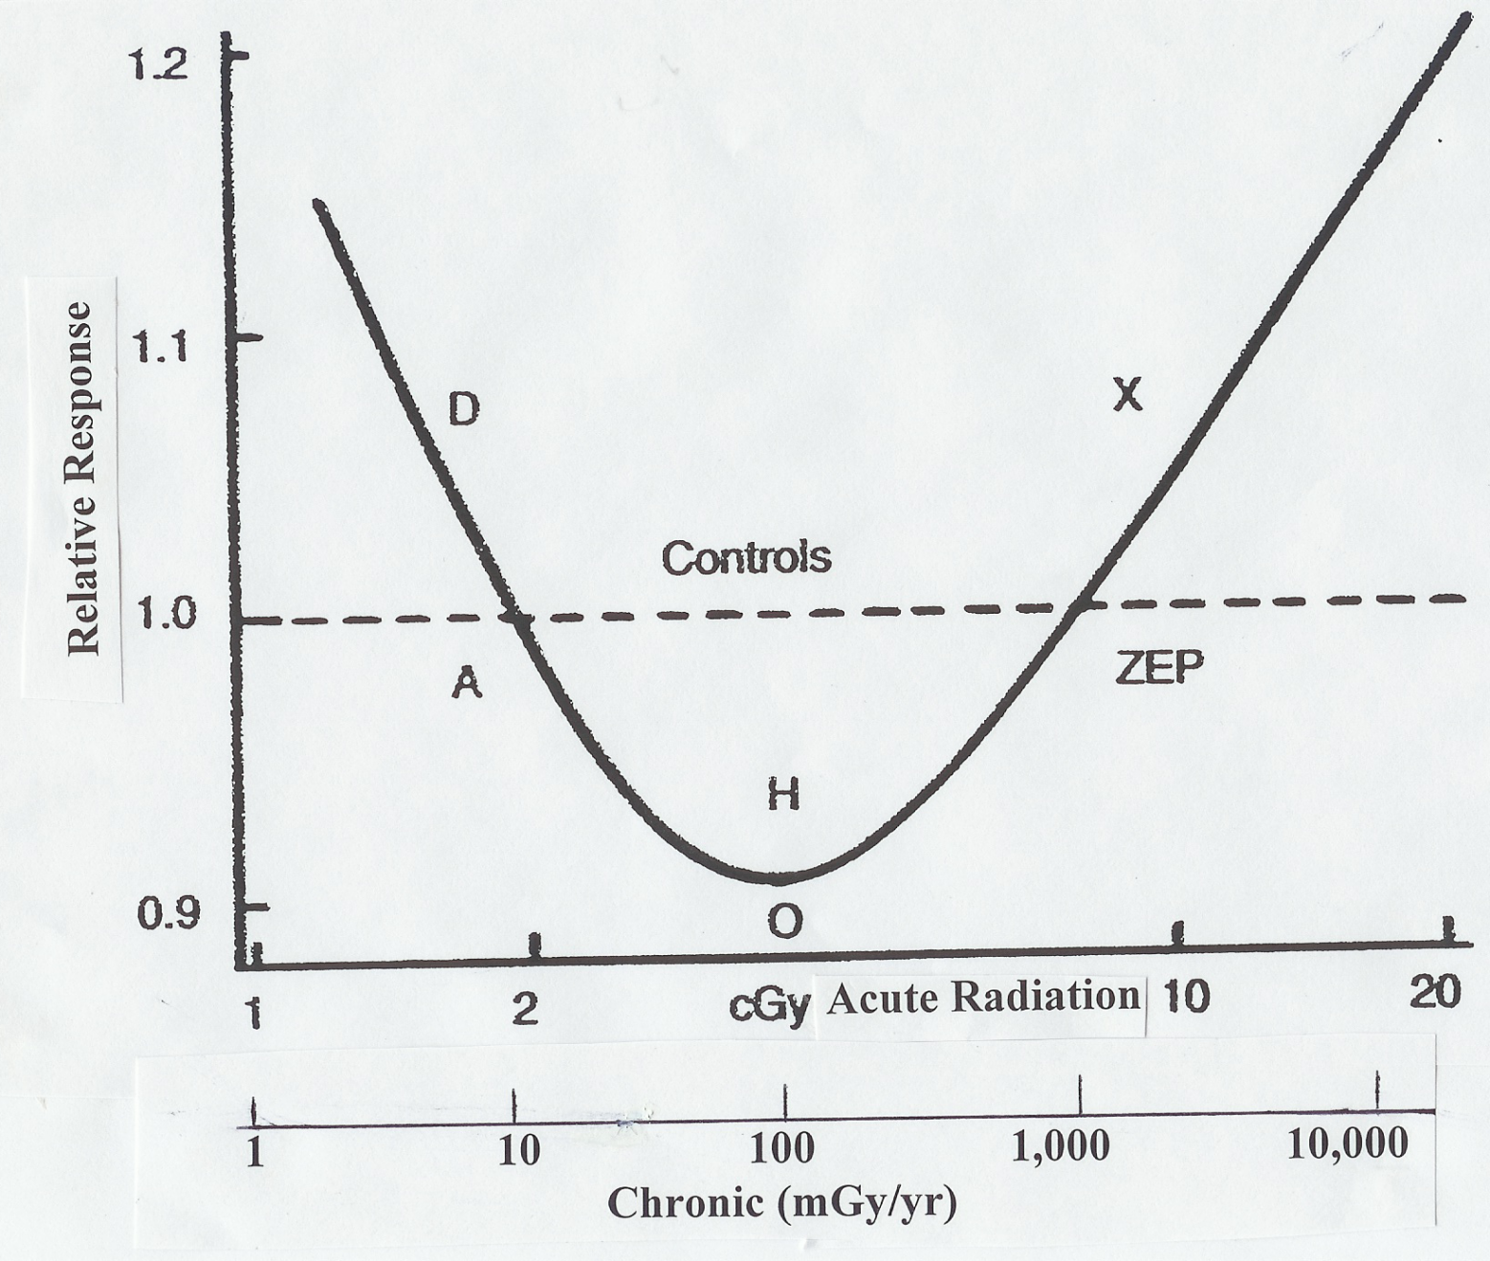
Summary of Low Level Rad. Effects
Concept Proposed by Dr. T.D. Luckey from cancer mortality, growth, lifespan, and reproduction data

Slide 23
Action Needed
Eliminate ALARA - Some estimates have been made of the cost of reducing collective dose for a commercial power plant by one person-REM is conservatively ~$10,000.
Fukushima cleanup would be facilitated. If nuclear worker limits were restored to the previous 5 REM (50 milli Sv) per year, then nuclear workers could be in average fields of 25 micro Sv/hour (2.5 mREM/hour) - Luckey’s conclusion is that the optimum health benefit is 2x this.
Contamination tolerable levels should be more realistic. Health physics can measure extremely low levels, can projections to levels of concern can be reliably made.

Slide 24
SUMMARY
Why is this issue important?
Radiation in low doses is not only harmless, but actually beneficial to health, up to 10 REM/year chronic, 5 REM acute dose
It is important for the public to know this so that they will not be fearful of
medical x-ray and CT procedures
and of nuclear power
So that regulatory bodies will not require as stringent controls on cleanup projects, costing huge amounts of money unnecessarily spent to protect public health to levels of exposure that are an order of magnitude below background.
Recent Ref.: “ANS President’s Special Session on Low Level Radiation”, Chicago, June 25, 2012

