Slide 1
NRC Perspective: 2013 TRTR Conference
Michael Johnson
Deputy Executive Director for Reactor and Preparedness Programs
Office of the Executive Director
September 24, 2013

Slide 2
Key NRC Priorities
Fukushima
Waste Confidence (ML131224A106)
Cyber Security (10 CFR 73.54)
Cumulative Effects of Regulations
Small Modular Reactors
Safety Culture

Slide 3
Budget, Hiring, and Grants
Budget and Sequestration
NSPDP and 2014 summer vacancy is posted on USAjobs
Summer internship posting closes the 18th of November
NSPDP closes the 19th of November
Grants webpage:
http://www.nrc.gov/about-nrc/grants.html

Slide 4
Types of Grants Awarded in 2013
Scholarships
For undergraduate students; Max $10,000 each
2 years/up to $200,000 to the institution
Fellowships
For graduate students; Max $50,000 each
4 years/up to $400,000 to the institution
Faculty Development
For probationary, tenure-track faculty during the first 6 years of their career and new faculty hires
3 years / up to $600,000 to the institution
($450,000 from NRC; $150,000 institution match)

Slide 5
FY 2013 Grant Awards
48 TOTAL AWARDS:
12 Scholarships
17 Fellowships
7 Trade School/Community College
Scholarships
12 Faculty Development
Awards posted to Grants webpage:
http://www.nrc.gov/about-nrc/grants/awards.html

Slide 6
Plans for FY 2014
FY 2013 grants were issued on August 1, 2013; Curriculum grants were not awarded due to sequester
Funding is uncertain for FY 2014---The deadline has not been established. The announcement will probably be posted on grants.gov in October; deadline will be 30-60 days later.
Current FY 2014 House budget language includes direction to NRC to fund $15M for the all but curriculum grants
FY 2014 may be affected by a proposed Federal Reorganization of STEM Education
Includes NRC’s scholarships, fellowships, and curriculum development grant programs (may not include faculty development)

Slide 7
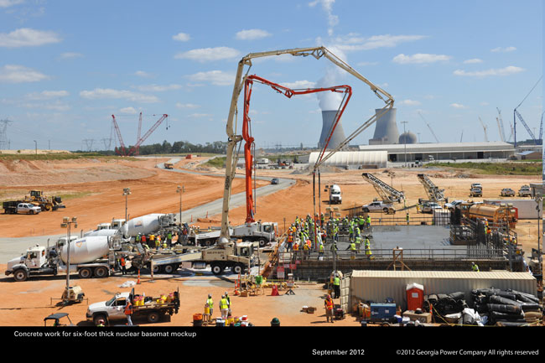
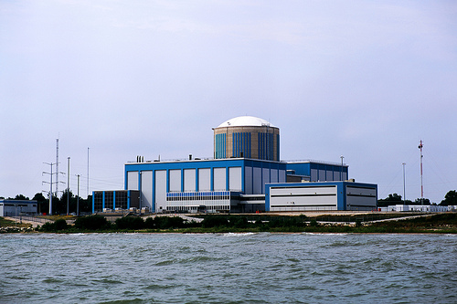
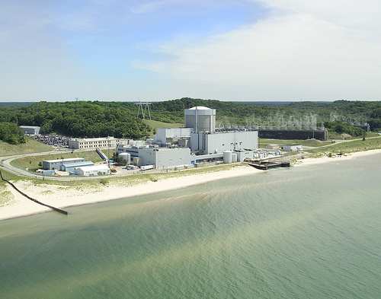
Focus Areas Special Interest Facilities
San Onofre
Fort Calhoun
Honeywell
Palisades
Kewaunee/ Crystal River
Vogtle/Summer

Slide 8
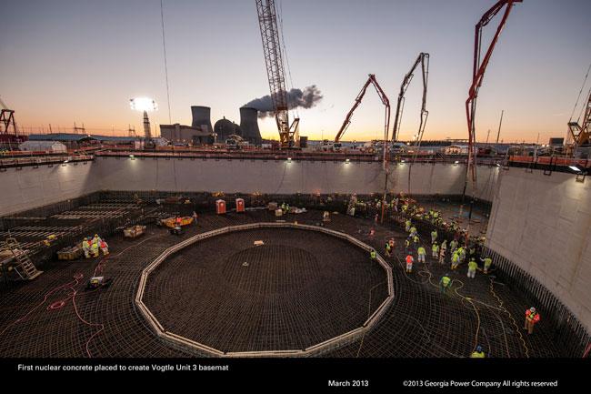
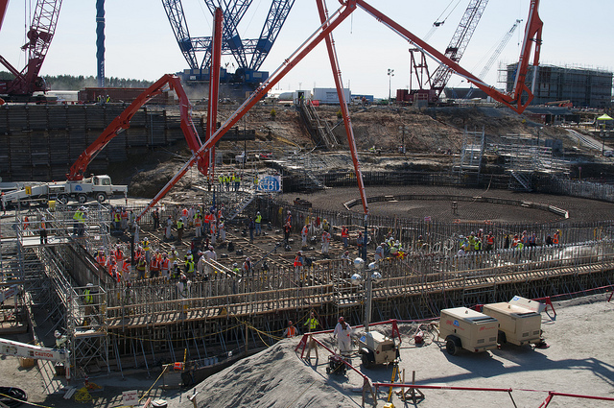
Vogtle and Summer Concrete Pour
Vogle - basemat
Summer - Concrete Pumps Placement

Slide 9
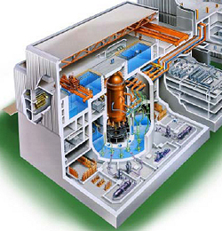
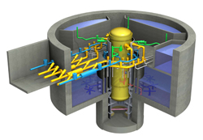
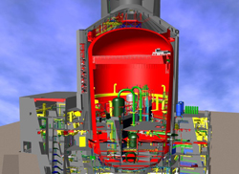
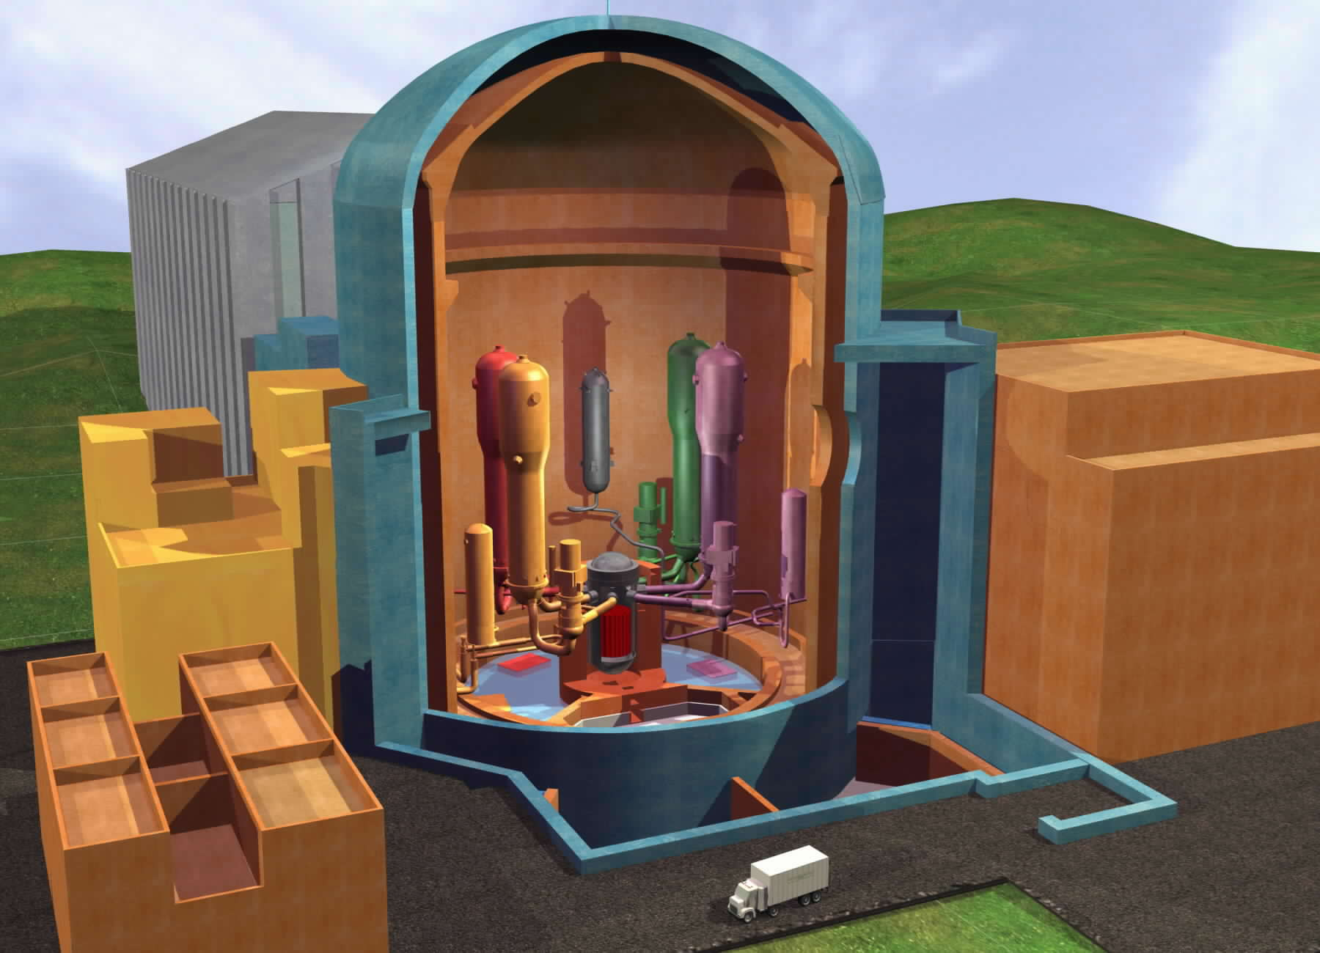
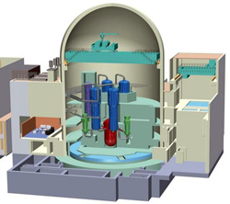
New Nuclear Plant Construction and Licensing Activities Worldwide
Construction and licensing of new nuclear power plants worldwide
New reactor licensing and construction in the U.S.
Licensing Process
Status of Licensing
Construction activities and Oversight
ABWR
ESBWR
AP1000
EPR
USAPWR

Slide 10
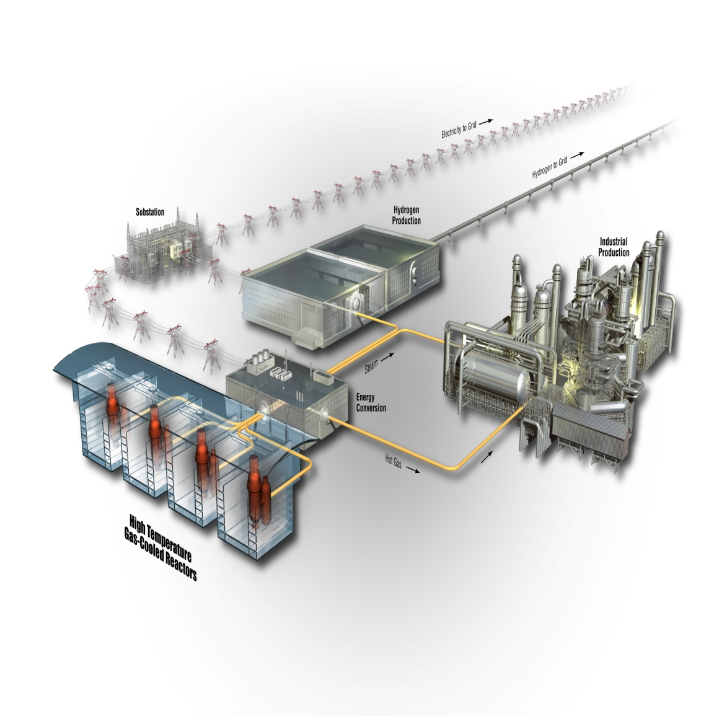
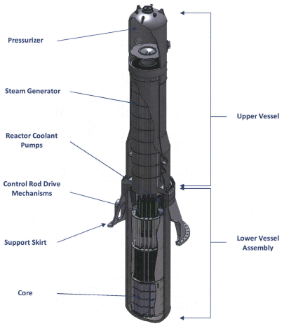
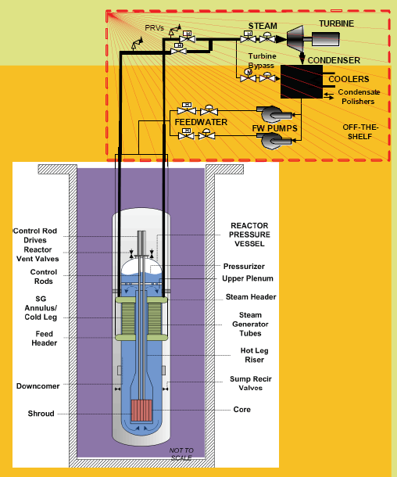
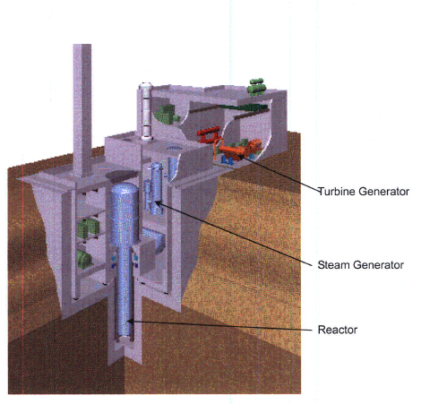
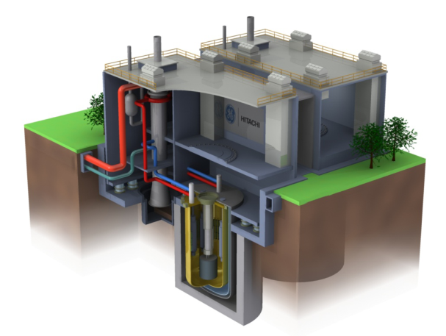
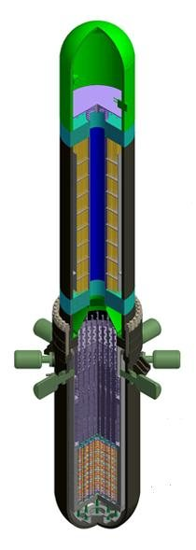
Advanced Reactors
Non-Light Water Reactors
iPWR Designs
High Temperature
Gas-Cooled Reactors (HTGRs)
Liquid Metal Reactors
B&W mPower
NuScale
PRISM
4S
Westinghouse
SMR
Holtec SMR-160

Slide 11
International Security
Nuclear Security Summits 2010 & 2012
Int’l Conference on Nuclear Security 2013
Int’l Physical Protection Advisory Service
Safety and Security Interface

