Slide 1
Transient Reactor Test (TREAT) Facility Restart Effort
Andy Beasley, Bradley Heath, Cody Race
TREAT Experiment Safety Engineering
2018 TRTR Meeting

Slide 2
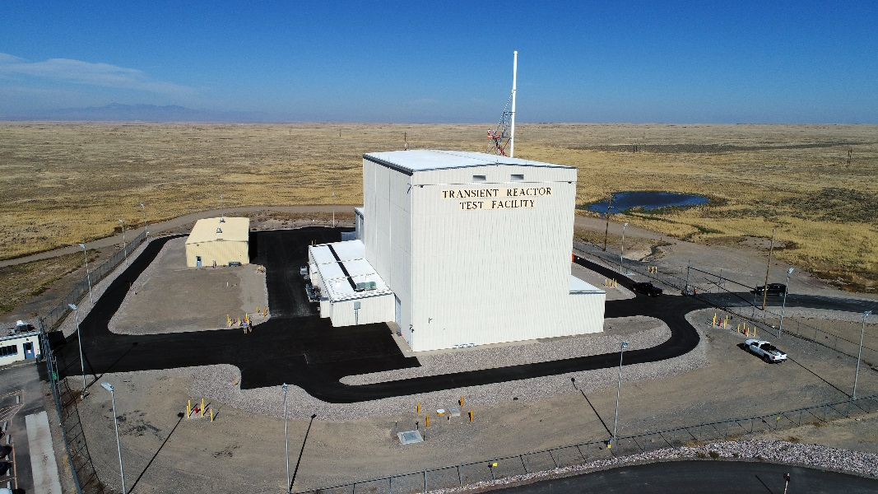


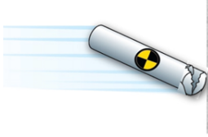
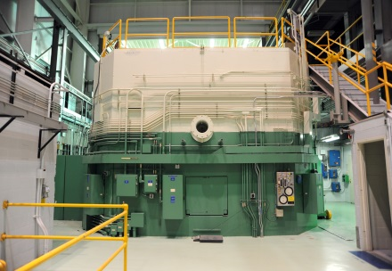
Background of the TREAT
Located at Idaho National Laboratory (INL)
Construction began 1958 and concluded in 1959
  $1.46 million in1959 dollars, $12.5 million 2018
Operated 1959 – 1994
  Performed nearly 3,000 transients
  Primarily supported testing of Integral Fast Reactor fuels
  Analogous to car crash testing but with nuclear fuel
  Placed in standby in 1994 with fuel in core

Slide 3
Background of the TREAT
Air-cooled, graphite moderated reactor
10,000:1 atoms C to atoms U
Steady state of 120 kW
Minimum Period of 0.023 s
Peak Power of 18,000 MW
Peak Energy of 2,900 MJ
Temperature Limited, clipped, or shaped (examples on next slide)

Slide 4
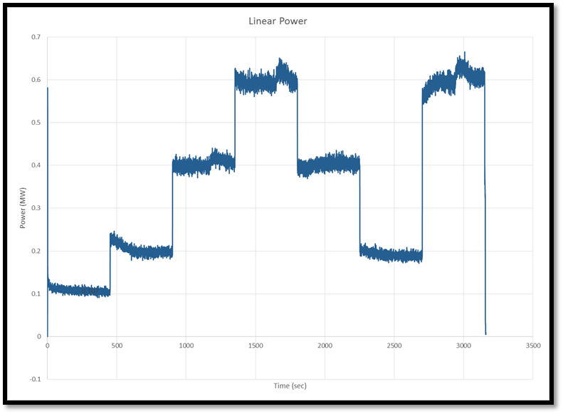
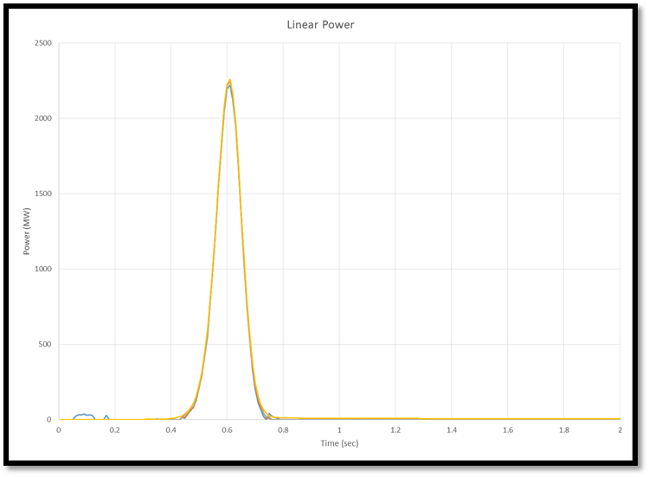
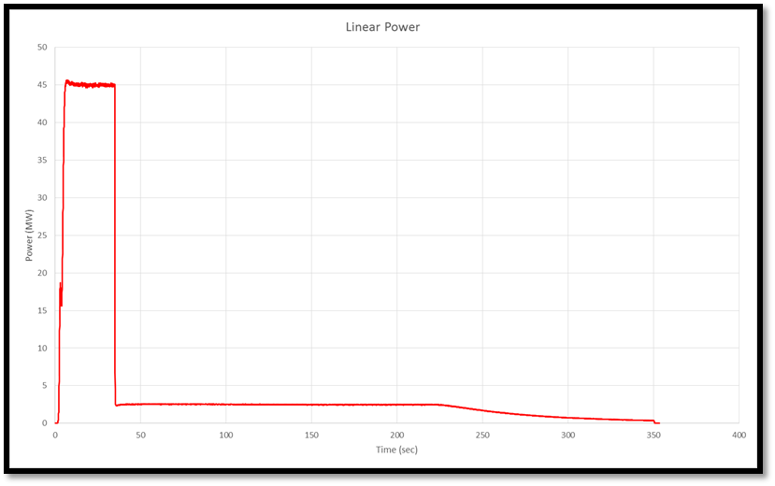

Slide 5
Resumption of Transient Testing Program
In December 2010 the U.S. Department of Energy (DOE) established a mission need to resume transient testing in the United States
Development of more accident tolerant and resistant fuels
Goal to resume testing by 2018
Three alternatives considered
  Do nothing
  Restart TREAT
  Annual Core Research Reactor
DOE makes decision to restart TREAT in Feb 2014.

Slide 6
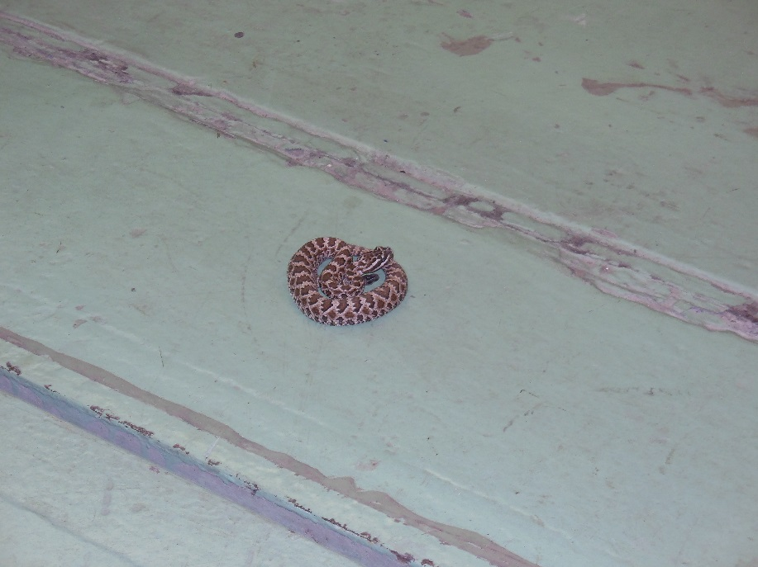
Where to restart
Create goals and milestones
Re-establish staff and begin building knowledge base
Acquire every record that can be found
Work in close coordination with regulator (DOE) to establish the philosophy that this is a recovery from an extended reactor outage and updating the safety basis.
Focus on time-related factors
  Age-related degradation for equipment
  Changes in operational and engineering standards, codes, regulations
Think out of the box
Snake found near the hodoscope pit

Slide 7
Goals and milestones
Informs progress towards mission accomplishment.
Tracked through standard earned value and project management tools.
Examples include:
  Re-establish preventative maintenance
  Implementation of a documented safety analysis
  Perform functional testing of systems and components
In all the Resumption of Transient Testing Program had 41 milestones spanning from December 2014 to August 2017.
  32 milestones completed ahead of schedule
  7 milestones completed on time
  2 milestone late

Slide 8
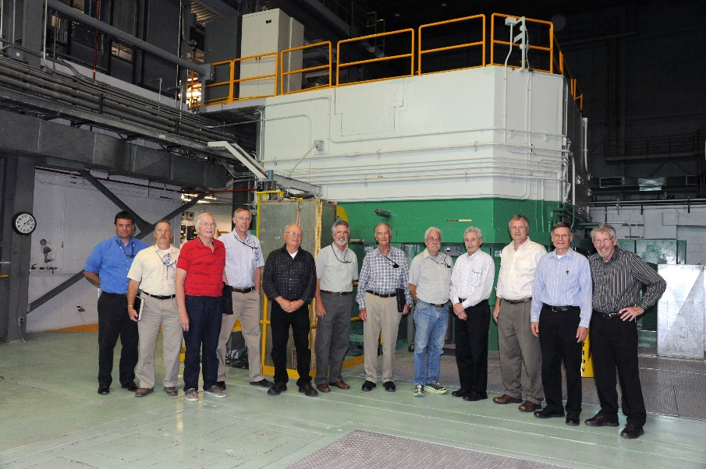
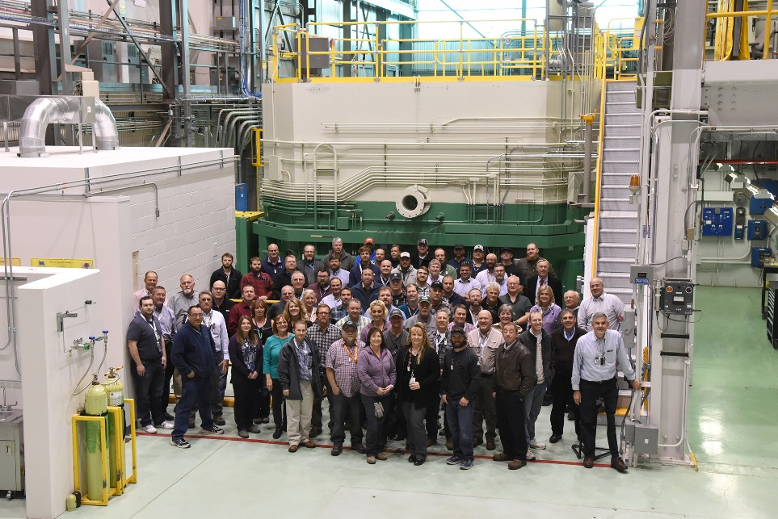
Staffing
While a few former TREAT employees still worked at INL, the majority had retired or were otherwise unavailable
Those who were available were contracted back to provide invaluable insights, knowledge transfer, and training.
  They also help identify what to keep and what to throw away (paper, parts, equipment)
  A few retirees still remain to answer the mysterious questions.
Staff were steadily hired on and today there are about 50 staff that support TREAT full time.

Slide 9
Searching for records
The challenge
  Time
    Fifty-five years since startup and nearly 20 since shutdown.
    Unknown number of records
  Multiple locations
    Records between INL and Argonne National Lab
  Changes in methodology
    File tracking and numbering schemes (prefixes, suffixes, etc.)
  Changes in technology
    Hardcopy in boxes, microfilm, desk drawer, filling cabinets, take home vs scanned into a document repository

Slide 10
Searching for records (cont)
The solution
  Scan every can-be-found-document.
    264 boxes found in storage in Idaho
    Several found in US government repositories
  Heavy reliance on legacy personnel to sort it all out.
  Several records still in thin air
  Bring documents up to current standards
    Literally redrawing several unreadable or poorly scanned drawings (which to the very real challenge of reestablishing configuration management and the relationship between CAD modeling and engineering modeling)
    Creating new procedures
    Rewriting old procedures
      Knowledge based vs procedural based

Slide 11
Recovering from an extended outage
A lot of discussion goes into convincing all parties that 19 years is an outage
When TREAT was shutdown the fuel was left in the core or in storage and several experiments were left in storage.
  Turn the lights off and lock the door so to speak
Usable space is always in high demand.
  While TREAT was not operated after 1994 other organizations continued to use the facility
Aims to avoid the schedule and cost it takes to apply capital asset project management.
Large scale refurbishment for system readiness.
  Returning to service where reasonable
  Like for like replacement
  Bringing up to standard

Slide 12
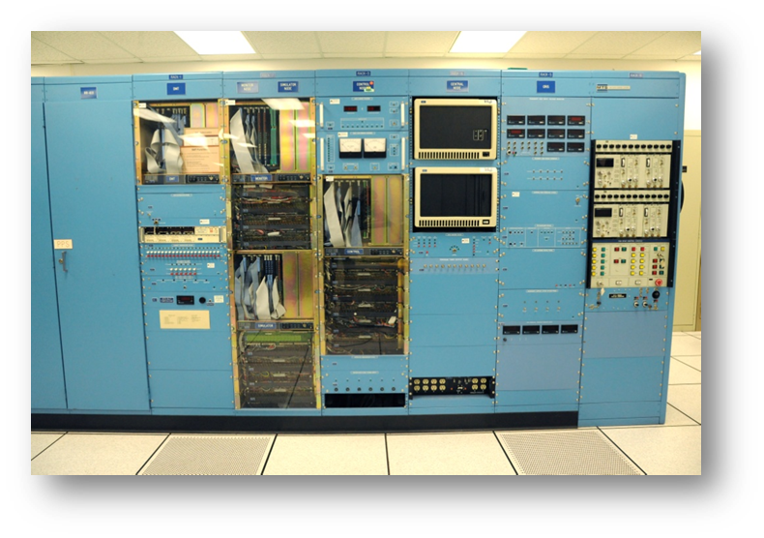
Focus on time-related factors
Between 1959 and 1994 TREAT underwent several upgrades.
Building upgrades in1963, 1972, 1979, 1982
Major upgrade in 1989
  New 60 ton crane, upgrades to reactor control and plant protection systems, modification to filtration and cooling systems, structural modifications
In terms of the current commercial fleet, 1989 technology is fairly new.
Age related degradation for other equipment
  Physical aging
  Obsolescence
System readiness
  Functions as designed
  Configuration management in place
Reactor Control System

Slide 13
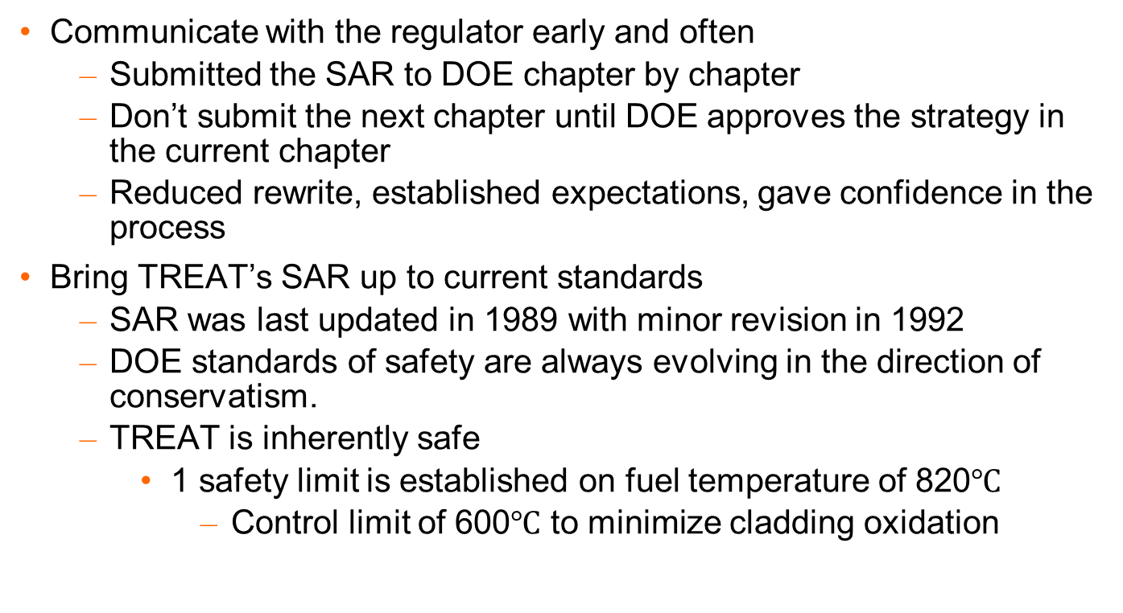
Reestablish the Safety Analysis Report (SAR)
Communicate with the regulator early and often
  Submitted the SAR to DOE chapter by chapter
  Don’t submit the next chapter until DOE approves the strategy in the current chapter
  Reduced rewrite, established expectations, gave confidence in the process
Bring TREAT’s SAR up to current standards
  SAR was last updated in 1989 with minor revision in 1992
  DOE standards of safety are always evolving in the direction of conservatism.
  TREAT is inherently safe
    1 safety limit is established on fuel temperature of 820$℃$
      Control limit of 600$℃$ to minimize cladding oxidation

Slide 14
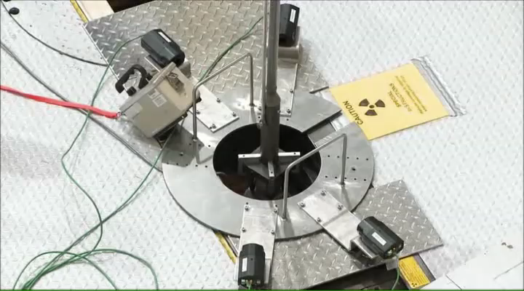
Think outside the box
Fuel inspection
Use statistical analysis to determine the number of fuel elements to be fully inspected to obtain confidence that the entire usable inventory is okay.
Borescope all coolant channels in core.
Saved about 4 months of time
Limits probability of fuel damage which has the greatest likelihood of being damaged during handling.
Trained on non-fueled assemblies to validate the process

Slide 15
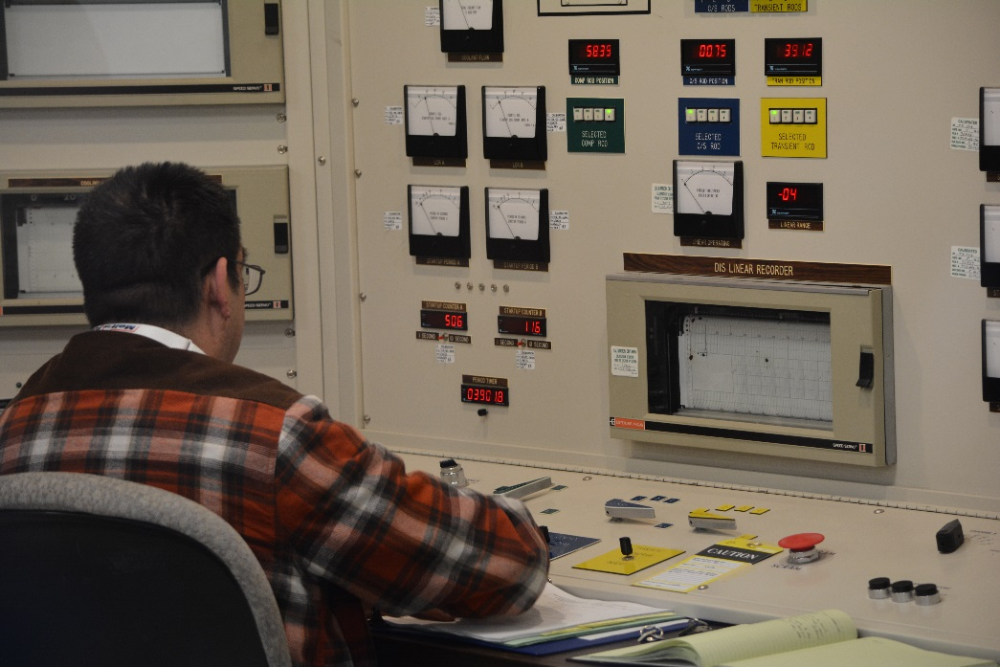
Think outside the box (cont)
How to train operators when they can’t operate the reactor?
  Turn reactor into simulator
  TREAT has computer simulator
  Poison the core so the control/transient rods can be operated.

Slide 16
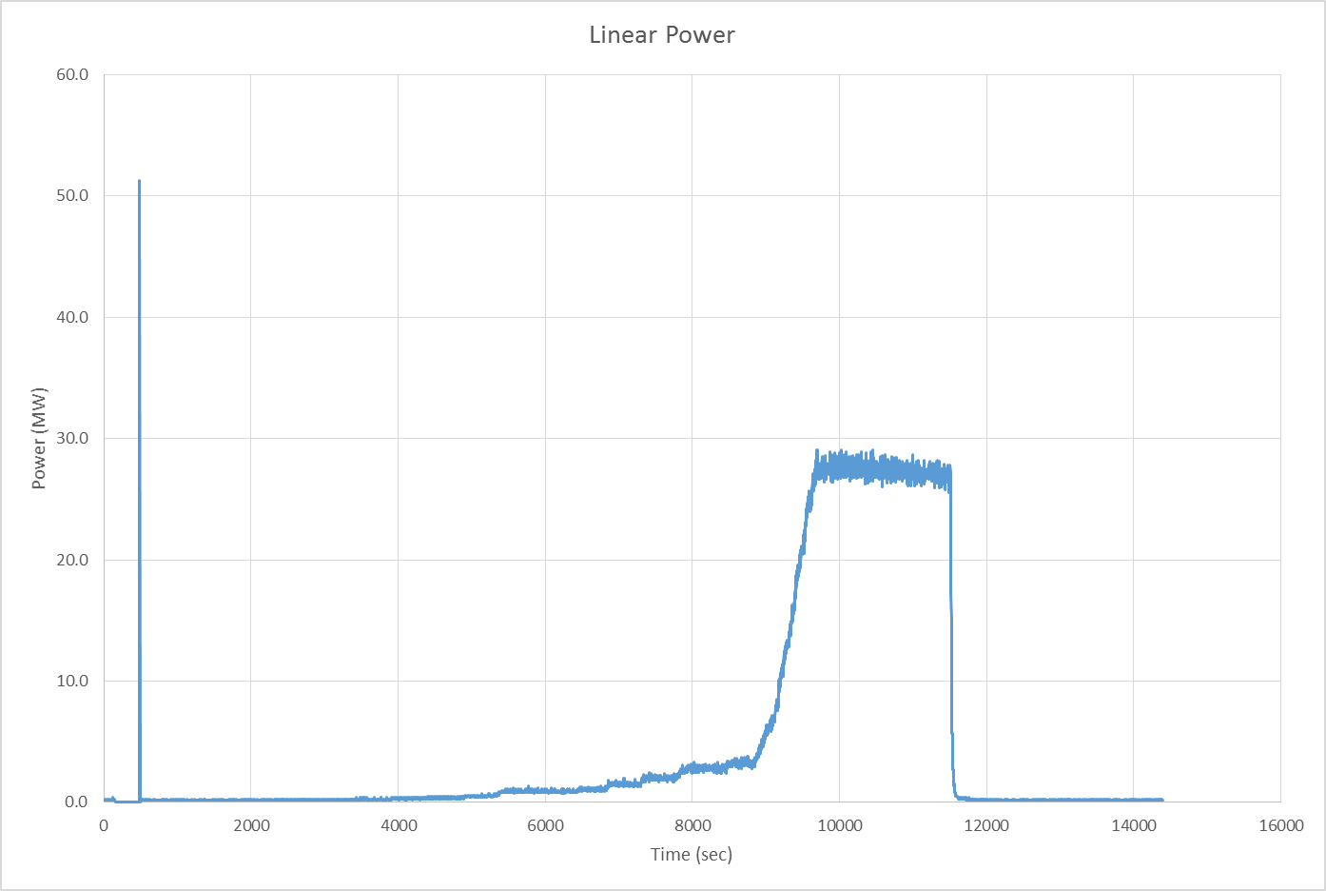
Restart
TREAT was restarted on November 14, 2017. This was 13 months ahead of original goals and saved $20 million from the total $75 million budget.
Effort took about 3 ½ years
Before start up all operators were provisionally qualified so initial efforts during restart were to fully qualify operators.
To date ~33 transients have been performed
  Transient prescriptions
    RIA
    Minimum pulse width
  MIT tests
  Concurrent testing
  Fast clip
  LOCA
  ATF-SETH

Slide 17
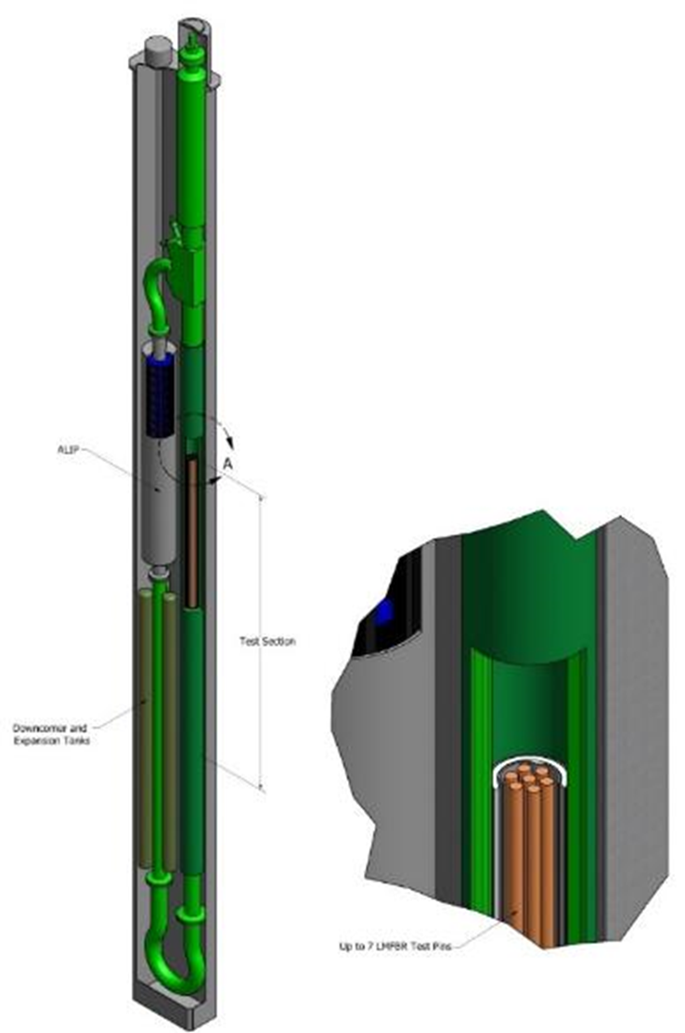
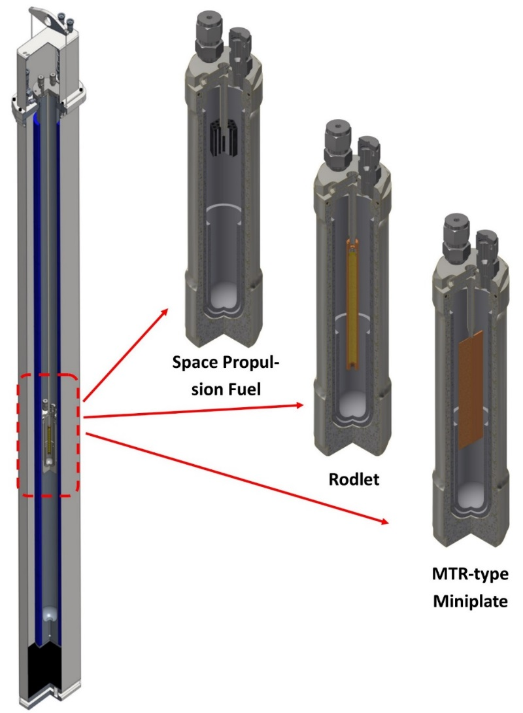
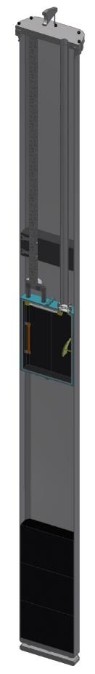
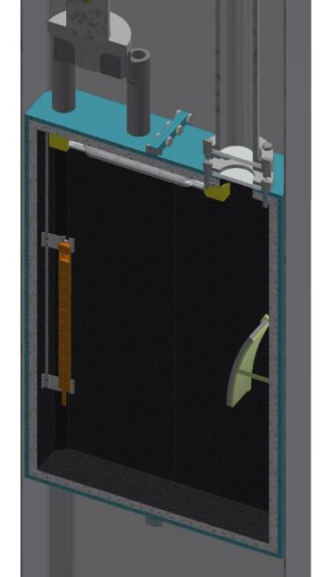
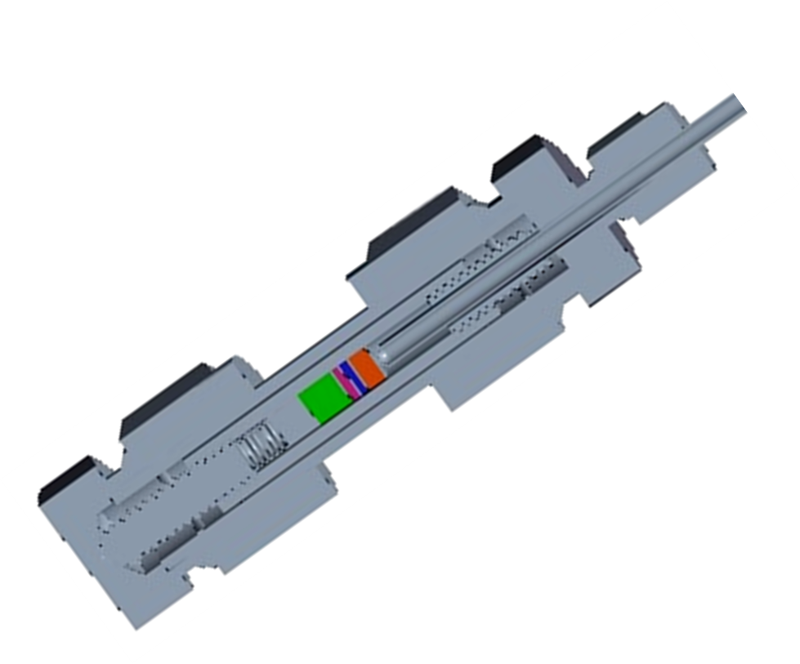
What's next
Optical Viewing Tests
(Future….)
Dry Capsule Separate Effects Testing (On Going)
Sodium Separate Effects Testing
(FY 20)
Research on Plutonium
(Early 19)
Others: AQUASETH, DRIFT, MIMIC, NASA

Slide 18
Summary
Transient testing has been reestablished in the United States.
The RTTP began in early 2014 and concluded in late 2017. The program completed 13 months ahead of schedule and ~$20 million under budget.
Several factors contributed to success.
  Extended reactor outage approach
  Focus on time-related factors
  Assistance from legacy personnel
  Implementation of goals and milestones into schedule
  Facility operational readiness assessments
  Unique approaches to training and system readiness
  Close and frequent communication between INL and DOE on strategy, progress, and SAR update.
  Others – it is difficult to summarize all the small, but significant successes of RTTP to 15 minutes.

Slide 19
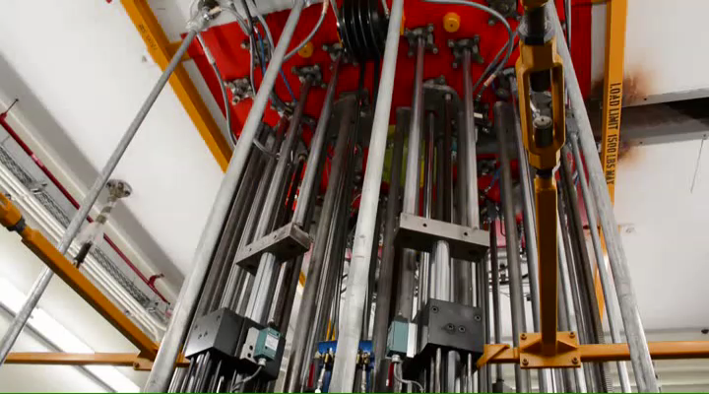
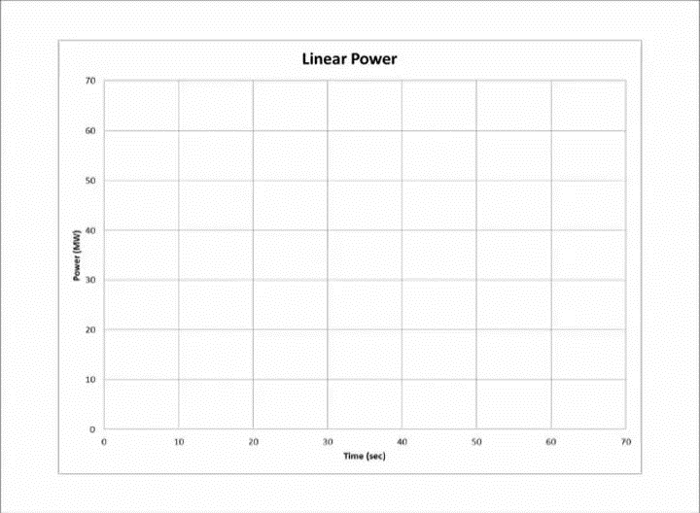
Questions?

